Slide 1
Core Concepts and Practical Techniques for Successful Library Metadata Analysis
(or, I am a metadata analyst and so can you!)
Stacie Traill & Martin Patrick
University of Minnesota Libraries
ELUNA Learns
August 19, 2020

Slide 2
What We’ll Cover
Background: Why are we talking about this? Why is this important?
Core concepts and knowledge: a long, scary list
Problem-solving approaches and techniques
Tools: a non-comprehensive, non-prescriptive sample

Slide 3
Why are we talking about this?
Job postings and job descriptions show a growing need for metadata analysis skills.
A need for library staff across types of libraries and technical functions (cataloging, metadata, collection management, discovery, systems).
No clear guidance exists (as far as we know) for learning these skills -- or even understanding what they are.

Slide 4
Metadata Analysis Tasks
Determine:
WHAT data are available
HOW those data can be accessed
HOW the data are used (or how they should be used)
WHAT remediations, transformations, enrichments, merges are needed
HOW to produce the desired outcomes
Efficiency
Sustainability
Scalability

Slide 5
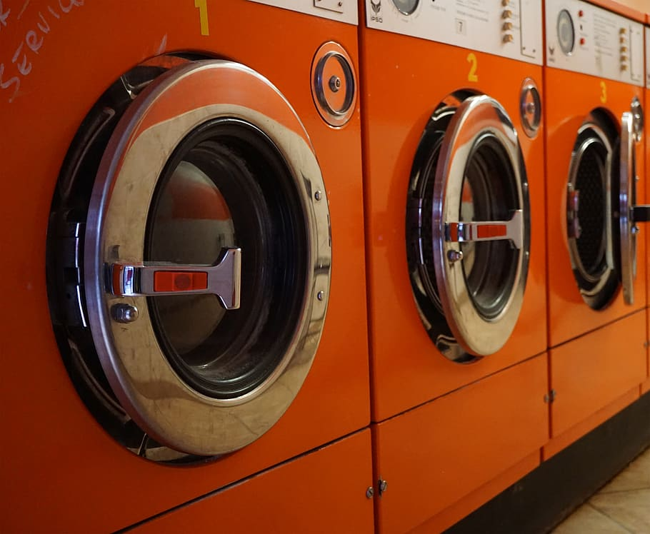
The Laundry List
https://www.wallpaperflare.com/three-red-front-load-clothes-dryers-laundry-vehicle-train-wallpaper-ekegv

Slide 6
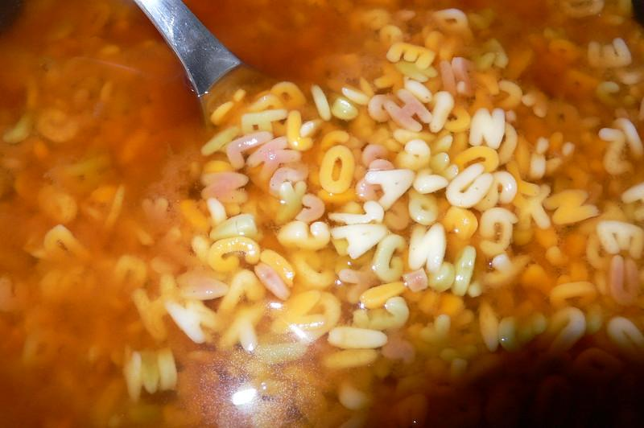
Core Knowledge: Library Metadata Standards, Applications, and Systems
Broad familiarity with library metadata standards
Content standards
Encoding/transmission standards
Deeper knowledge of widely-used standards (MARC is probably not optional)
Legacy standards and practices
Local practices and locally-developed schema
Library systems
Metadata management
Cross-functional impacts of data changes
Reporting and analysis
Image credit: Beanbag Amerika CC-BY-NC 2.0 https://www.flickr.com/photos/bean/322616749/

Slide 7
A few of many...

Slide 8
Core Knowledge: Data Cleaning and Text Normalization
AKA Data Wrangling: evaluating and transforming data to ensure validity, accuracy, completeness, consistency
Critical for clean-up and remediation projects where the goal is to improve, correct, or enhance the source data.
Also important for:
Crosswalking/mapping metadata
Creating analyses that combine data from different systems/standards/application profiles.

Slide 9
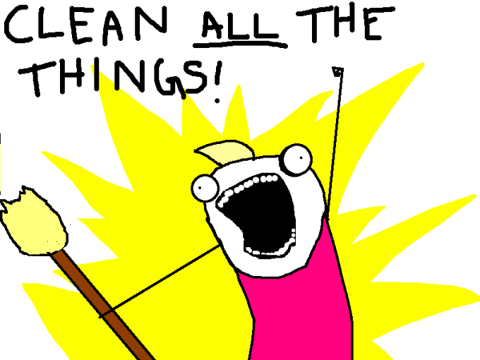
Core Knowledge: Data Cleaning and Text Normalization
Programmatic text manipulation
Recognizing and expressing patterns (regular expressions)
Conditional statements and actions
Isolating elements for evaluation/change
Programmatic file manipulation
Character encodings
Documentation
Standardized values in use
Departures from standards
Image credit: Allie Brosh, http://hyperboleandahalf.blogspot.com/2010/06/this-is-why-ill-never-be-adult.html

Slide 10
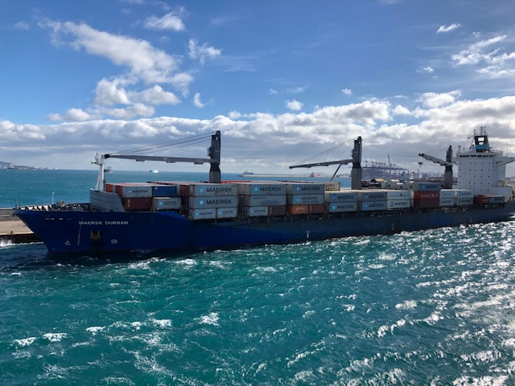
Core Knowledge: Data Serializations
Serializations: ways to package data structures or objects for storage or transmission
Most common:
XML
JSON
CSV
...many others exist
Keys to working with any serialization:
How can I process this data with my desired toolset?
How can I output the processed data in other serializations?
Image credit. Stacie Traill

Slide 11
Core Knowledge: Interoperability
2 types: metadata and systems
Metadata interoperability: “the ability of … systems or components to exchange descriptive data about things, and to interpret the data ... in a way that is consistent with the interpretation of the creator of the data”*
Comparability/compatibility across systems, standards, schema
Essential for metadata mapping/crosswalking
Often depends on using and maintaining reliable identifiers for matching, reconciliation, and enhancement
*https://www.dublincore.org/resources/glossary/metadata_interoperability/

Slide 12
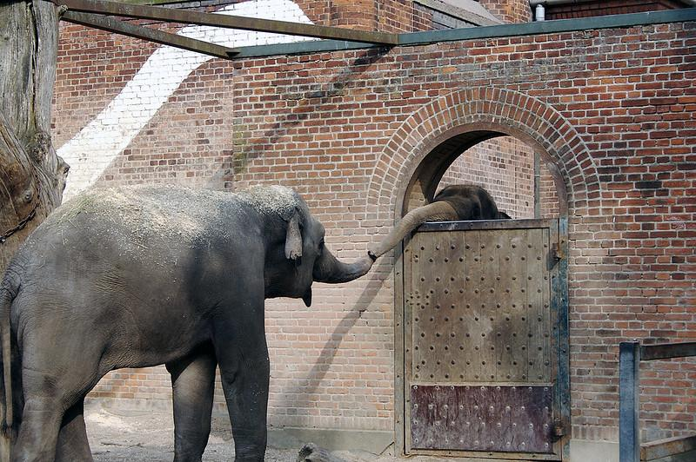
Core Knowledge: Interoperability
Systems interoperability: how different systems or applications connect and communicate in a coordinated way.
Getting data in and out of systems
Understanding how interoperating systems use communicated metadata
Building connections between systems (conceptualizing, devising requirements, writing code)
Extract-Transform-Load (ETL) processes
Image credit: Jacob Bøtter CC-BY 2.0 https://www.flickr.com/photos/jakecaptive/135024146

Slide 13
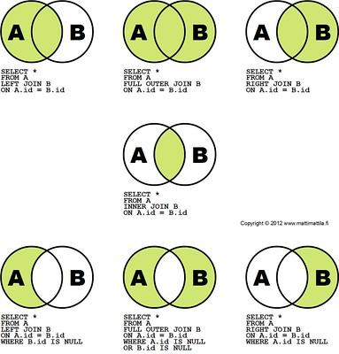
Core Knowledge: Database Design and Querying
Database design principles
Relationships and logical structure
Data modeling
Query languages (SQL, XQuery, XPath, SPARQL…)
Image credit: Matti Mattila CC-BY 2.0 https://www.flickr.com/photos/mattimattila/8190148857

Slide 14
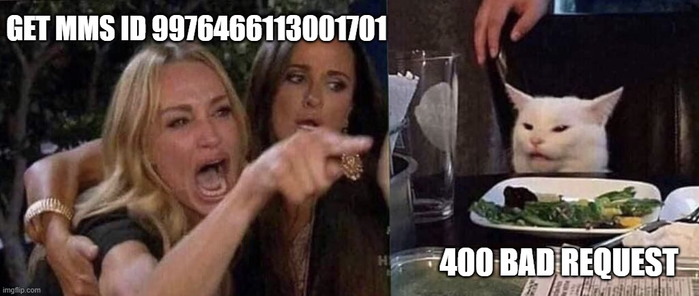
Core Knowledge: Web Technologies and Services
How web applications are created and managed
Technology stack
Request/response cycle
Basics of HTML, CSS, Javascript
APIs (REST...etc.)
Library-specific
OpenURL, OAI-PMH, Z39.50/SRU
Semantic web and linked data
BIBFRAME, RDF, OWL, JSON-LD, SPARQL
https://imgflip.com/memegenerator/187112276/woman-yelling-at-cat

Slide 15
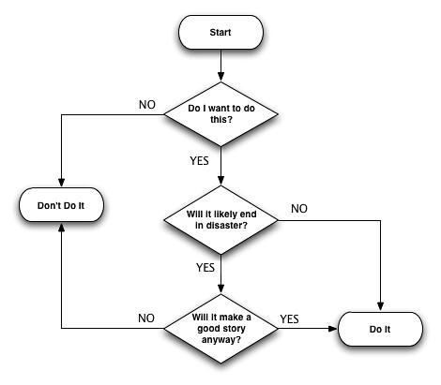
Core Knowledge: Workflow Analysis and Documentation Practices
Business and requirements analysis
Flowcharting
Process improvement analysis
Documentation best practices
Plain language
Accessibility
Image credit: J. Holmes CC-BY-SA 2.0 https://www.flickr.com/photos/j3rmz/1229271594

Slide 16
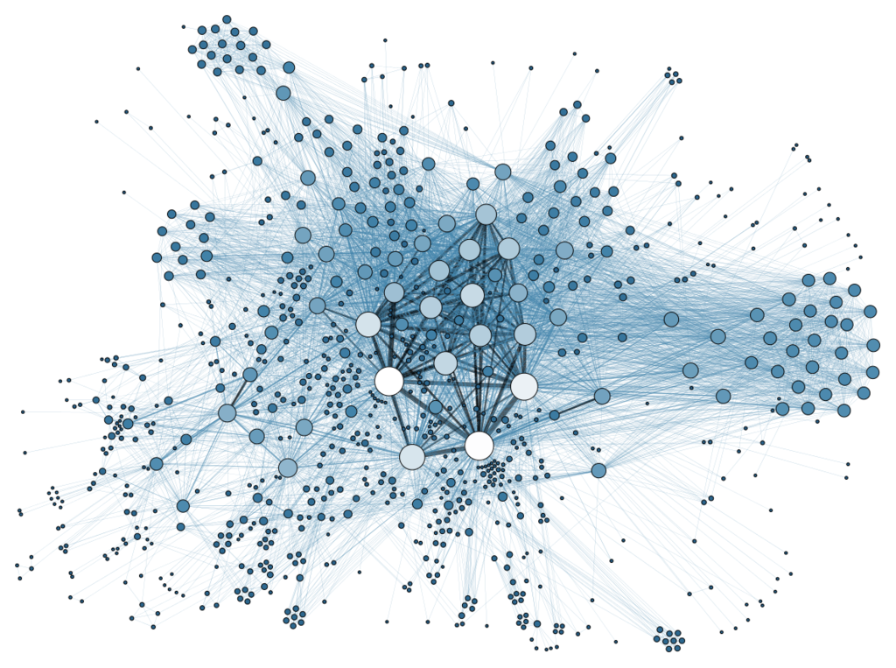
...And more (nice to have)
Data visualization
Quantitative analysis/statistics
Project management
Image credit: Martin Grandjean / CC BY-SA https://commons.wikimedia.org/wiki/File:Social_Network_Analysis_Visualization.png

Slide 17
Problem Solving Approaches
Merriam-Webster.com says about "problem":
a question raised for inquiry, consideration, or solution
a proposition in mathematics or physics stating something to be done
Some examples of non-problem "problems":
OCLC DataSync report processing
HathiTrust Print Holdings submissions
Choosing a record source for e-resources

Slide 18
The Four Big Steps to Metadata Analysis
Awareness of the problem
Determining the extent of the problem
Assessing the importance and/or urgency of the problem
Implementing (and sharing) a solution to the problem

Slide 19
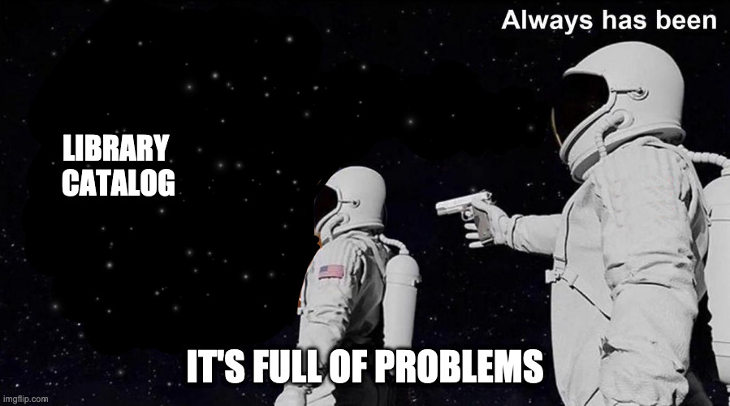
Finding Problems

Slide 20
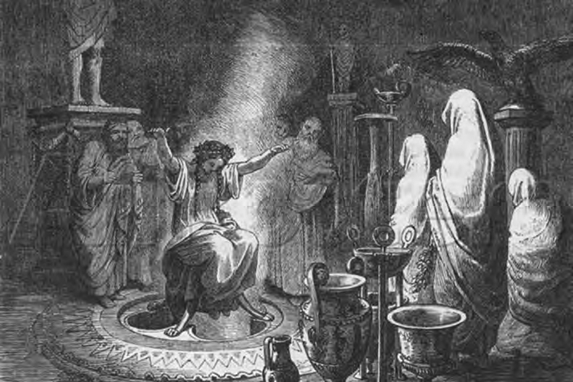
Sources of Problem Reports
User reports
Staff experience
Leftover from migration
System functionality changes

Slide 21
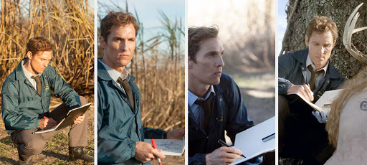
Investigating extent
Searching Alma
Searching Alma Analytics
Seeing trends and connections (intuition)
Organizational knowledge and local practice history
Take notes!

Slide 22
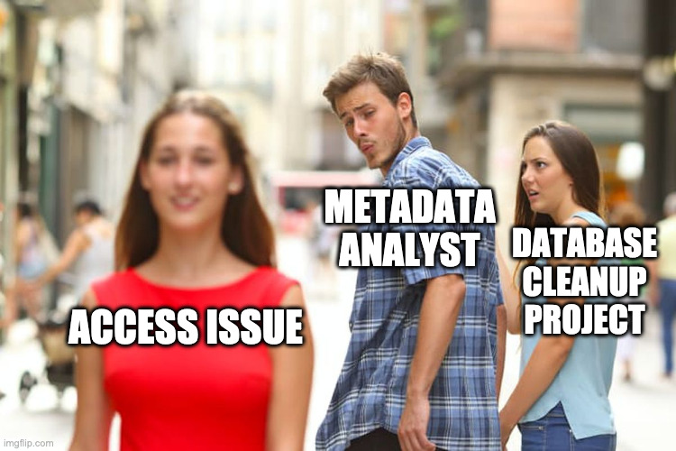
Assessing importance and urgency
How does this affect users?
How long has this been affecting users?
Does it block access, limit access, increase access?
Just a good thing to do?

Slide 23
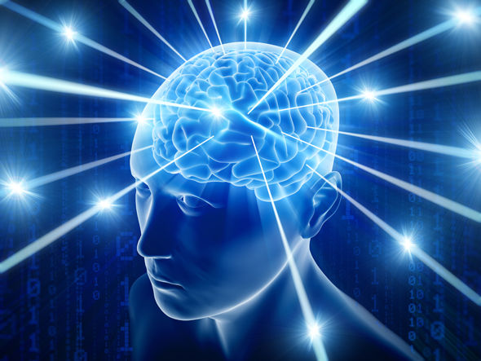
Implementing a solution
After your investigation, what will you do?
Questions to think about:
What needs to happen with these records?
Are there multiple things that need to happen?
Is it predictable?
Does something else have to happen first?

Slide 24
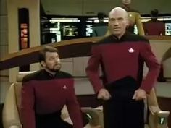
The Grand Maneuver
Gather up and export records from Alma
Edit in an external program
Use merge rules, normalization rules, and import profiles to bring those edits into the catalog

Slide 25
Tools within Alma
Repository search
Alma Analytics queries
Local search indexes
Local params in Alma Analytics
Indication rules, normalization rules and processes, and merge rules
Export jobs and Publishing Profiles
Alma APIs

Slide 26
External Tools
MarcEdit
Python
pymarc
Jupyter notebooks
OpenRefine
Excel/Google Sheets
Other languages:
Rust with marc library, Ruby, Google Apps Script, etc.
ELUNA Document Repository, conferences, journals, GitHub

Slide 27
Text and non-MARC Metadata
A good text editor, pulling double-duty with XML and JSON data
Notepad++ on Windows (free)
BBEdit or TextWrangler on Mac (not free but worth it)
A good code editor
Microsoft's Visual Studio Code (free, macos, Windows, Linux)
Atom (free, macOS, Windows, Linux)

Slide 28
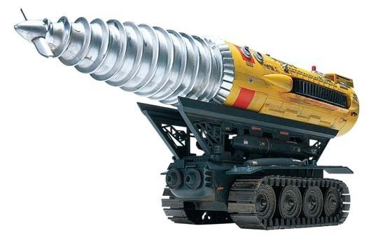
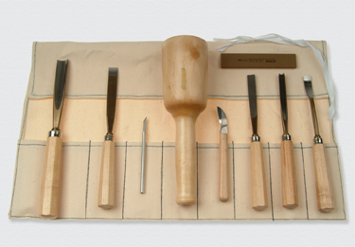
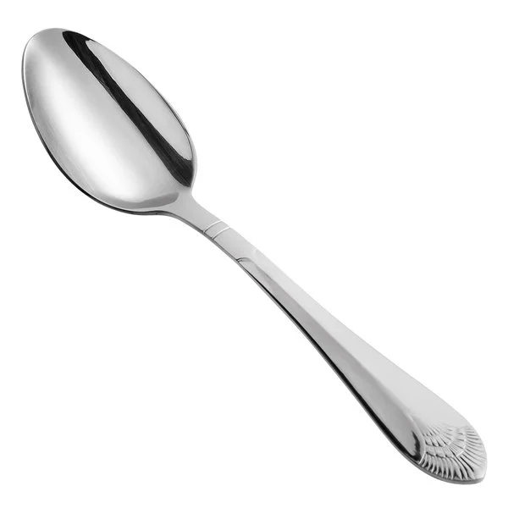
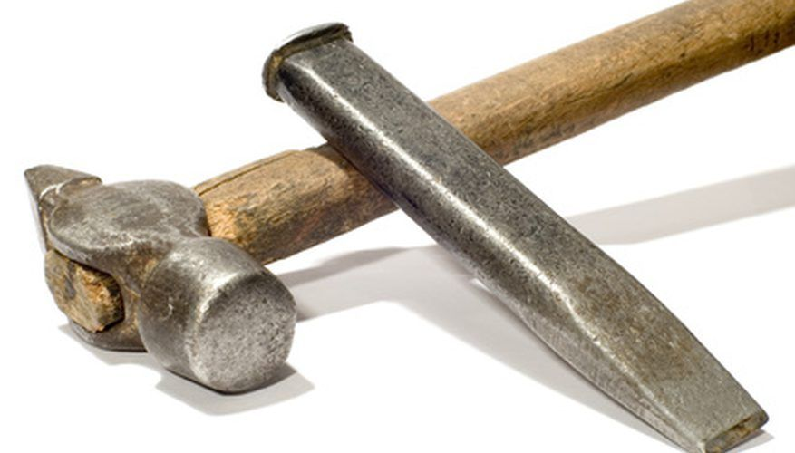
Solving the problem
What tools do you have?
OR
OR

Slide 29
Some example problems and their tools
Inserting e-ISSN into print journal records
Goal: insert only the e-ISSN into a print journal in the 776 field
Used Connexion client, Google Apps Script, MarcEdit, merge rules, import profiles
Linking serial analytics to primary record after migration from Aleph
Goal: update over 300,000 records with Aleph IDs to point to Alma MMS IDs instead
Used Alma Analytics with a local param field, Excel, and wrote my first python script using a python dictionary and the pymarc library, merge rule

Slide 30
Sharing the solution
It's important for local knowledge AND for the community to know about things.

Slide 31
Further Resources
Contact Us
https://z.umn.edu/metadataanalyst
Stacie Traill
trail001@umn.edu
Martin Patrick
patri299@umn.edu

