Slide 1
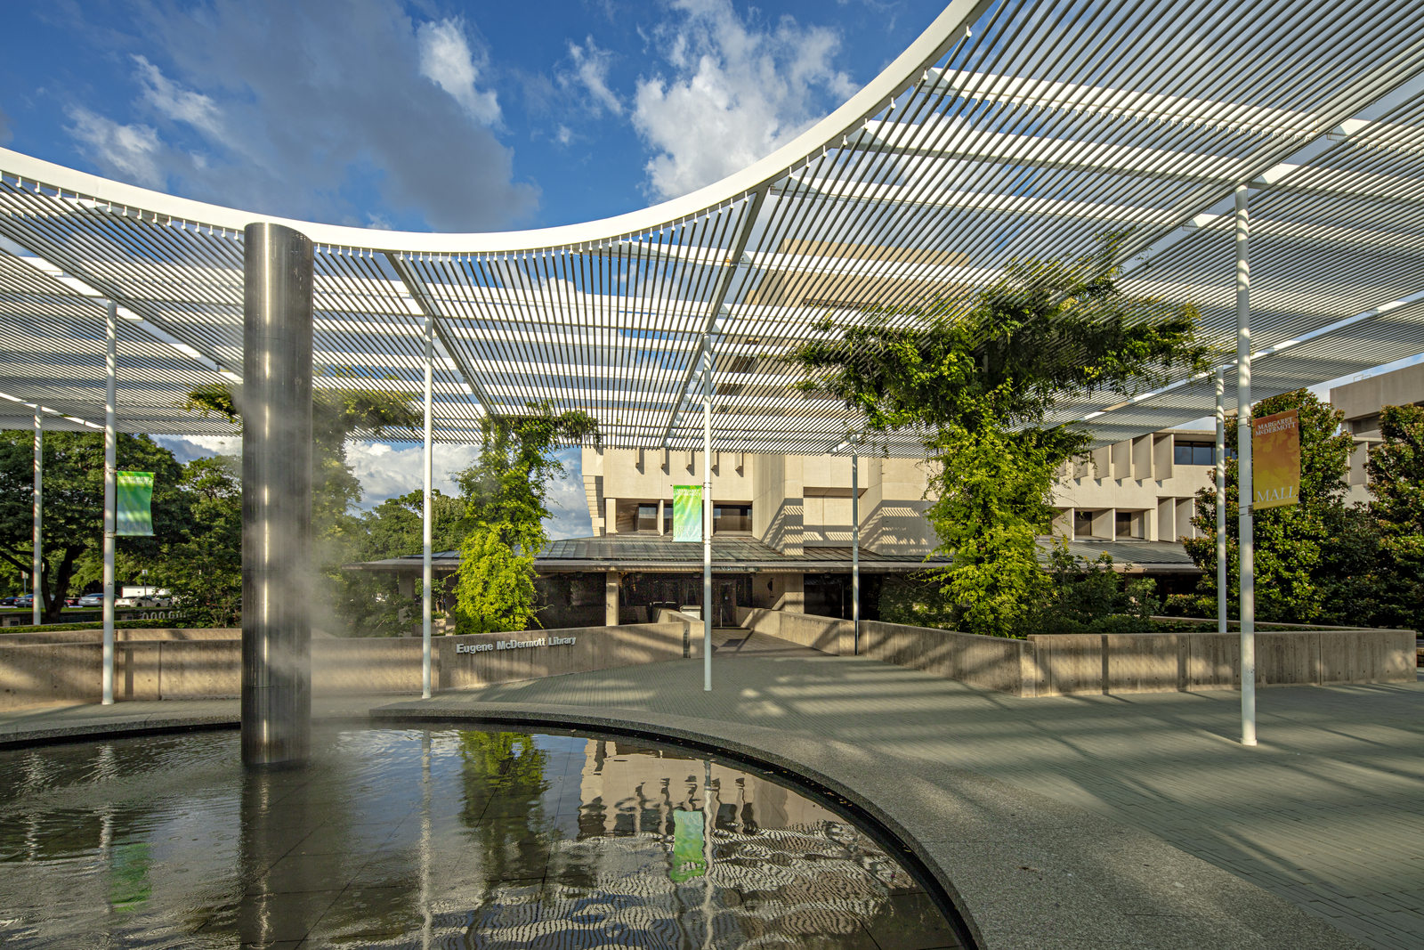
Rialto Development Partner
Eugene McDermott Library
Pauline Martin, Assistant Head of Acquisitions & E-Resources

Slide 2
Before Rialto
Primary suppliers: Gobi (firm order ebooks & print) & Oasis (print)
Our Workflow
Research/ Instruction
Acquisitions
Cataloging
Ebooks
Load/Overlay final records
Process print
Review & Select
Submit selections in Gobi or email
Duplicate check
Pricing/Availability
Order (EOD/import or manually entered)
Receive/Invoice (EDI)

Slide 3
Needed Improvements
Issues | Goals
Complex workflow & time-consuming acq. process: Multiple vendor platforms Multiple publishers on single subaccount Next day load order + addt’l day(s) load inv. Manual edit POLs & package POs | Simplify ordering/invoicing process on single platform
Slow selection process, limited search filters, remove titles owned | More options to narrow or expand selections
Time delay from request to fulfillment | Faster turnaround on title requests
Unnecessary duplication of order documentations | Digital/Paperless records & maintain integrity of documentation for retention and audits

Slide 4
Rialto Implementation
Implementation Team: 2 Selectors, 2 Acquisitions, 2 Catalogers, 1 Systems
Project Timeline
> 1,600 orders (1,500 ebooks & 100 print)
~56 Issues/ Feedbacks (12 Selection, 21 Acquisitions, 20 Metadata, 3 Systems) Documented internally on SharePoint list linked to Microsoft Teams for discussion along with meeting notes.
Dec./Jan. Onboarding/ Testing
February Acq. staff training
March Campus Closes
April 3 Selectors added
Aug./Sept. All Selectors training for Fall

Slide 5
Issues/Feedbacks
Delayed/Duplicated orders
Holdings not matching or overmatching in Market
Order templates & list sharing
Stock availability/Pre-pub/DRM-free indicator
Missing offers
Date range facet for selecting
Price discrepancies from cart to invoice
Unable to create POLs in MD Editor
POLs stuck in auto-packaging or no bib records created
Records importing with errors or not activated
Invoicing by fund or cost center
Disable task list for ebooks

Slide 6
What We Like…
What We Want…
+ Integrated with Alma
Holdings displayed in Market
Visible fund balance
Auto-generates POLs and POs
Reporting codes/Receiving notes
Order history and status
Attaches orders to existing bibs
+ Rapid fulfillment
Faster turnaround on ebooks
+ Shared templates & lists
+ And More!
Acquisitions
Invoicing multiple line items
Ability to transfer order notes for ebooks to POLs
Allow other purchasers or mgrs to see the status for all orders
Detailed order status
Ability to cancel orders
Flexibility to move items in selector carts
Selectors
Add JSTOR
Direct link from Choice Review
Shared List notes
Metadata Svcs
Better record qualities from publishers

Slide 7
Present and Future
Currently at UTD:
Continuing to select & order primarily ebooks with print as needed
Exploring options internally to improve invoicing in Alma
Rialto has helped us significantly simplify ordering process for remote work
Issues are at a minimal with few delayed orders from publishers, but overall Rialto Support has been responsive and helpful.
Future Goals:
Complete digital/paperless order documentations
Single ordering system that provides multiple line item invoices
Additional selector training to explore recommendation feed and ranking

Slide 8
Thank you!
pauline.martin@utdallas.edu

