Slide 1
An Introduction to Alma Analytics Data Visualization (DV)
Yoel Kortick
Senior Librarian

Slide 2
Introduction
Accessing DV and creating a project
Displaying and filtering data
Accessing a saved DV project
Using multiple visualizations in the same project
Some examples

Slide 3
Introduction
In this presentation we will show a general introduction to OAS (Oracle Analytics Server) Data Visualization, specifically how it is used with Alma in the framework of Alma Analytics.
The general introduction will be done by actually using the data visualization.

Slide 4
Introduction
First we will create a data visualization project and save it, and then access it.
Next we will add an additional visualization in the same “canvas” of the same project, using two different methods. Along the way we will show how different visualizations may be accessed and changed.
Finally, we will show a few examples of other data visualization projects.

Slide 5
Introduction
For more additional Data Visualization topics see also
YouTube videos at YouTube videos about OAS (Oracle Analytics Server) and DV (Data Visualization)
Developer Network blog posts at: Blogs about OAS (Oracle Analytics Server) and DV (Data Visualization)

Slide 6
Accessing DV and creating a project

Slide 7
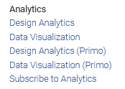
Accessing DV and creating a project
Data Visualization is accessed from the Analytics menu of Alma:

Slide 8
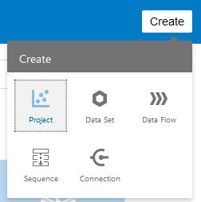
Accessing DV and creating a project
The Oracle Business Intelligence home page will open in a new tab and from there you can create a new project:

Slide 9
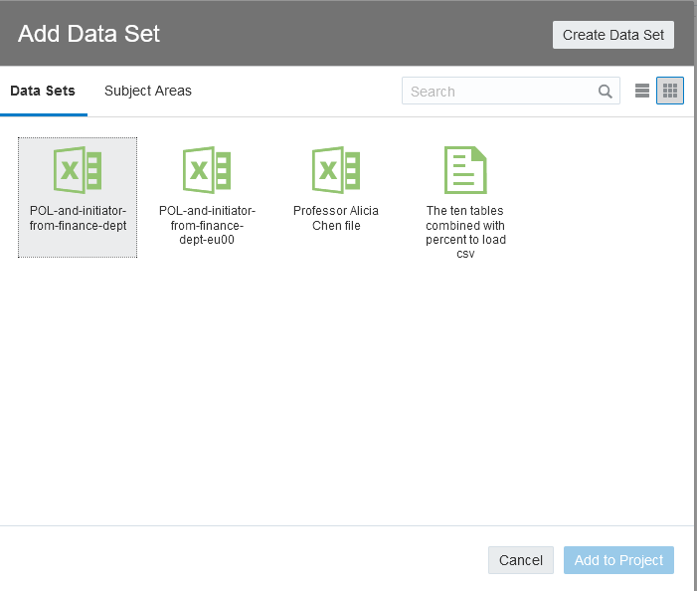
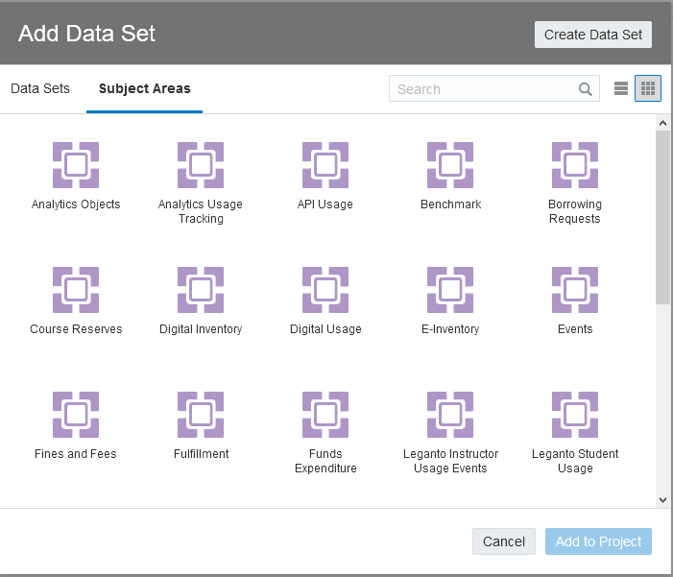
Accessing DV and creating a project
When creating a project an Alma Analytics subject area or predefined data set may be chosen:

Slide 10
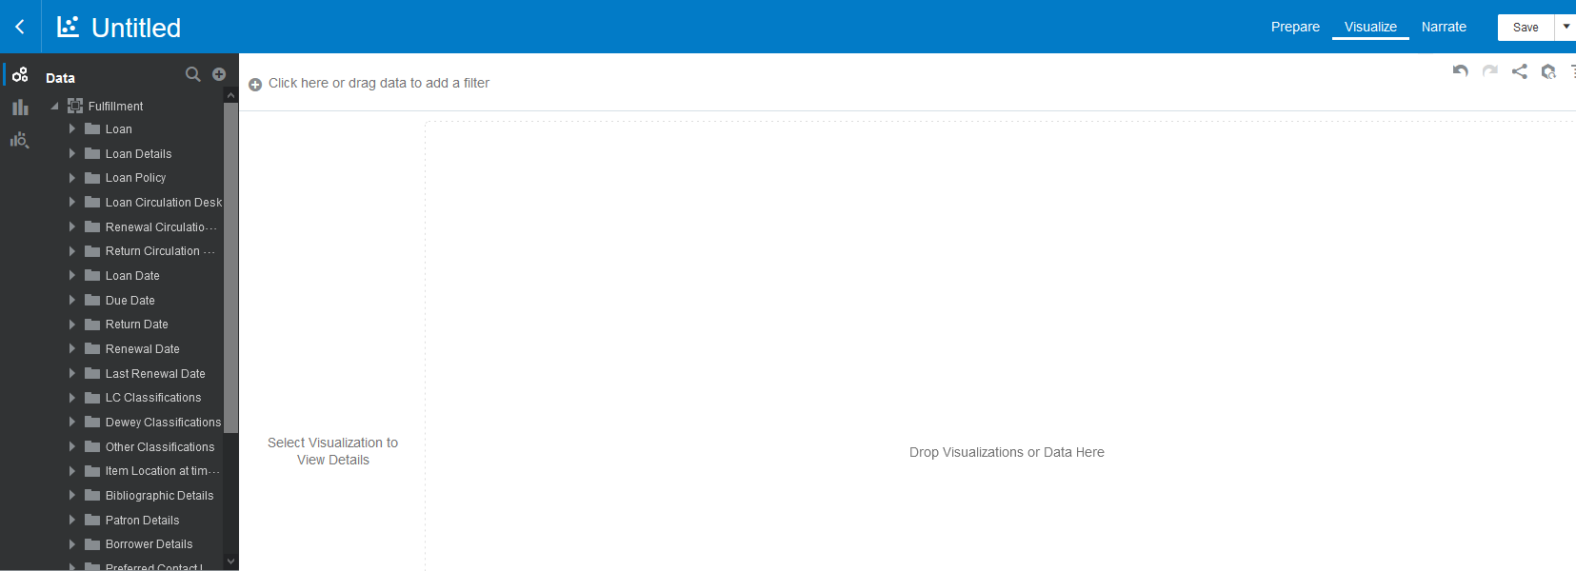
Accessing DV and creating a project
After adding a subject area, the following appears:

Slide 11
Displaying and filtering data

Slide 12
Displaying and filtering data
To display and filter data:
Drag fields from the subject area on the left to the canvas on the right to display them.
Drag fields from the subject area on the left to the filter section on the top to filter them (this can also be done by other methods such as right clicking fields and choosing “Create filter”).

Slide 13
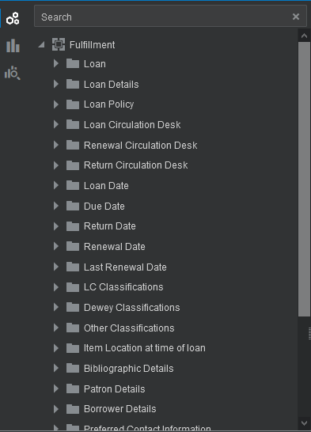
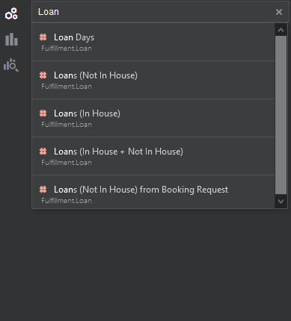
Displaying and filtering data
From within the data elements section of the navigation pane it is possible to search for fields:

Slide 14
Displaying and filtering data
On the next slide we are using the fulfillment subject area and
Drag to the canvas the "Number of loans (not in house") and the "LC Classifications Group 1"
Drag to the upper "Filters" section the "Loan Year" and "Number of loans (not in house)"
Filter by "Loan Year" = 2020 and "Number of loans (not in house)" >= 1000
In the initial results we will right click the "LC Classifications Group 1" which is "Unknown" and choose "remove selected".

Slide 15
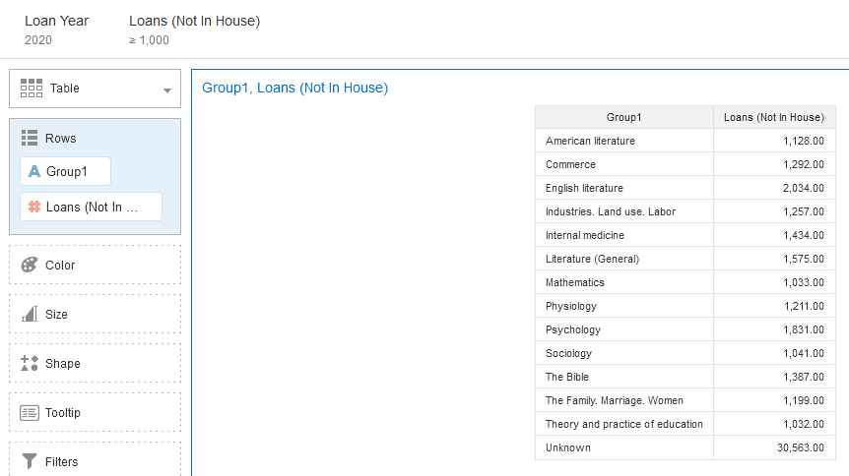
Displaying and filtering data
Here are the filters on top

Slide 16
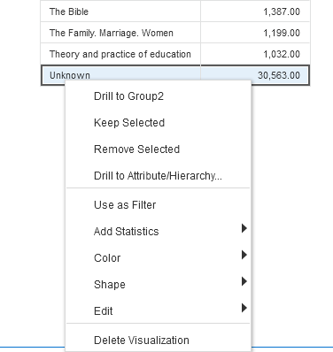
Displaying and filtering data
In the initial results we will right click the "LC Classifications Group 1" which is "Unknown" and choose "remove selected".

Slide 17
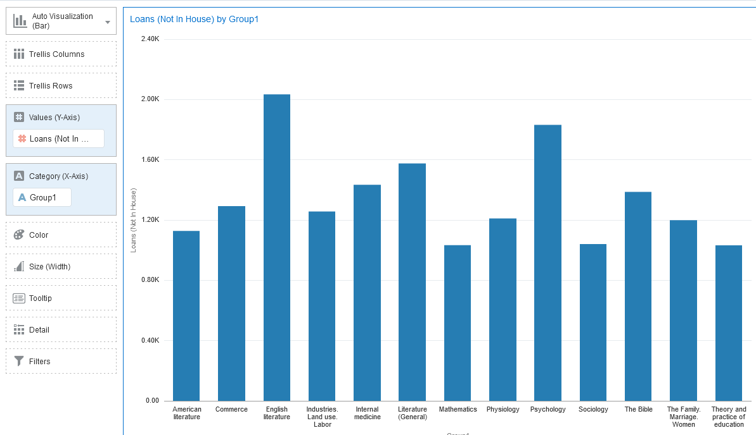
Displaying and filtering data
If we choose “Auto Visualization” then the DV will choose for us a bar graph

Slide 18
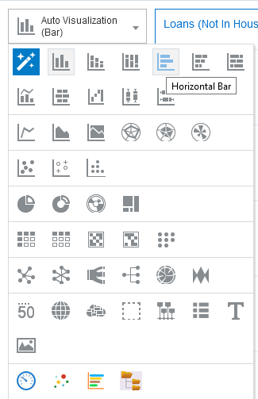
Displaying and filtering data
We can click the visualization (where now it states "Auto Visualization (Bar))" and choose a different visualization. Here we choose Horizontal Bar.

Slide 19
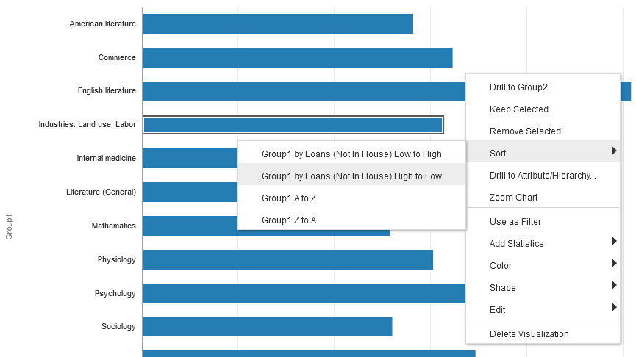
Displaying and filtering data
The values can be sorted as desired by right clicking and choosing "sort". We will sort the LC Classification Group 1 by loans high to low.

Slide 20
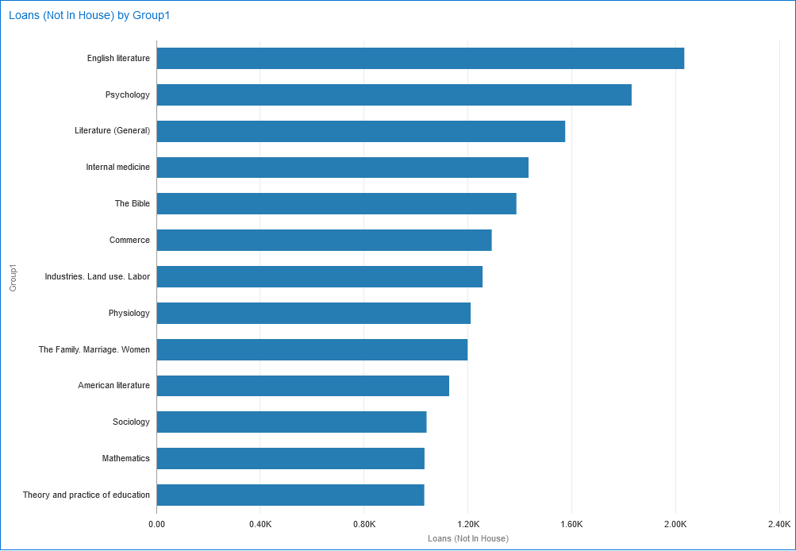
Displaying and filtering data
The data is now sorted:

Slide 21
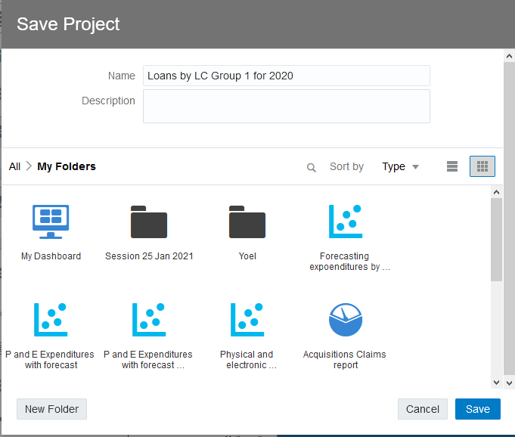
Displaying and filtering data
Save the Project via the "Save" button on the top right:

Slide 22
Accessing a saved DV project

Slide 23
Accessing a saved DV project
The Project can then later be accessed from the Data Visualization home page (which is accessed as we saw from within Alma choosing "Data Visualization" from the Alma menu).
There are multiple ways to access and open the saved project. One way is:
Click the three lines on top left
Choose "Catalog"
Navigate to where the project was saved
Right click the project and choose "open"

Slide 24
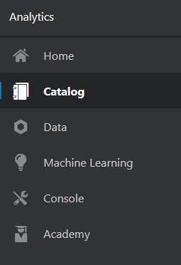
Accessing a saved DV project
Click the three lines on top left and choose "Catalog"

Slide 25
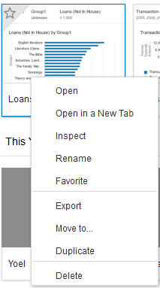
Accessing a saved DV project
Navigate to where the project was saved
Right click the project and choose "open"

Slide 26
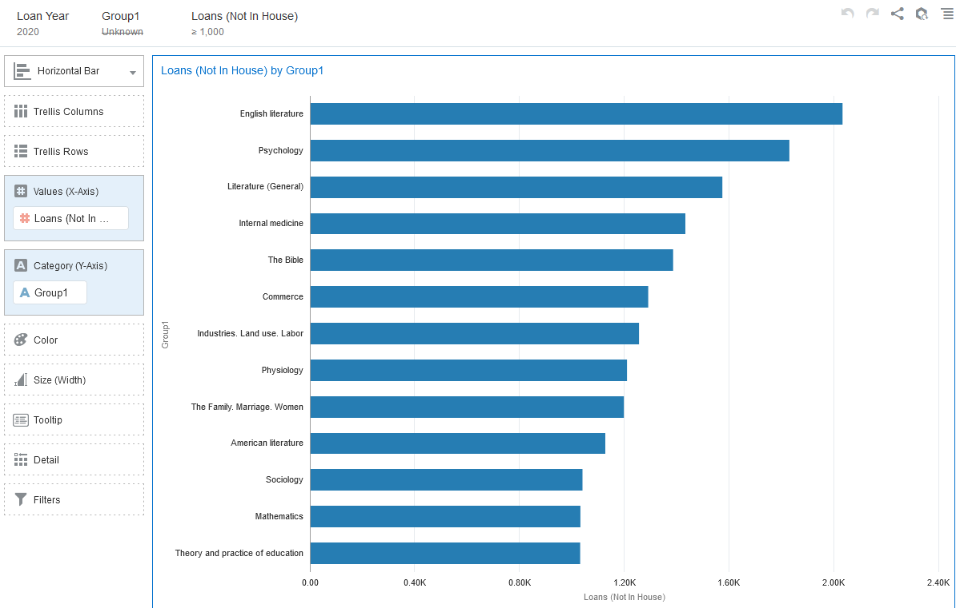
Accessing a saved DV project
The project opens

Slide 27
Using multiple visualizations in the same project

Slide 28
Using multiple visualizations in the same project
It is possible to have two different visualizations based on the same data on the same canvas. To do so first duplicate the visualization. “Menu (on top right of visualization) > Edit > Duplicate Visualization”.

Slide 29
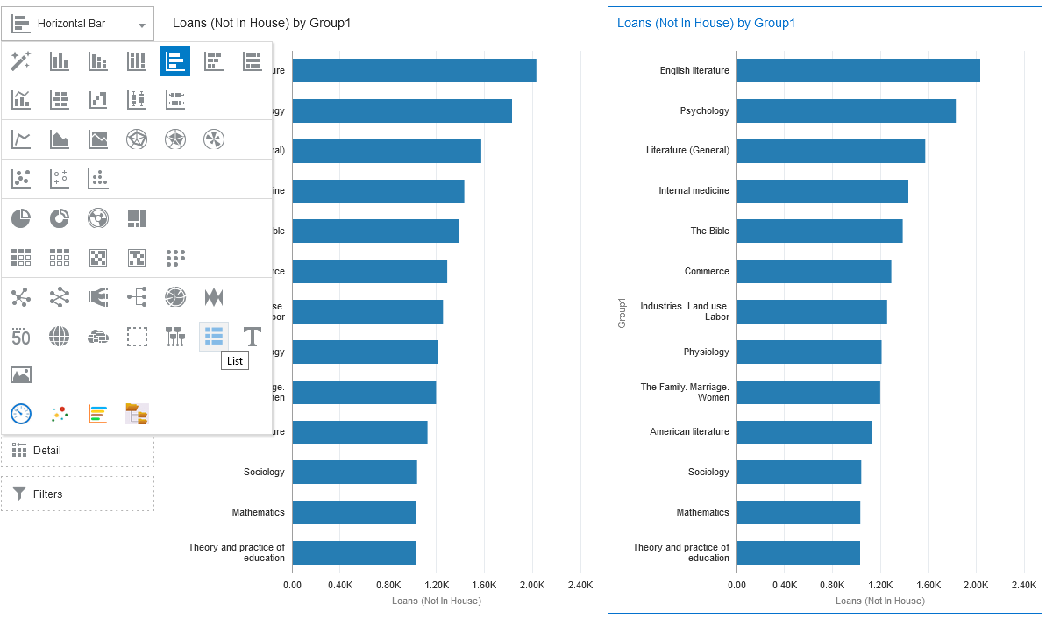
Using multiple visualizations in the same project
Now we have two identical visualizations and will change one of them to a list

Slide 30
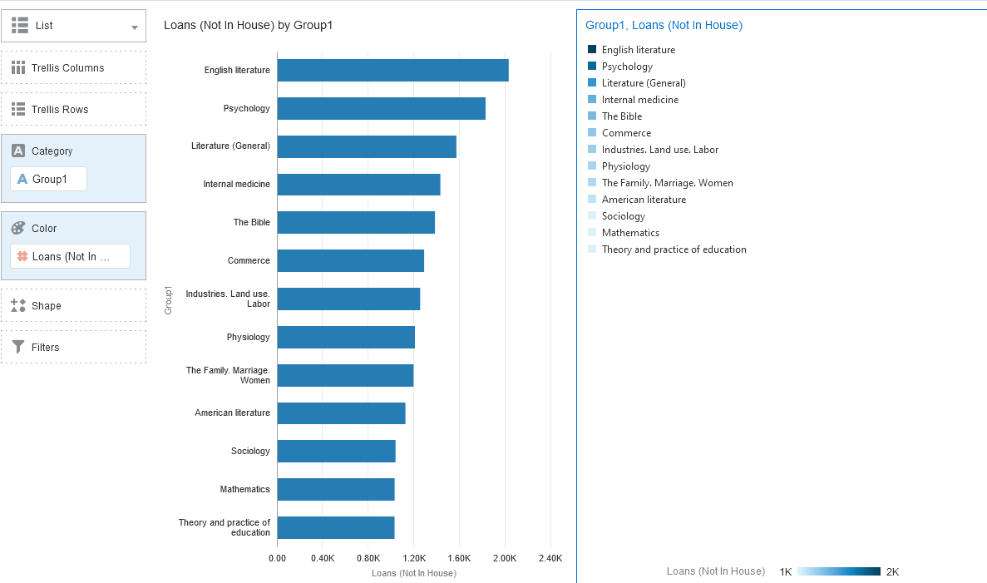
Using multiple visualizations in the same project
Now we have two different visualizations with the same data on the same canvas. One is "Horizontal Bar" and one is a "List":

Slide 31
Using multiple visualizations in the same project
Now we will delete the "List" visualization:

Slide 32
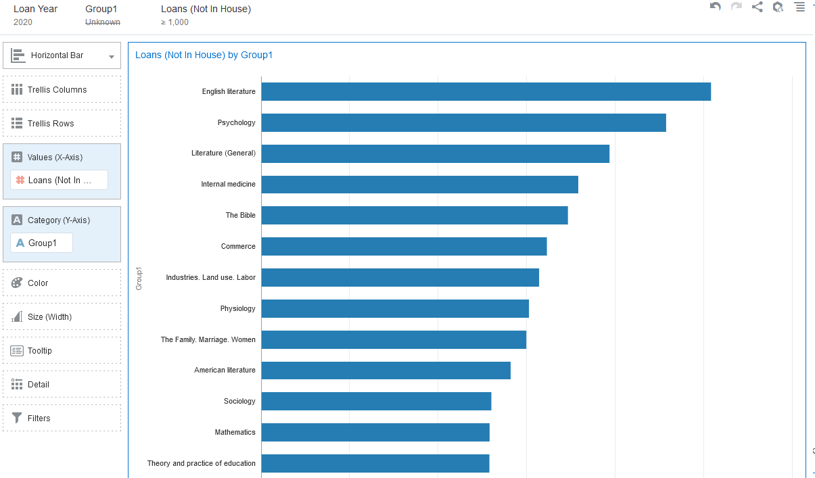
Using multiple visualizations in the same project
Now again we have one visualization on the canvas:

Slide 33
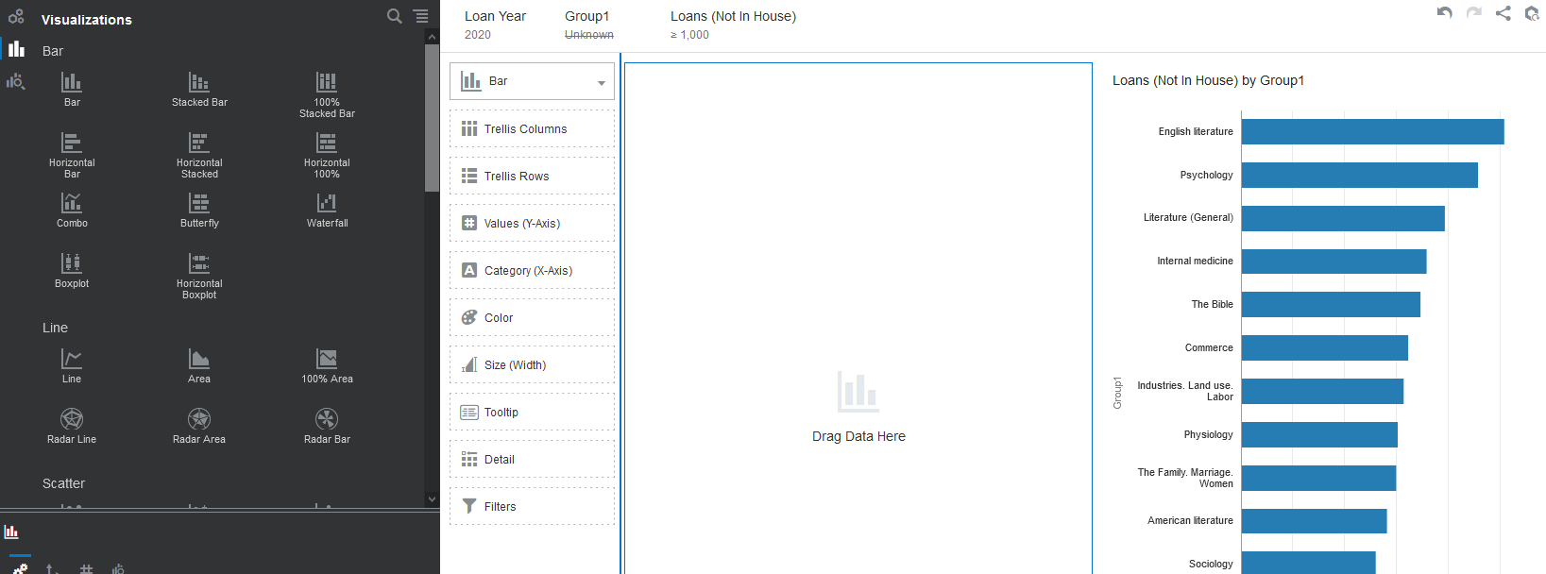
Using multiple visualizations in the same project
We can also have two visualizations on the same canvas with different data. Here we have clicked the "Visualizations" icon in the left pane and dragged in a new blank "Bar" visualization.

Slide 34
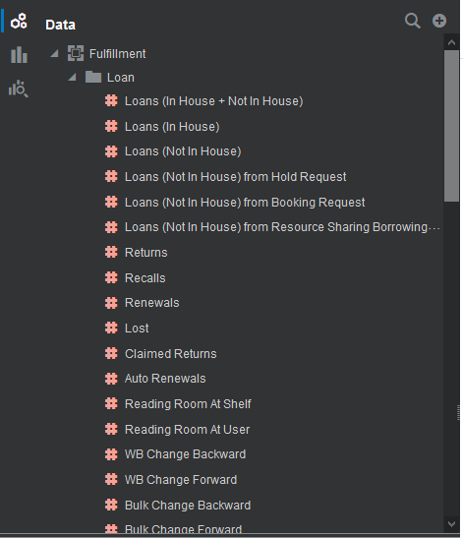
Using multiple visualizations in the same project
With the new blank "Bar" visualization selected we can make a new visualization, for example with number of loans by month. First we select the "Data Elements" icon in the left pane.

Slide 35
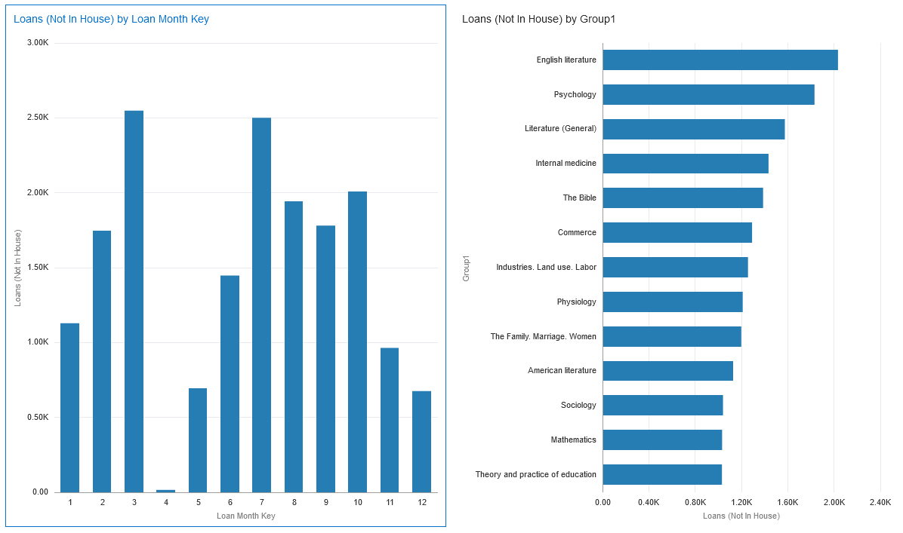
Using multiple visualizations in the same project
And now we drag in to the "Bar" visualization the number of loans and loan month key. Now we have two visualizations with different data in the same canvas. Note that in this case the filters on the top apply to both visualizations in the same canvas.

Slide 36
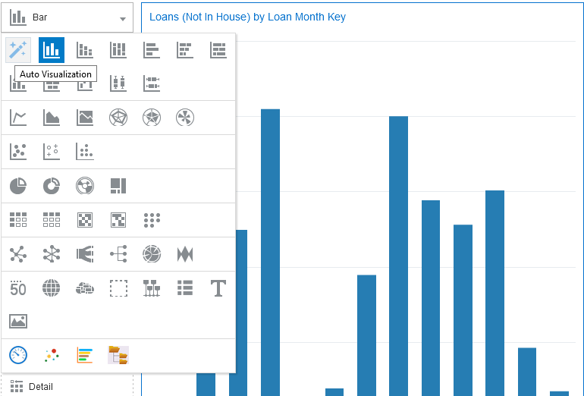
Using multiple visualizations in the same project
Now instead of the "Bar" visualization on the left we will choose "Auto Visualization"

Slide 37
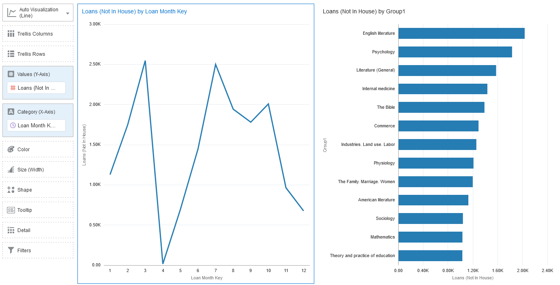
Using multiple visualizations in the same project
The "Auto Visualization“ chose a line graph

Slide 38
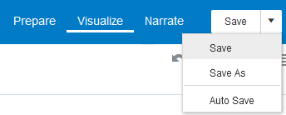
Using multiple visualizations in the same project
And now we can save the project again, this time with a new name

Slide 39
Some examples

Slide 40
Some examples
Primo device usage for last 365 days

Slide 41
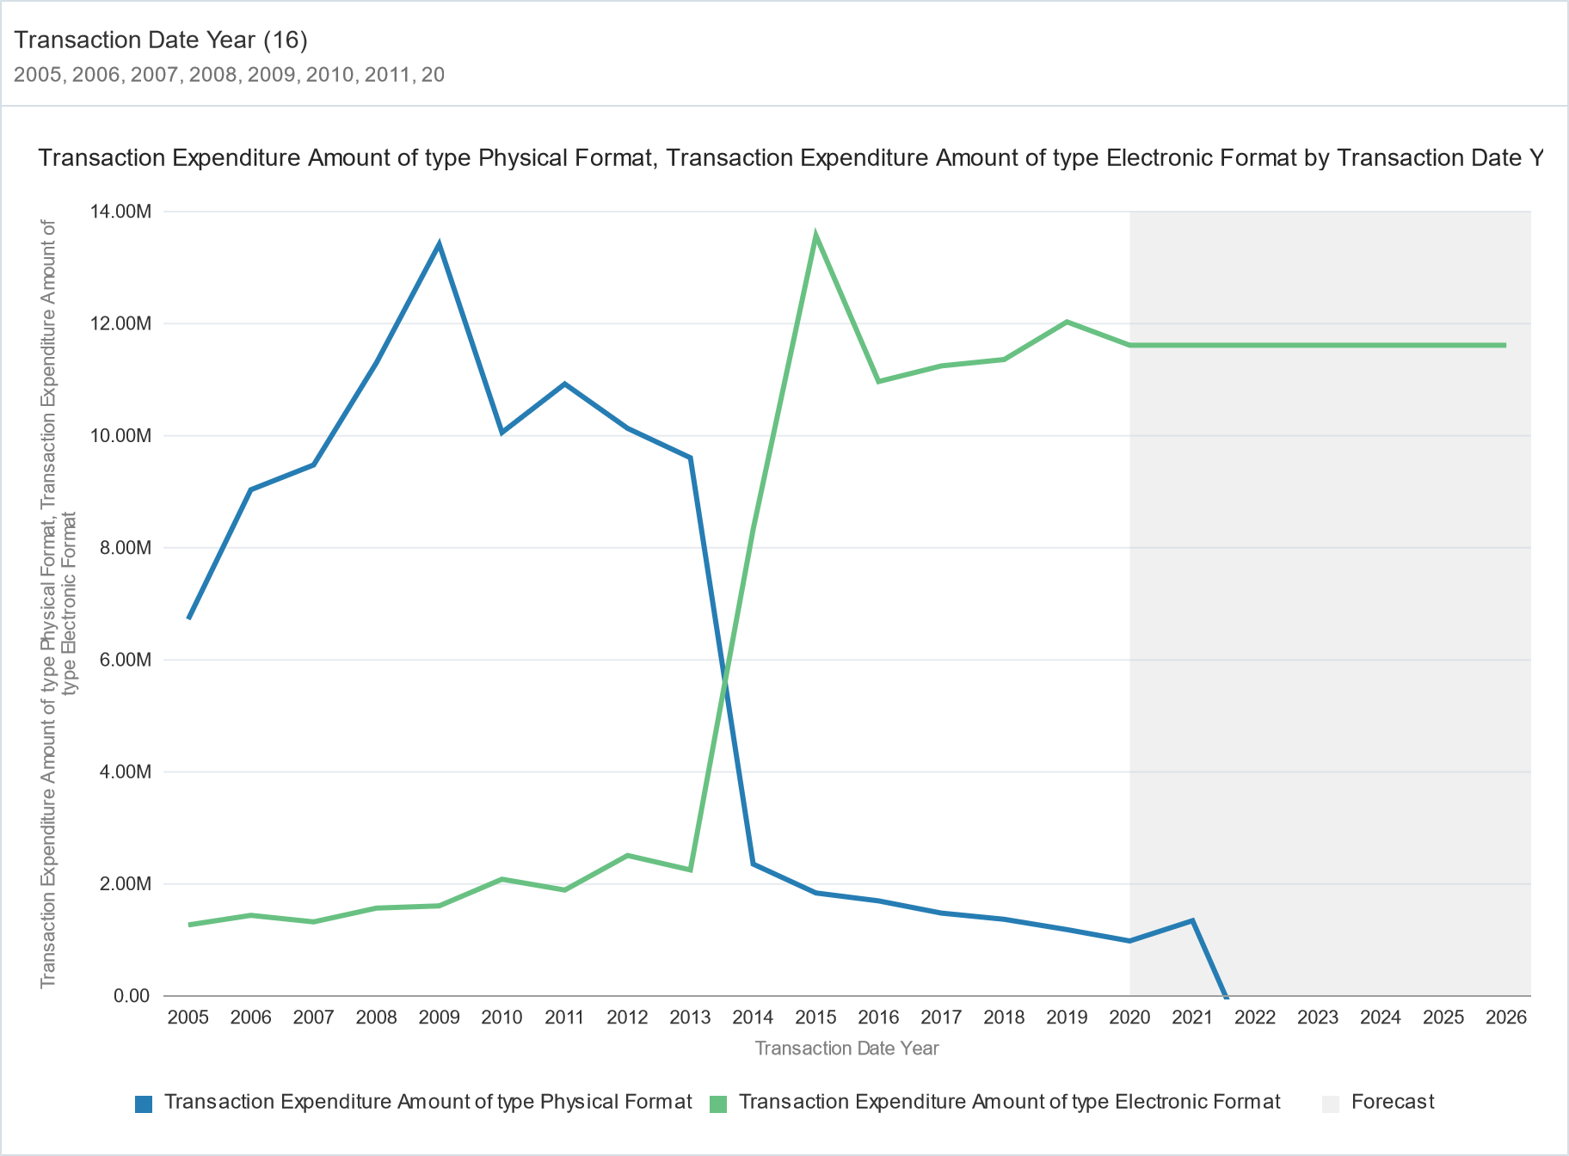
Some examples
Physical and electronic expenditures with forecast

Slide 42
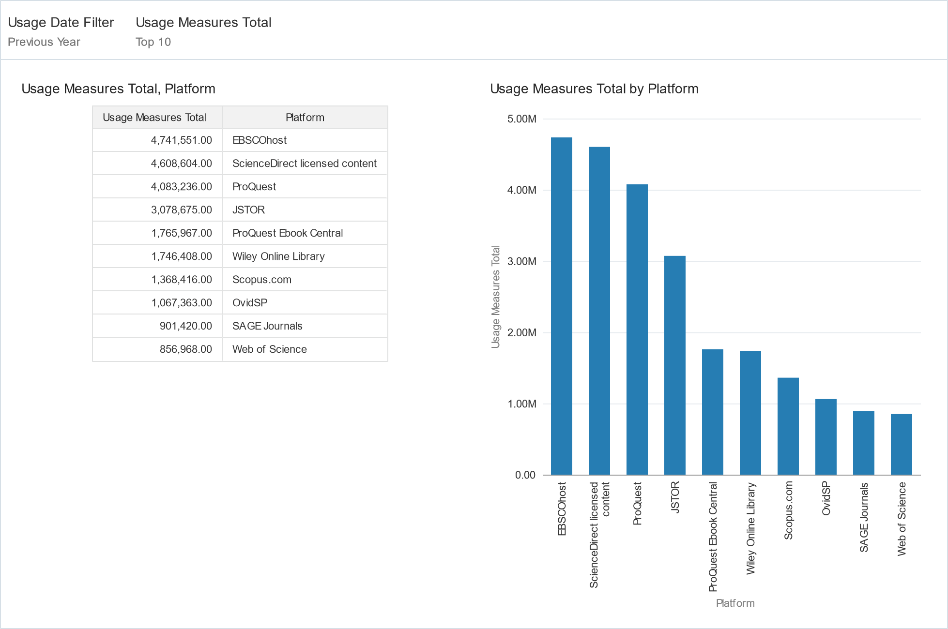
Some examples
Top 10 platforms for COUNTER R5 usage in previous year

Slide 43
Thank you!
xxx@exlibrisgroup.com

