Slide 1
ProQuest Rialto
Yuval Kiselstein Vice President, Product Management

Slide 2
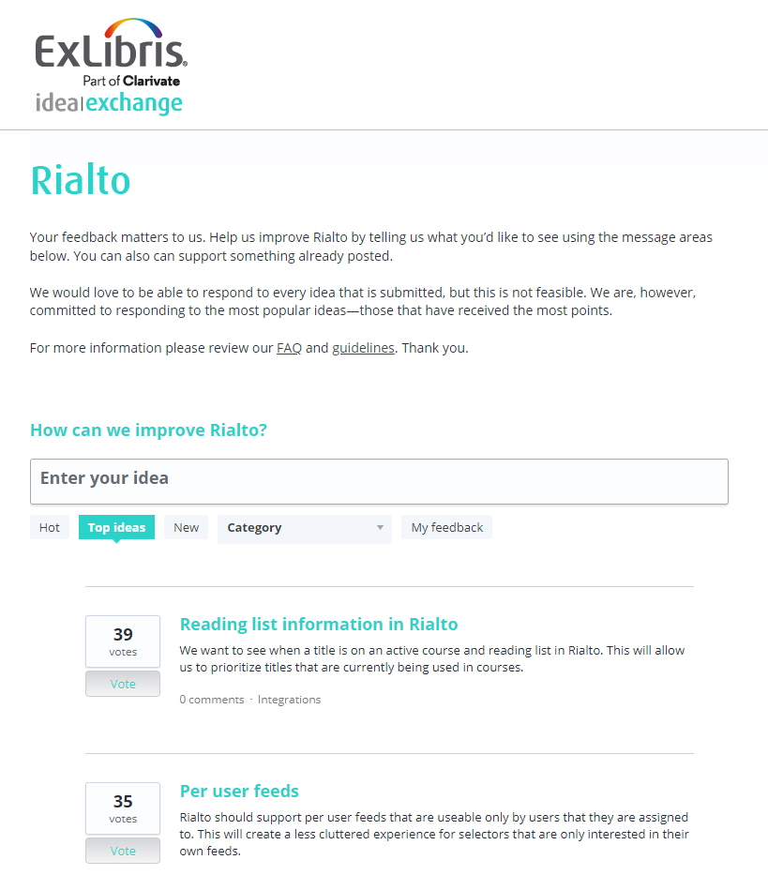
Growing Community and Collaboration
100+ Rialto Libraries in North America!
Since last ELUNA:
100 New Rialto Customers Globally
60 New NA Customers
Product Working Group
First Rialto Customer Feedback Survey
Rialto Idea Exchange Launched March 2022

Slide 3
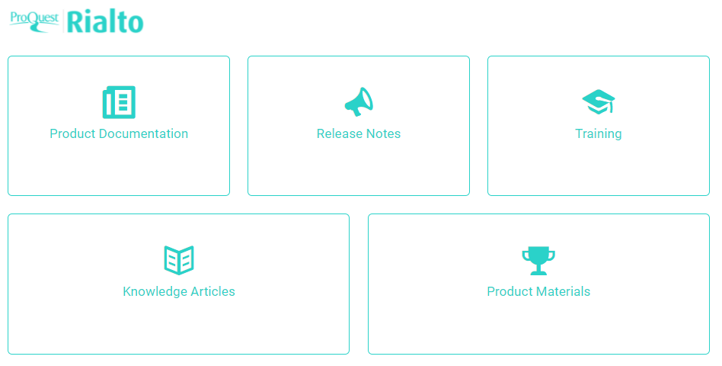
Join the conversation
Rialto Discussion List
Knowledge Center
Rialto ELUNA Learns sessions
Educational Release Webinars
Visit us at ALA in June!
ELUNA Selector Committee

Slide 4
What Rialto customers are saying
"We are super pleased with how things are going with Rialto, and honestly, incredibly relieved at the amount of work this is saving us…We just love it so far. It really couldn’t have come at a better time."
Washington & Lee University
“We are really enjoying using Rialto! It makes the workflows so much easier and less time consuming, and we have access to so many more electronic book suppliers than before.”
Avondale University
“From an acquisitions standpoint, the integration has been amazing, so much easier than having to create and follow up on orders.”
Trinity International University
“We’ve experienced significant streamlining of many of the stages of the acquisitions workflow process. Rialto is now our go-to marketplace for titles.”
University of South Australia
“The ordering process for Rialto literally takes about 5 seconds. It’s a great product.​
The time savings is genuine.”
NUI Galway
Notes:
All customers have been using Rialto for at least a year

Slide 5
Recent Product Development
Notes:
We keep introducing new capabilities in Rialto that help your efficiency, streamline the workflow, and collaborate within the library and with the faculty members. List of 3-4 major features around these themes since last Elune.

Slide 6
Our development is community-driven.
Some of our recent customer-requested enhancements:
Evidence Based Acquisition
Selection Plan
Consortia Holdings ​
Accessibility​
Advanced Search
Comments on Lists
Ebook Preordering
Cart Field Customization
Notifications ​
Additional metadata exposed
Stock Status
Cart Values in Order History
Publication Type Filter
Orders Awaiting Approval
Stored page display preferences
Adjustments for smaller screens
Improved shopping cart
Bulk upload to list
John Benjamins e-Platform
Gale eBooks
JSTOR

Slide 7
Comments on Lists
Collaboration
Rialto supports collaboration with the ability to comment on shared lists
Comments appear within the Offer Details panel

Slide 8
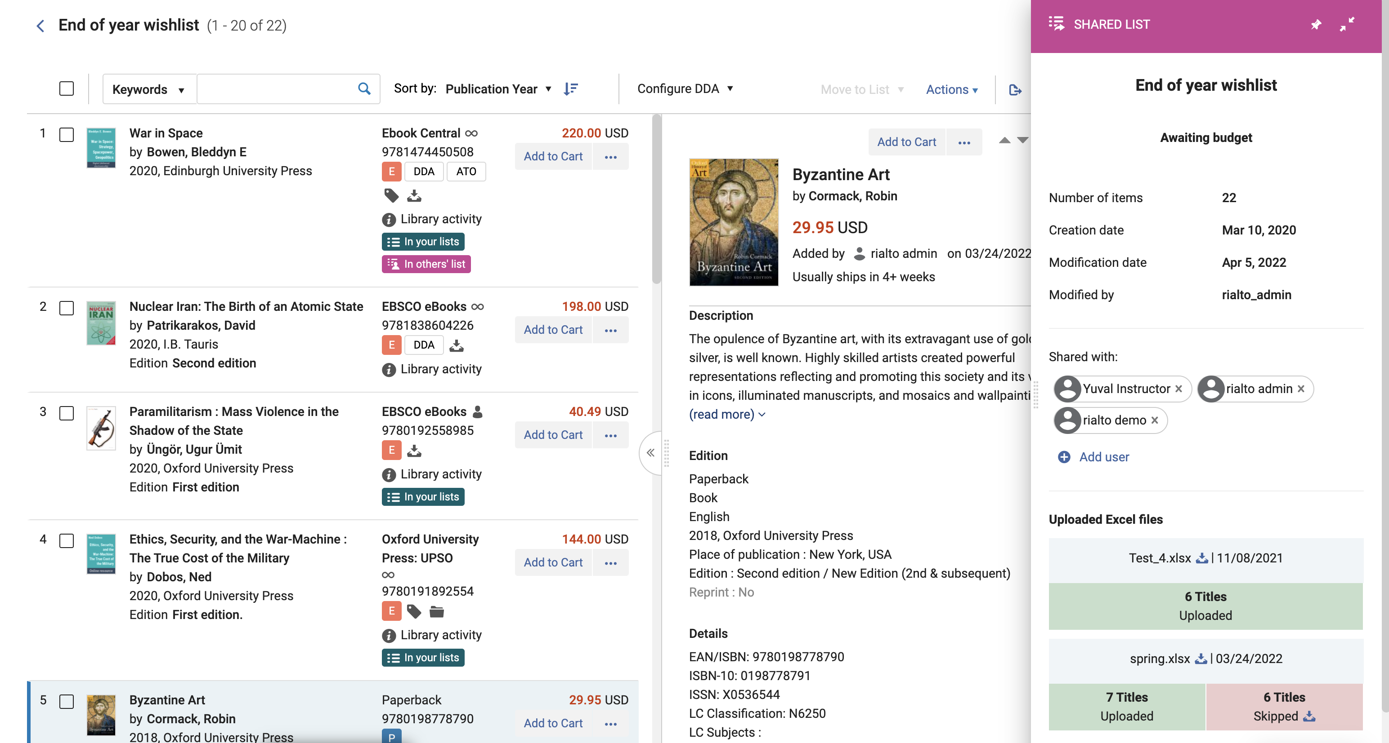
Upload to List
Efficiency
Upload a spreadsheet of ISBNs to a new or existing list, and search for them in the Rialto marketplace to view matching offers
Save time and easily search for a large title list in the marketplace

Slide 9
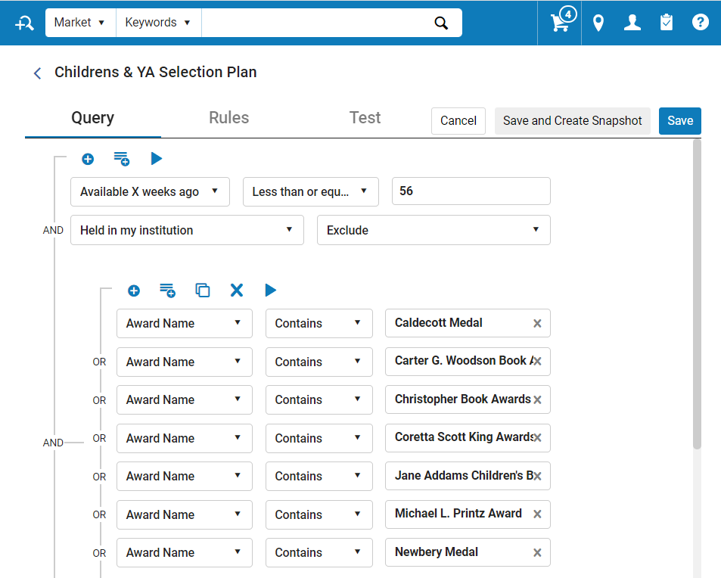
Selection Plan Enhancements
Collection Development
Filters for Awards and Reviews
Selection Plan History page added
Additional testing tools added
Duplicate Selection Plan rules
Many additional filters for more targeted plans

Slide 10
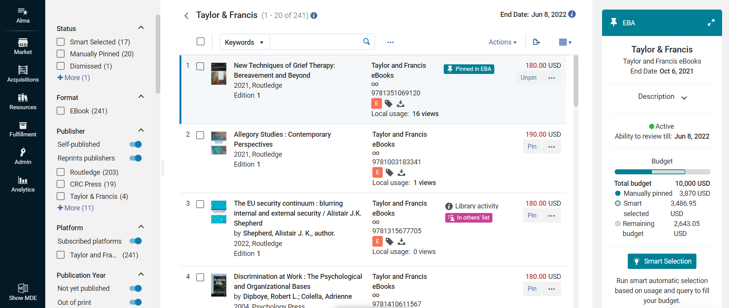
Evidence Based Acquisition in Rialto
Acquisition Models with Efficient Workflows
SUSHI usage while reviewing
Make early selection decisions throughout the program
Real-time monitoring of planned spend
Other library activity (holdings, DDA, etc.) available
Robust tool to assist selection
Notes:
When you choose EBA with Rialto, you get all the benefits of Rialto’s powerful selection tools embedded within your EBA workflow. Currently available with Ebook Central and Taylor & Francis
Customer Challenge: Limited visibility into what’s in EBA pool & lack tools for monitoring programs
Solution: Rialto’s innovative tools for monitoring and selecting titles.
The pool view allows users to see all titles currently available in the EBA plan.
Facets allow overview and drilling down by subject, year, etc., in order to explore different aspects of the pool
SUSHI usage visible on each title while reviewing
Other library activity visible from the pool view, such as holdings, DDA, in others’ lists – to avoid duplicate purchases
The ability to pin titles for potential purchase at the end of the program, in order to speed up end-of-program decisions
Real-time monitoring of planned spend: Budget monitor shows current value of pinned titles against the budget
Smart Selection tool suggests titles according to library-defined queries, ensuring quick decisions during the time-sensitive selection phase

Slide 11
New Platforms in the Digital Marketplace
Coming Soon

Slide 12
An Easy & Enjoyable Implementation Process
“This has been an incredibly positive experience and the easiest implementation by far”
—Washington & Lee University
We know libraries have many priorities today, and implementing a new product isn’t exactly top of mind. That’s why Rialto’s implementation was specifically designed to be simple and easy.
You complete two forms, followed by a short training session
And we do the rest! Within a week, Rialto is ready for your library.
“The implementation process for Rialto was truly enjoyable.” — University of Calgary
“I appreciate that Rialto was implemented quickly. Also, our implementation manager was very responsive.” — Embry Riddle Aeronautical University
Notes:
The ProQuest Rialto team reimagined the implementation experience to remove roadblocks and unnecessary work.
Since Rialto is embedded into Alma, your library’s existing settings are used to make implementation smooth and easy with minimal work by you.
We know it’s a challenging time and we would like to make sure we provide you with smooth implantation for Rialto and help you gain the value for Rialto in a very short time and with minimal effort from your staff – highlight the ease of implementation

Slide 13
Rialto’s Journey Continues Coming in 2022

Slide 14
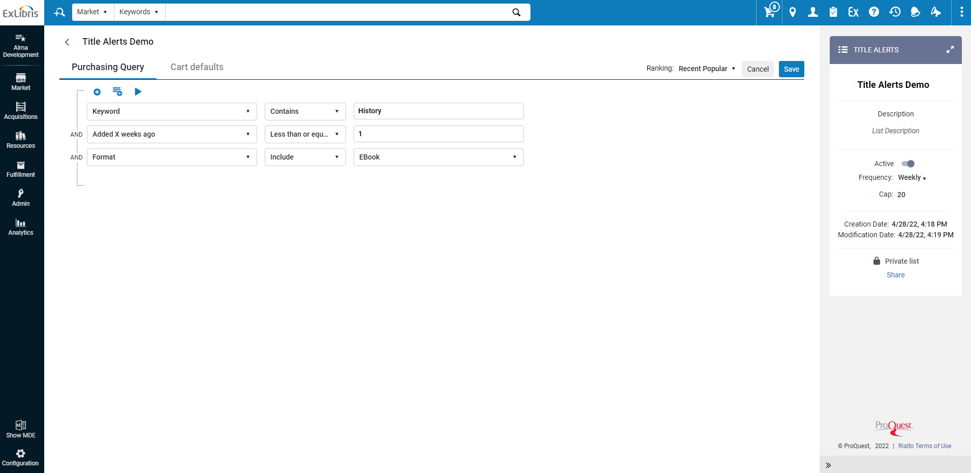
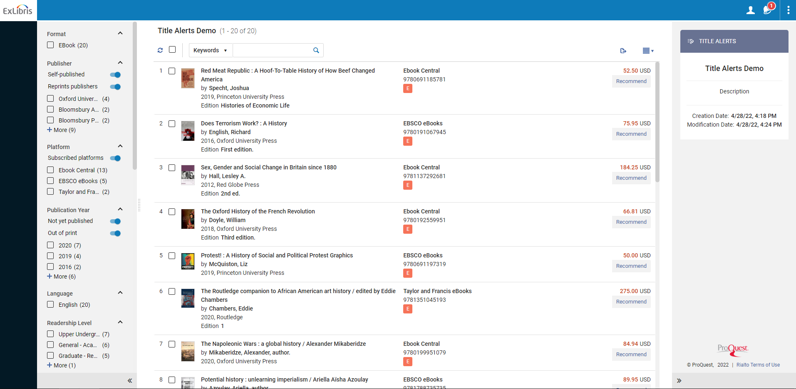
Title Alerts and Faculty Title Alerts
Collaboration
Efficiency
Lists of titles created according to a library-defined query and ranking.
New lists drawn up at pre-defined intervals (weekly, biweekly, or monthly) for review by library staff
Title alerts may be shared with faculty, who will be able to review title alert lists and recommend titles for purchase

Slide 15
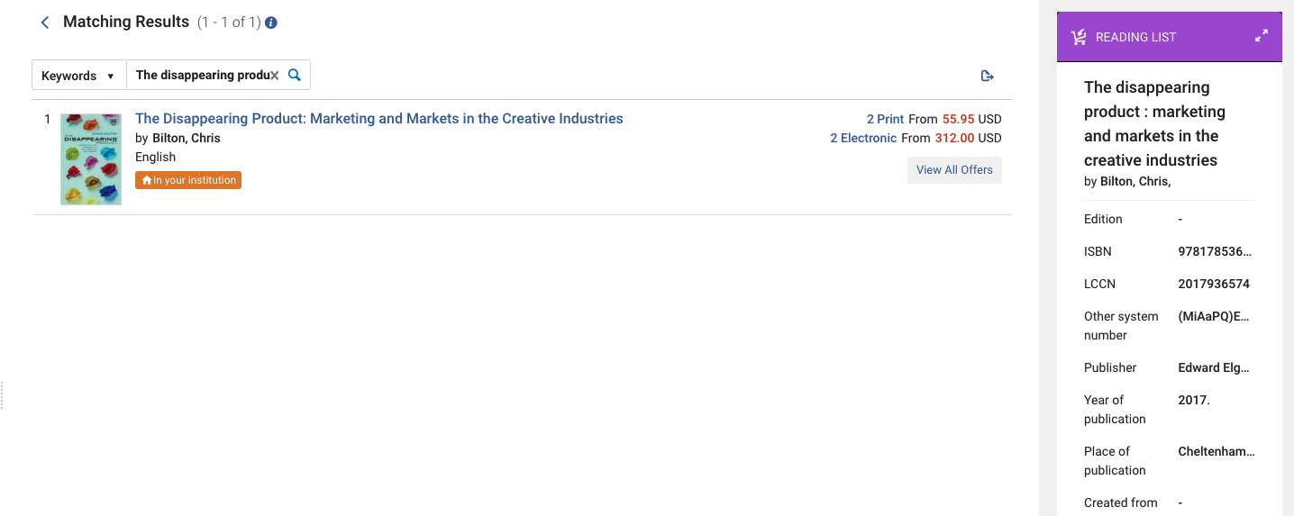
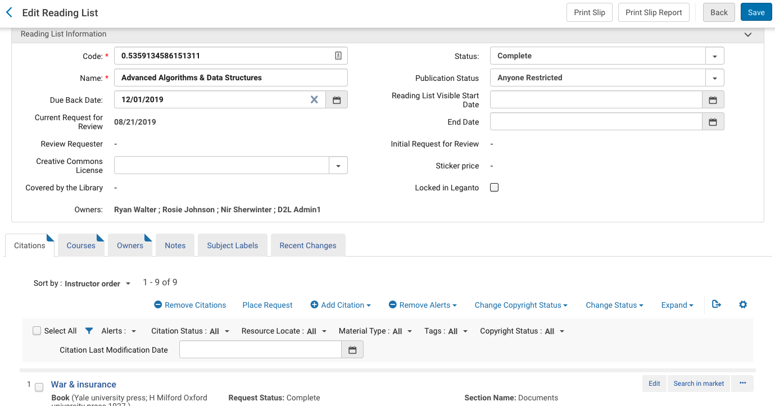
Search from Alma Reading List
Efficiency
Search in Rialto from Alma Reading List management
Reading list context as part of the purchasing decision process
Streamlines the workflow for libraries whose staff both manage reading lists and order in Rialto without purchase requests.

Slide 16
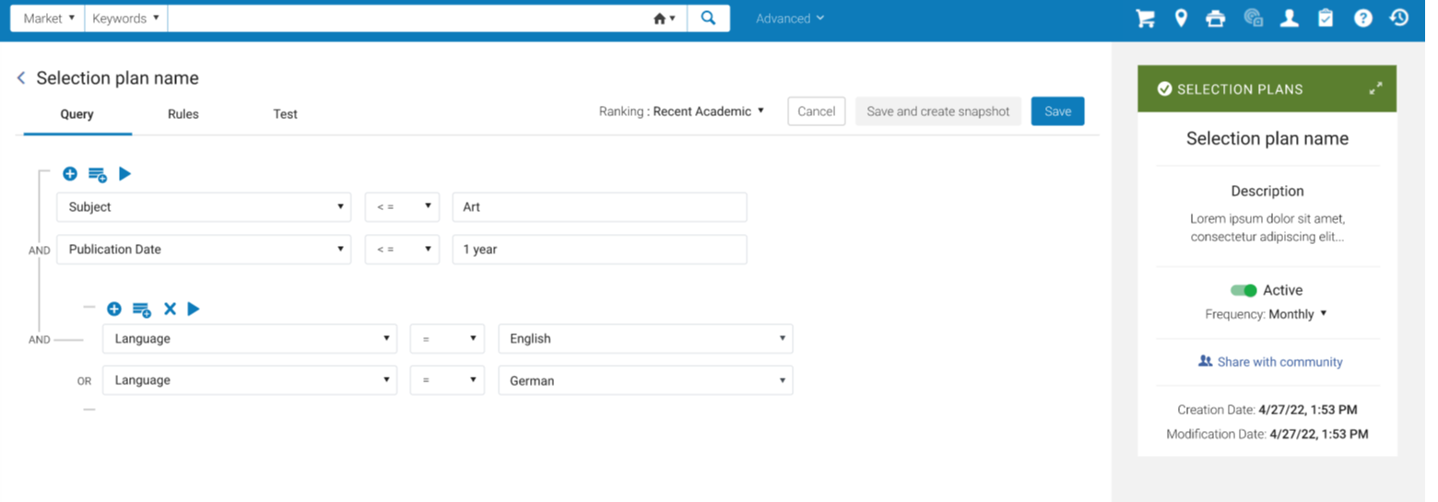
Community Selection Plans
Collaboration
Efficiency
Use the power of community sharing to enhance your Rialto selection plan
Share a selection plan or recommendation feed with the Rialto community
Users may preview shared plans and save them to the local institution

Slide 17
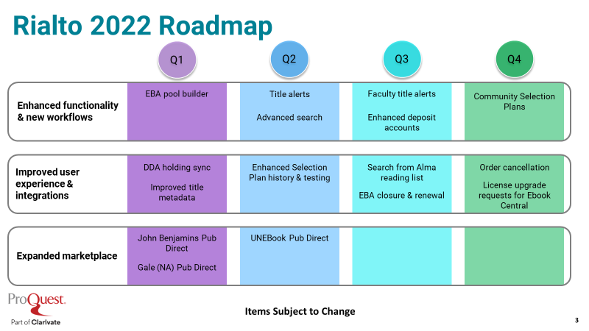
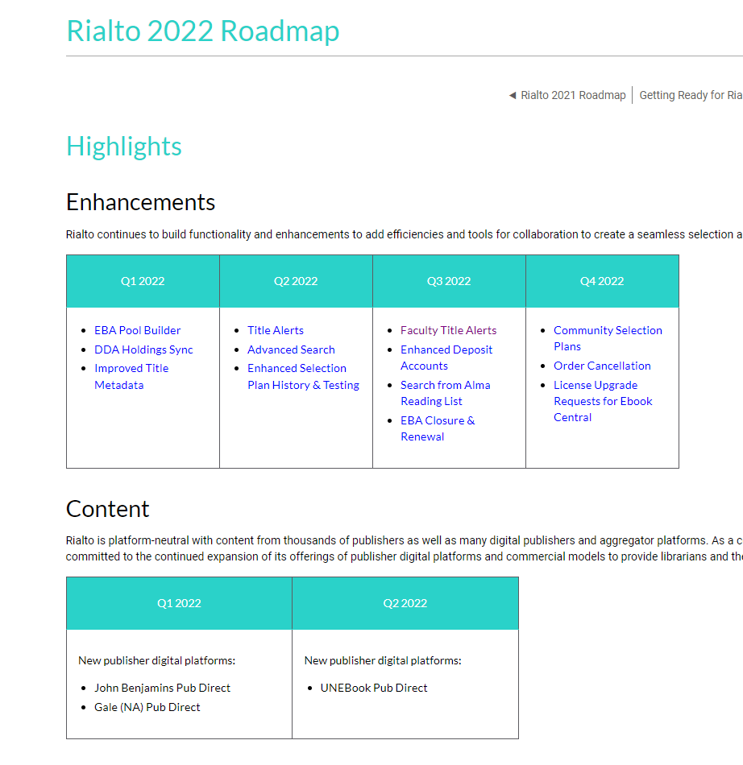
And there is so much more to come
Visit the Rialto Roadmap in the Knowledge Center
https://knowledge.exlibrisgroup.com/Rialto/Product_Materials/020Roadmap/Rialto_2022_Roadmap

Slide 18
Yuval Kiselstein
Yuval.Kiselstein@clarivate.com

