Slide 1
Leganto Product Update
Dolav Ben Artzi, Leganto product manager
Notes:
Leganto Product Update | Dolav Ben Artzi, Ex Libris | 2:50pm – 3:20 pm. 25 minutes plus 5 for questions
1:55 pm – 2:25 Rialto
21:25 connect (Break | 2:25 pm – 2:30 pm)
21:50 presenting

Slide 2
Overview of New Resources
Product Highlights from the Past Year
Upcoming Development Plans
Q&A
Agenda

Slide 3
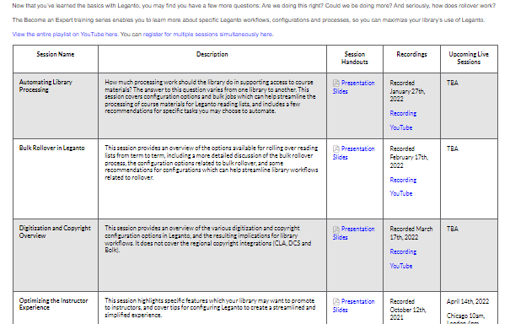
Library training
Leganto for Library Staff: new basic training kit
Become an Expert: advanced training

Slide 4
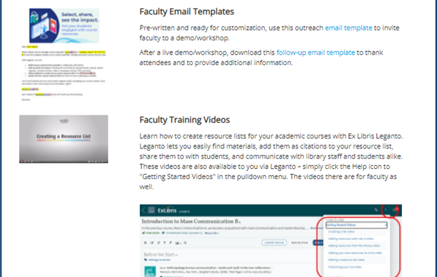
Tools to engage instructors
A compelling kit for marketing Leganto to instructors
An engaging demo kit for helping the library motivate instructors who are new to Leganto
A new and comprehensive, yet simple, instructor training kit.

Slide 5
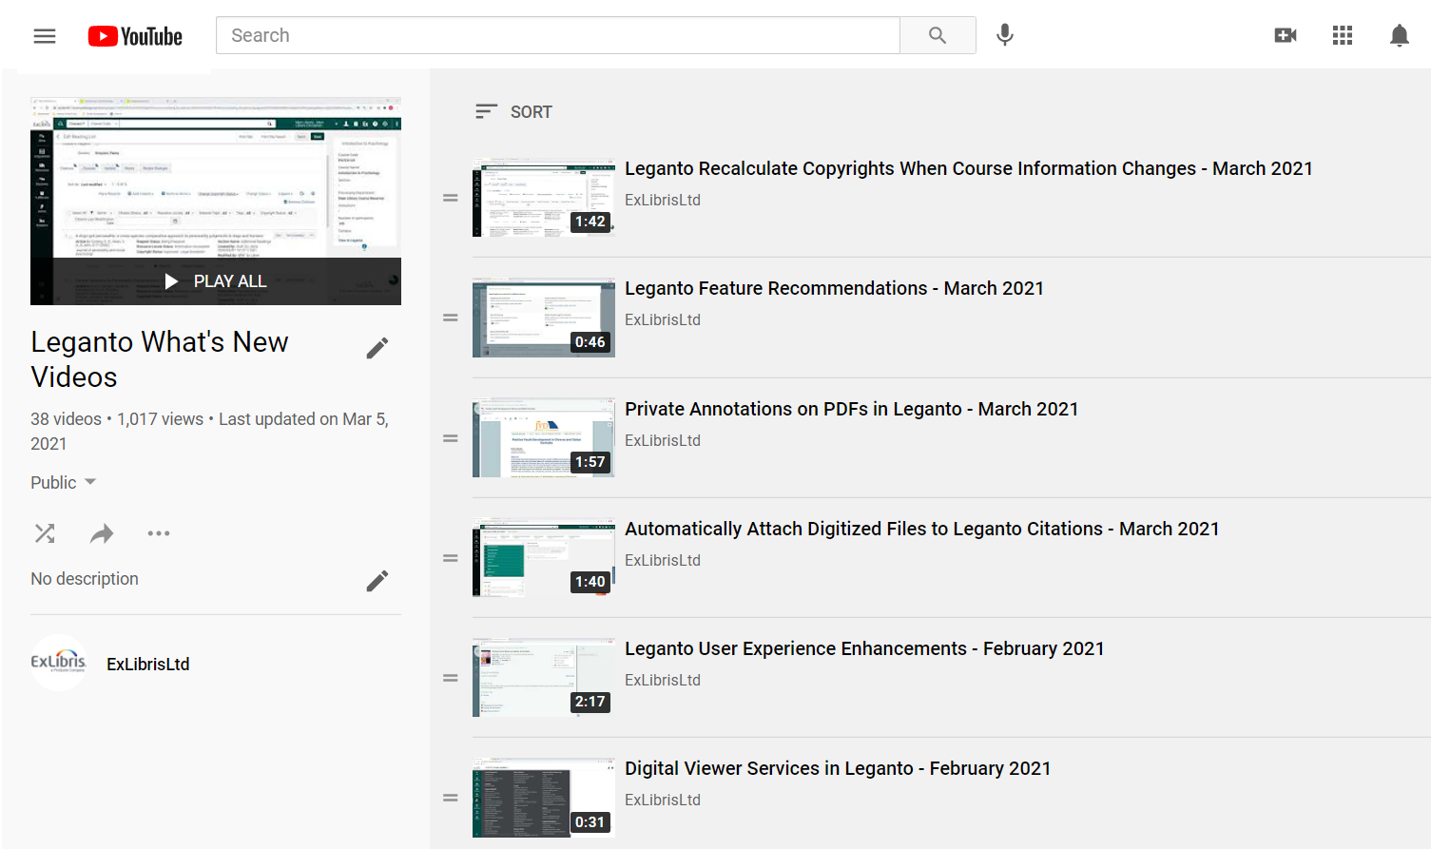
Learn what’s new in Leganto
What’s New Videos
Release notes

Slide 6
Product Highlights from the Past Year

Slide 7
Library workflows in Alma

Slide 8
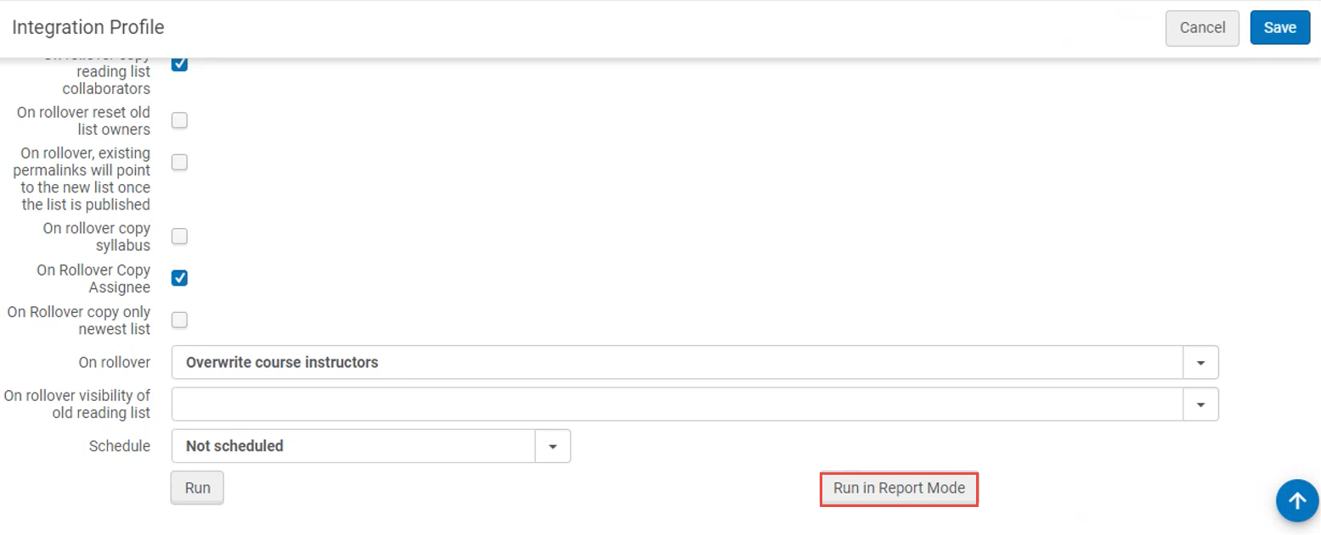
Run course loader in report mode
Watch a Video
Notes:
Doesn’t work for rollover

Slide 9
Manual Locate
Watch a Video
Notes:
Idea exchange
Searching by ISBN or title (configuration?)
link a citation to a different bib

Slide 10
Manual Locate
Watch a Video
Notes:
Idea exchange
Searching by ISBN or title (configuration?)
link a citation to a different bib

Slide 11
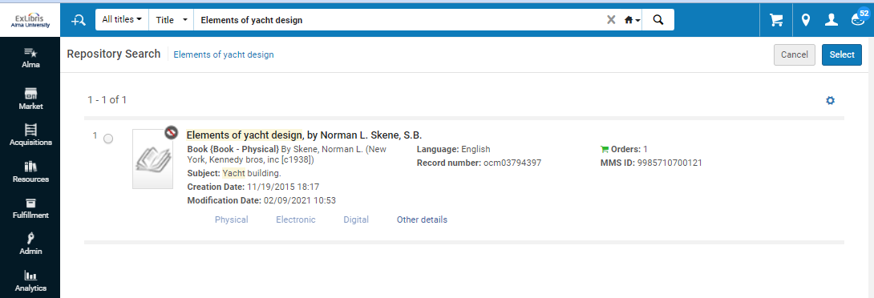
Manual Locate
Watch a Video

Slide 12
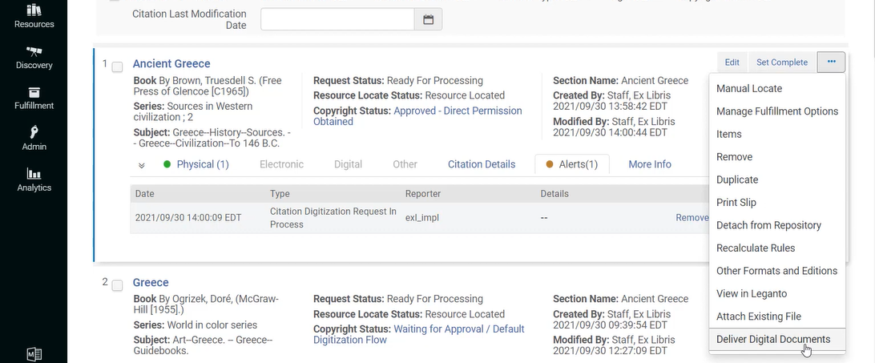
Streamlined digitization workflow
Watch a Video

Slide 13
Streamlined digitization workflow
Watch a Video

Slide 14
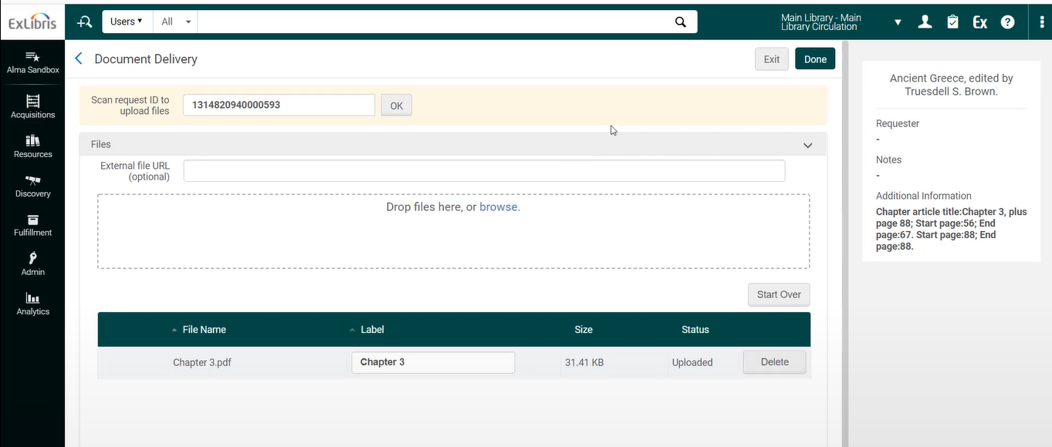
Streamlined digitization workflow
Watch a Video

Slide 15
Instructors and students’ interactions with library services in Leganto

Slide 16
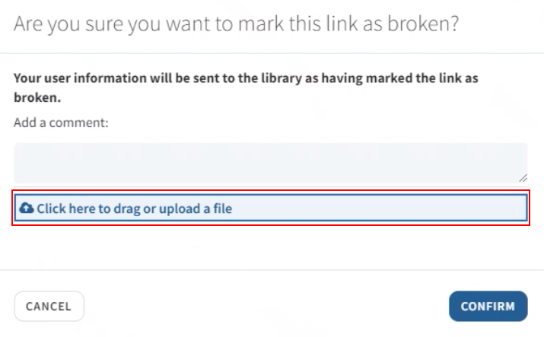
Broken link reporting (NERS)
Watch a Video

Slide 17
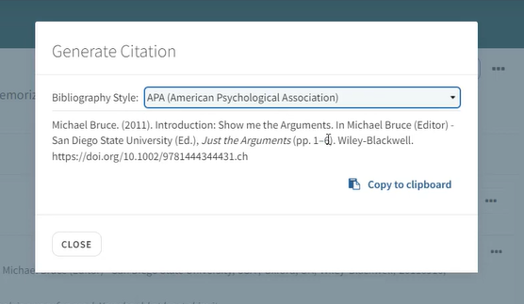
Quick cite
Watch a Video

Slide 18
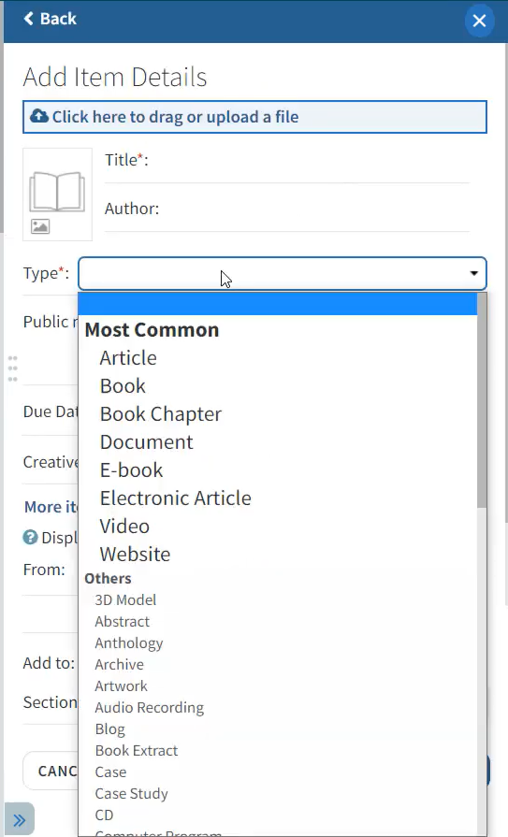
Add custom citations’ material types
Watch a Video
Notes:
Leganto comes with a long out of the box list of material types.

Slide 19
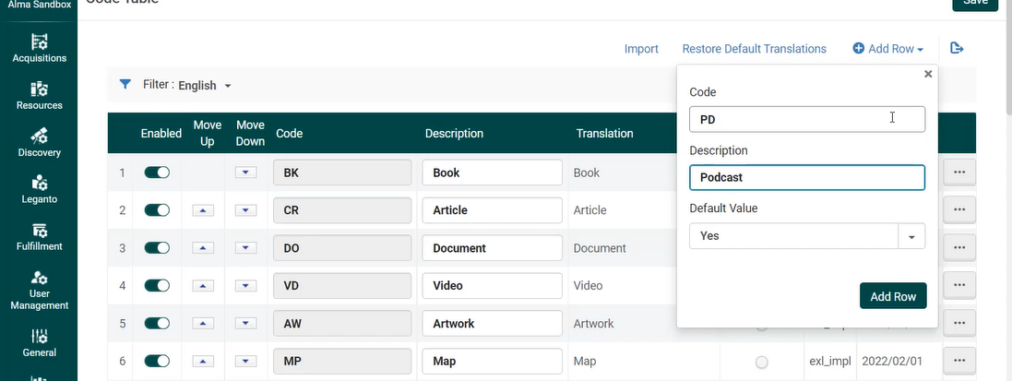
Add custom citations’ material types
Watch a Video

Slide 20
Easy labels customization - view label codes in Leganto
Watch a Video

Slide 21
Easy labels customization - view label codes in Leganto
Watch a Video

Slide 22
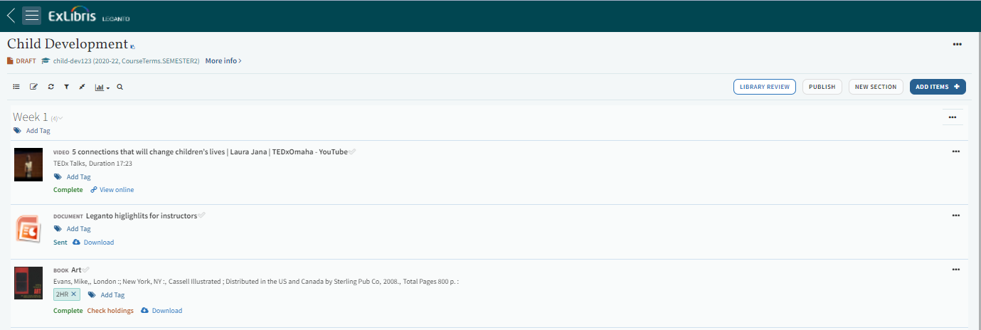
Easy labels customization - view label codes in Leganto
Watch a Video

Slide 23
Easy labels customization - view label codes in Leganto
Watch a Video

Slide 24
Easy labels customization - view label codes in Leganto
Watch a Video

Slide 25
Learning management system integration – LTI 1.3
Why upgrade from LTI 1.1 to LTI 1.3?
Both are used by learning management systems (LMS) for integration with external tools.
The IMS Global support for LTI 1.1 will end on June 30, 2022
More seamless integration of Leganto with the LMS
Assignments in Leganto
How to upgrade?
Directions on Developer Network
You can use LTI 1.1 and LTI 1.3 in parallel in the LMS

Slide 26
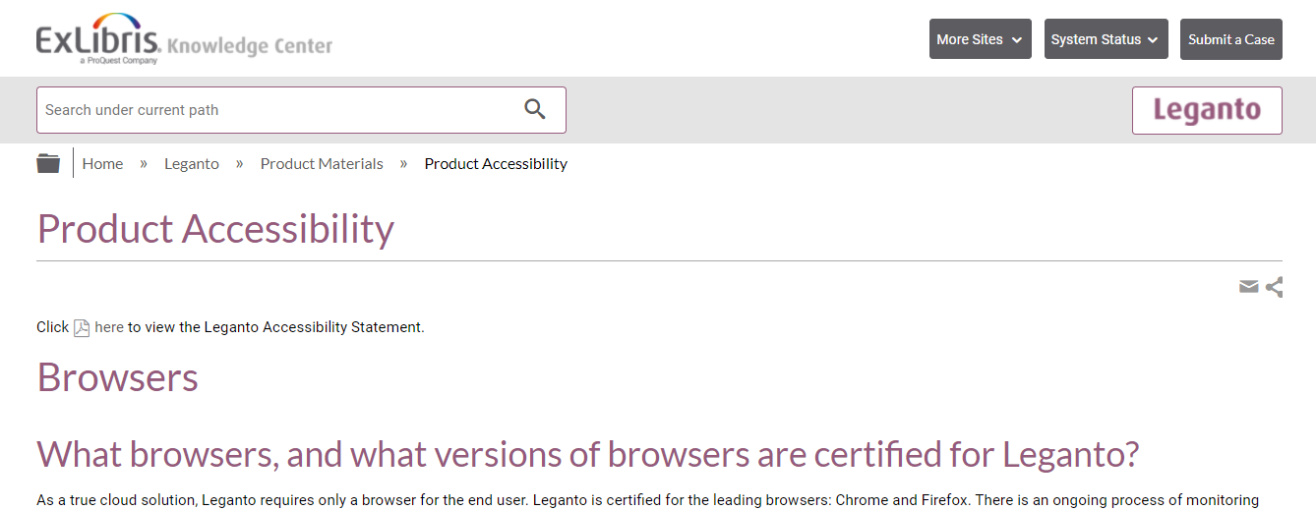
Accessibility Update
VPAT 2.3 for 2021 available on Knowledge Center and describes the Leganto support of WCAG 2.1
Expect to have an updated VPAT in Q3
https://knowledge.exlibrisgroup.com/Leganto/Product_Materials/Product_Accessibility

Slide 27
Extended support for teaching and learning

Slide 28
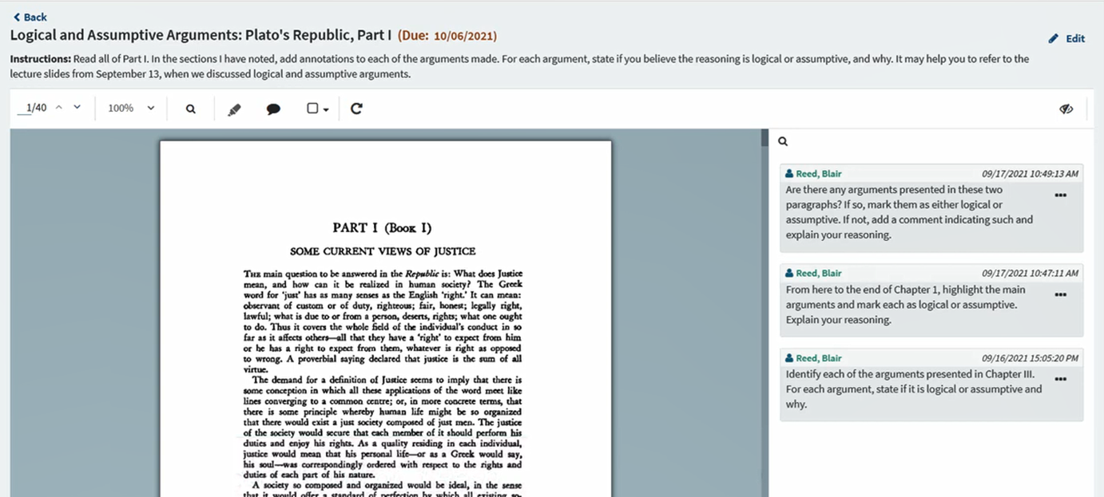
Active learning
Watch a Video

Slide 29
Active learning services:
Social Reading
Read and Respond assignments
Active learning values:
Motivate students to complete assigned readings
Assess students’ understanding of the text
Foster student interaction with fellow students and with the instructor
Notes:
Social reading ו- Read and respond assignments זמינים לכם בחינם דרך לגנטו.
ואתם בהחלט יכולים להשתמש בהם כדי לעזור למרצים לייצר אינטראקציה סביב חומרי קריאה, לתת מוטיבציה לסטודנטים לקרוא את חומרי הקריאה, וכדי למדוד את ההבנה של הסטודנטים.

Slide 30
2022-2023 developments
Provide on-going developments based on community feedback
Support annotations on Alma Digital objects
Provide Active Learning features for more citation types
Support Social Reading for groups of students
Offer features that help instructors quickly grade student assignments in large classes

Slide 31
Upcoming development highlights
2022-2023 Roadmap
2022-2023 User Experience highlights

Slide 32
Streamline reading list processing experience

Slide 33
Streamline processing experience
Enable library staff to focus on the most important tasks by offering:
More automatic workflows
Additional navigation options
New options for data clean-up

Slide 34
Streamline processing experience
Highlights:
New configuration for automatically changing citation status to Complete for eBooks with an unlimited number of licenses
Open a citation in Alma from Leganto
Enabling course archiving, utilizing a mechanism similar to reading list archiving

Slide 35
Purchasing workflow
Highlights:
Present demand in other lists on the purchase request screen
Add the citation tags to the Demand in other lists informative table
Open Rialto from a citation in Alma, for seamless integration

Slide 36
Leganto analytics

Slide 37
Out of the box analytics reports
In cooperation with the community (new Leganto Analytics focus group)
Impact: Support decision making, analyze workflows, demonstrate library impact
Highlights:
Day-to-day set of reports – a collection of quality customer-created reports which will be added to the out-of-the-box set of reports and will be supported by Ex Libris.
Advanced "big picture" reports – the group will build together a set of advanced reports to be added to the out-of-the-box set of reports. These reports will be supported by Ex Libris.

Slide 38
New User Experience

Slide 39
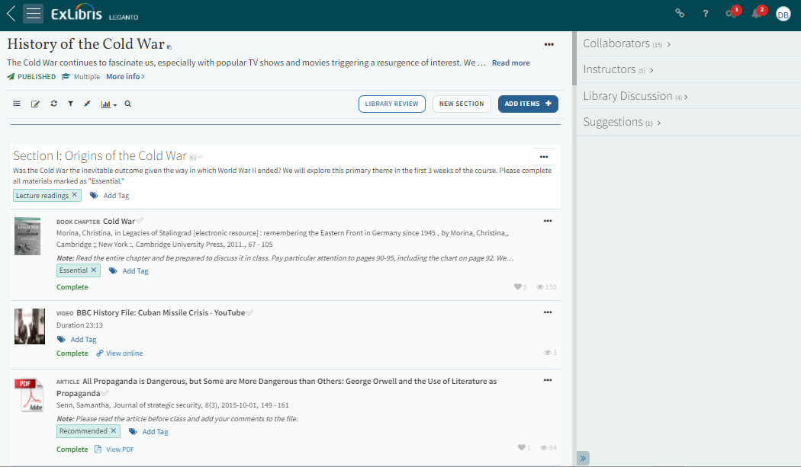
Today

Slide 40
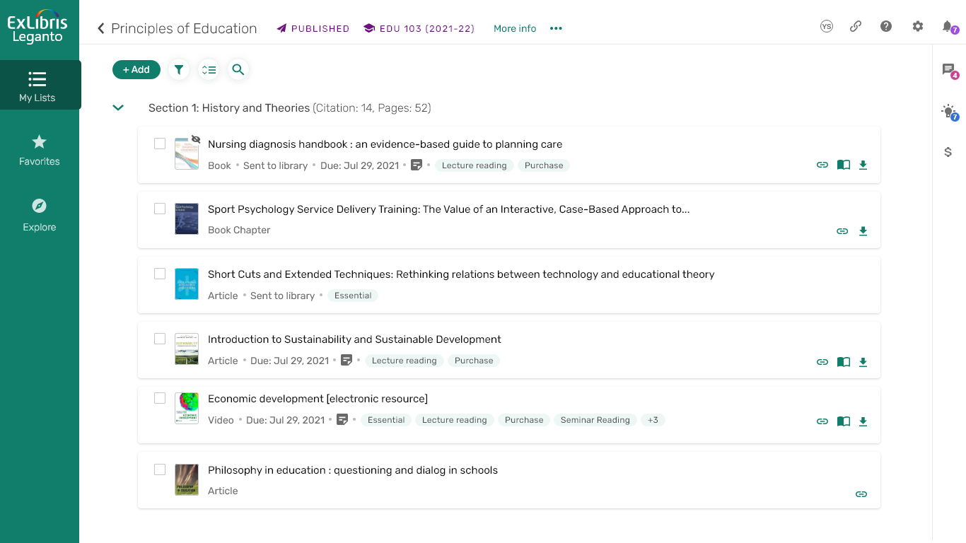
New
Disclaimer: Early-stage mockup

Slide 41
Key pillars of the Leganto new user experience
Make a distinction between instructors’ and students’ experience
Focus on the experience in the learning management system (LMS)
Screen resolution – optimize the instructor view to laptop screen size
Adaptive user experience context - present the most relevant information to the current user’s workflow
Security, accessibility, and performance
Notes:
I talk about the backround of the
3-4 main points of the new UI
Here is an example of what it will look like in the redesign.
Refer back to Yael presentation.
Yael talked about the Research – the opening day of Leganto

Slide 42
Leganto New User Experience – Library search demo

Slide 43
Questions?

Slide 44
Dolav.ben-artzi@clarivate.com

Slide 45
Easy transition
Time to prepare:
Gradual deployment:
Communication
Training:
The new UI will be released during H1 2023
Both versions will coexist for 9 months
Test the new UI while the previous UI still exists
Move to the new UI during academic break
Early updates to the community in emails and webinars
Ex Libris will provide training and supporting materials for the new UI

