Slide 1
Print Books on Demand: How to Leverage Primo, OASIS, and Alma to Streamline Workflow
Shixing Wen swen@odu.edu
Associate University Librarian for Scholarly Communication & Resources
Old Dominion University Libraries
ELUNA 2018

Slide 2
Print Books on Demand (pDDA)
What is pDDA?
Why is pDDA needed?
How can we streamline pDDA workflow?

Slide 3
What Is pDDA?
Print Books on Demand applies the concept of DDA (Demand-Driven Acquisition) for ebooks to print books.
Users can directly order a print book from the library catalog with or without mediation from library staff.

Slide 4
Why Is pDDA Needed?
Despite the advantages of e-Books (e.g., 24/7, concurrent access and keyword search capability), circulation statistics indicate that print books are still checked out regularly.
Note: a large portion of books don’t get checked out.
Note: the library budget is declining in real purchasing power because of cost inflation of library materials.
We need to find ways that will yield a better return on investment. pDDA is one of the options.

Slide 5
How to Streamline pDDA Workflow
Unlike DDA for ebooks, users can’t click on a hot link and get a print book instantly. Print DDA entails a different workflow.
Old Dominion University Libraries have collaborated with ProQuest to leverage Primo, OASIS, and Alma to streamline the workflow for users and library staff.

Slide 6
1) pDDA Profile
A profile for pDDA needs to be set up with subject and non-subject parameters, just like any approval plan.
We use the same profile of our approval plan with YBP for the print DDA with Coutts.

Slide 7
2) Discovery Records
Books published 2016-
19,888 bib records
1% chance of discovery
Records need to be in Primo for users to discover books from the pDDA service.
We opted for books published from 2016 onward.
Our initial load included 19,888 bib records. In perspective, there are 2.8 million bib records in our Alma instance.
The chance to discover these pDDA records is less than 1%. (What about PCI records?)
We receive new book records on a weekly basis.

Slide 8
Primo, OASIS, and Alma
Ex Libris has created an Order API in Alma to work with OASIS.
The Order API auto-populates an Order Form in Primo with bibliographic data (Title, ISBN), user name, and email address.
Ex Libris has created a scheduled job to update OASIS with our holdings in Alma on a daily basis to prevent unintentional duplicated orders between vendors.

Slide 9
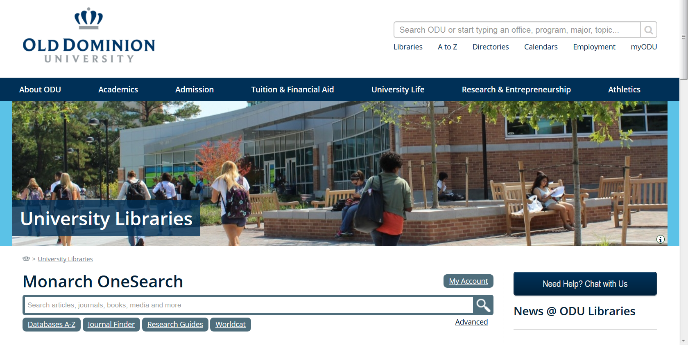
3) Workflow in Primo
pDDA is meant for serendipitous discovery

Slide 10
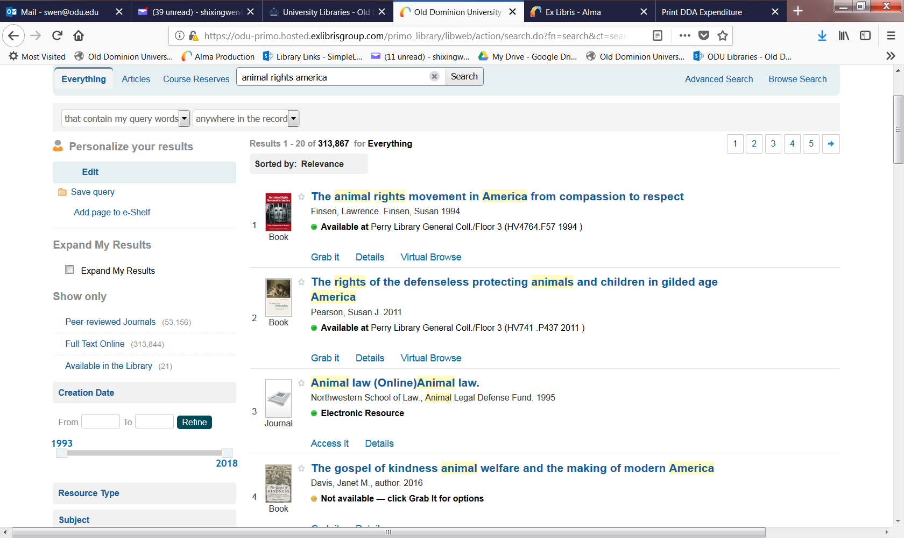
Workflow in Primo
Note: Faculty and students need to sign into Primo in order to use the print DDA service.
If there is a print DDA discovery record, there will be a note under the title “Not available – click Grab It for options”.
There could be different situations for this note (e.g., In Process) but definitely one situation is for print DDA discovery.

Slide 11
Workflow in Primo
Users need to sign-in to Primo in order to see options.
Click “Grab it”
Click “Order Now!”

Slide 12
Workflow in Primo
Since user is logged in, the order form will be populated with their information.
Choose “User Classification”.
Click the “Place Order” button.
The order will go directly to Coutts/OASIS without any mediation from library staff.

Slide 13
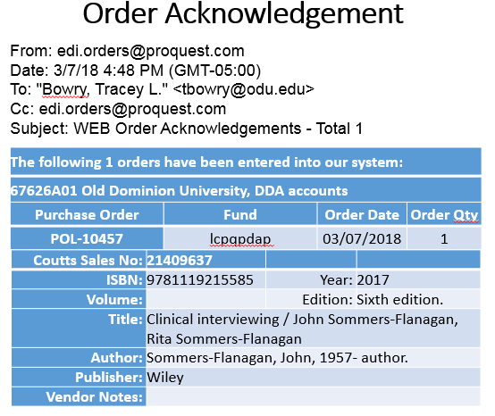
Workflow in Primo
A confirmation message will pop up with information about when the book will be available.
Acquisitions staff will receive an Order Acknowledgement.

Slide 14
4) Workflow in Alma
Once the book is received, Acquisitions staff will
find the order record by scanning the barcode on the book
edit the Receiving Note in order record to include patron contact info

Slide 15
Workflow in Alma
Original “Receiving Note” supplied by Coutts

Slide 16
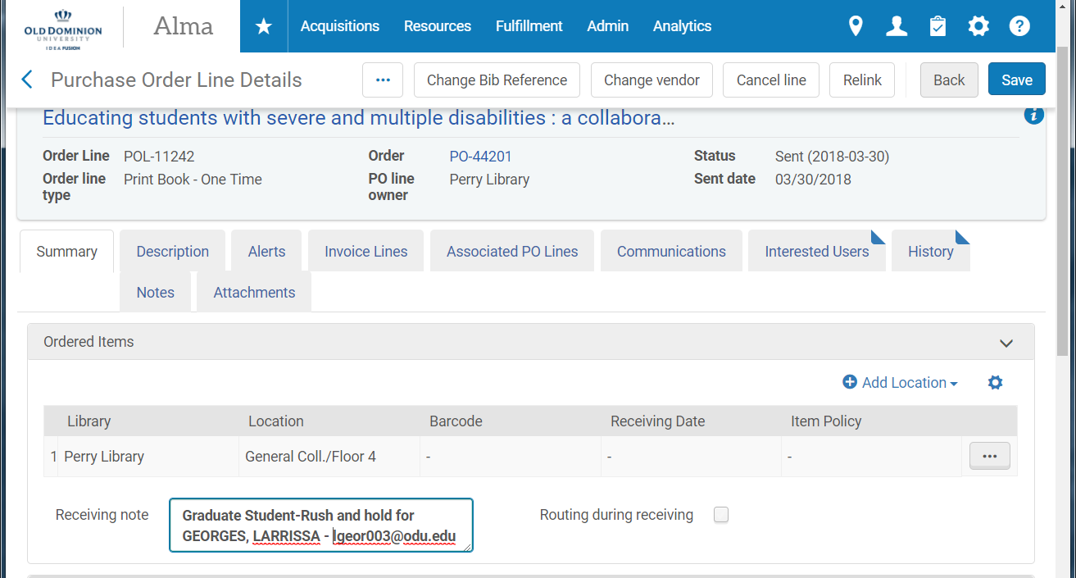
Workflow in Alma
Receiving Note is edited

Slide 17
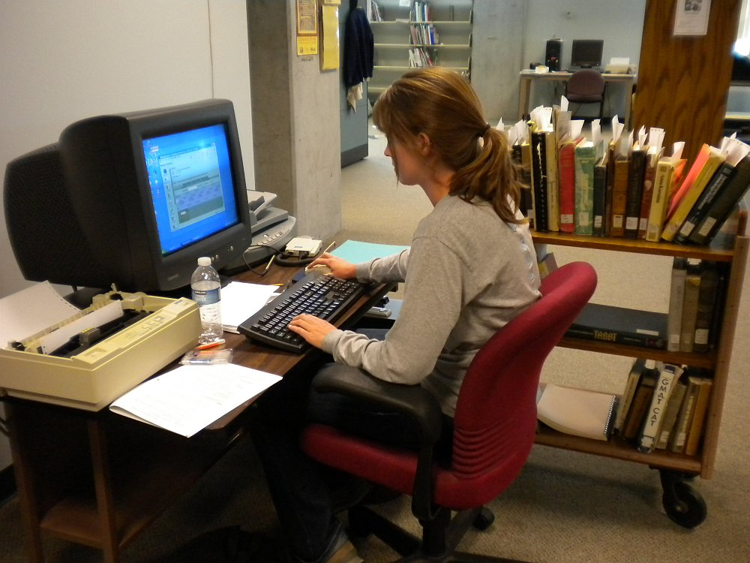
Workflow in Alma
MARC records and EDI invoices
Acquisitions staff receives a notification email from ProQuest that a MARC file is ready on the ftp server.
Acquisitions staff loads the MARC file and the corresponding EDI invoice file.

Slide 18
Workflow in Alma
Access the MARC files at Coutts’ FTP server via import profile in Alma

Slide 19
Receiving Process
Workflow in Alma
Acquisitions staff receives a shipment of shelf-ready books from Coutts each week and:
1) verifies the books against the invoice and reviews the books for damage
2) processes the invoice in Alma and places a slip in the book with the name of the patron who ordered the book
3) brings the books to the Help Desk to be put on hold for the patron

Slide 20
Circulation Process
Workflow in Alma
Once a pDDA book is received at the Circulation Department, Circ staff:
1) scan the barcode of the book to put on hold
2) generate an email notification to the user

Slide 21
And, the user gets the book …

Slide 22
Preliminary Data
Orders by LC Classification
Orders by User Group
Turnaround Time
Loan Data

Slide 23
Orders by LC Classification

Slide 24
Orders by User Group

Slide 25
Turnaround Time

Slide 26
Loan Data

Slide 27
Thanks to pDDA Implementation Team!
Roger Jette Director of Technology, ProQuest Coutts North America
Glenn Wallwork Software QA Engineer Sr., ProQuest Coutts North America
Svetlana Smirnov Ex Libris
James LeFager Ex Libris

Slide 28
Questions?
Contact:
Shixing Wen
(swen@odu.edu)

