Slide 1
Utilizing Natural Language in the Library
How Today’s Libraries are navigating COVID-19 challenges and emerging stronger than ever
Greg Davis, Iowa State University & Mike Rossetti, myLIBRO
Notes:
Good Afternoon everyone. Thank you for taking time to attend this webinar. My name is Venkat and I am part of BigTapp and I take care of products and partnerships. As per this agenda, I will take next 10 minutes in setting the context for this webinar and then hand this over to Ganesh for further discussion and demo. Post that we will take questions.

Slide 2
1
Introductions
2
Recap of Iowa State Alexa Project
3
Natural Language & Flow Assists Accessibility
4
Future of Libraries : COVID Impact & Response
5
Q&A

Slide 3
Iowa State University Project Recap

Slide 4
Why Smart Assistants in Libraries?
50% of teenagers are using voice search daily. (Quoracreative)
60% of smart phone users have tried voice search at least once in the last year. (Quoracreative)
By 2021 25% of digital workers will use virtual employee assistants daily. (Quoracreative)
By 2021, early adopter brands that redesign their websites to support visual and voice search will increase digital commerce revenue by 30%. (Gartner)

Slide 5
Why Smart Assistants in Libraries?
In 2020, AI becomes a positive net job motivator; creating 2.3M jobs while only eliminating 1.8M jobs. (Gartner)
As of 2019 an estimated 35 percent of U.S. households are equipped with at least one smart speaker and by 2025 forecasts suggest that this penetration rate will increase to around 75 percent. (Statistica)

Slide 6
Why Smart Assistants in Libraries?
The most common voice searches on smart speakers are asking for music (70%) and the weather forecast (64%), followed by fun questions (53%), online search (47%), news (46%), and asking directions (34%). (Adobe)
30% of Smart Speaker owners say their speaker is replacing time spent with TV. (Smart Audio Report)

Slide 7
Iowa State Library’s First Try ISU Library Facts
Making extensive use of YouTube videos and DIY postings, we developed an Alexa skill that can give facts about the Iowa State University Library’s artwork, collections, and spaces.
The skill is called: IowaStateLibFacts
Built using free development tools available in Amazon Web Services

Slide 8
What We Learned and the Importance of Partnerships
Significantly more complex voice command interaction skills required compared to IowaStateLibFacts
Found an Alexa Skill development partner that already had a head start in developing library smart assistant skills
Collaborated with the University of Iowa Library and others

Slide 9
Academic Libraries: Prepare to Open the Doors

Slide 10
COVID-19 increased importance of digital services
Scheduling for In-Library Services such as computers, study rooms, printing, etc.
Self-checkout and other touch-free services ensure student & staff safety and convenience
Need to connect numerous digital services within one solution, rather than individual apps
Curbside/Contactless Pick-up

Slide 11
What is the top priority for re-opening?

Slide 12
Common Re-Opening Questions

Slide 13
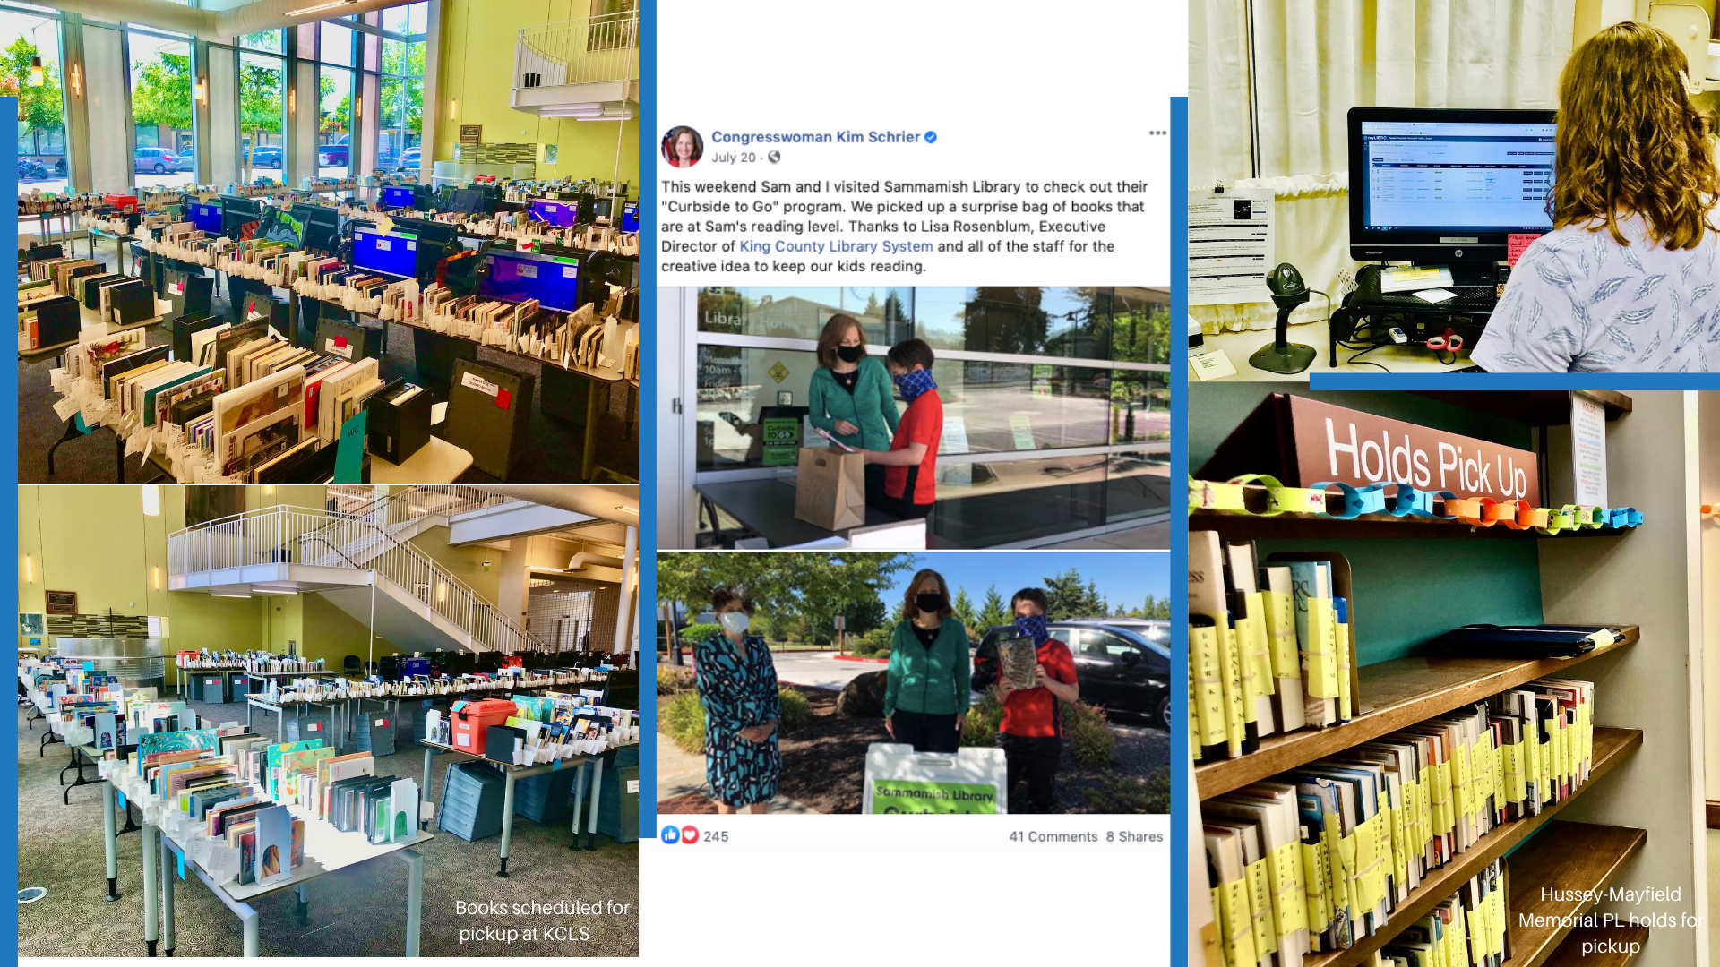

Slide 14
Summary: Re-Opening Plans
Phase 1
Phase 2
Phase 3
Book lending through contactless services
Public libraries have opened by providing patrons with curbside pickup. Academic libraries are considering contactless services.
Limited in-library space usage
How will libraries manage the amount of students allowed in their space if they have to limit capacity?
Increased access to in-library services
Libraries have to prepare to organize students’ access to limited in-library services, with new social distancing guidelines.
Contactless service and managing call-in orders
In–library space reservations for students
Student self-checkout

Slide 16
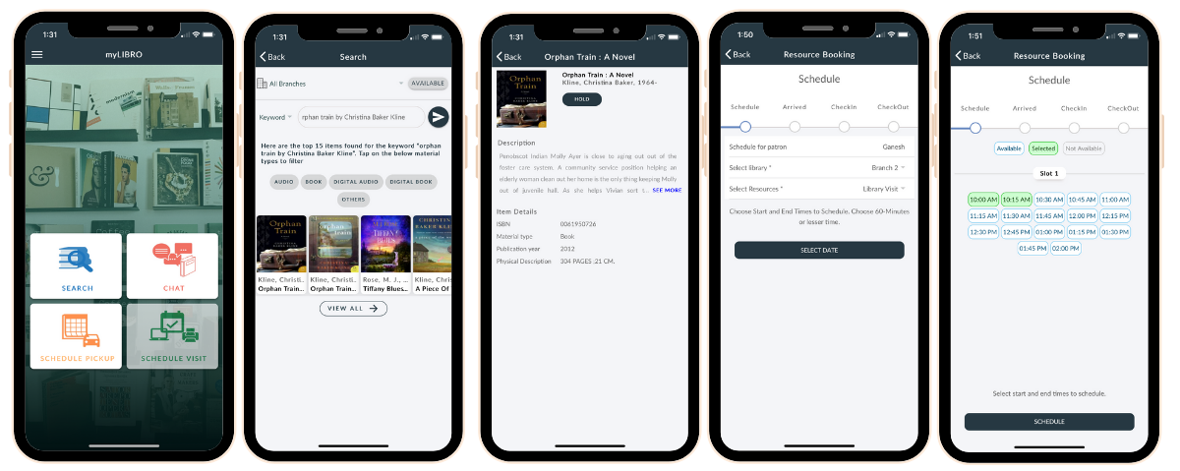
Student app for scheduling appointments & pick-ups
One myLIBRO Pickup = Reduction of two phone calls
Saving 100s of hours for staff

Slide 17
myLIBRO has helped libraries reopen all across the nation
Scheduling platform makes it easy to organize & manage orders
In-library services: Library Visits, Printing, Computer Reservations, passport photos, Room Reservations
Connects with Library’s ILS systems
Self check-out allows for less contact & increased safety

Slide 18
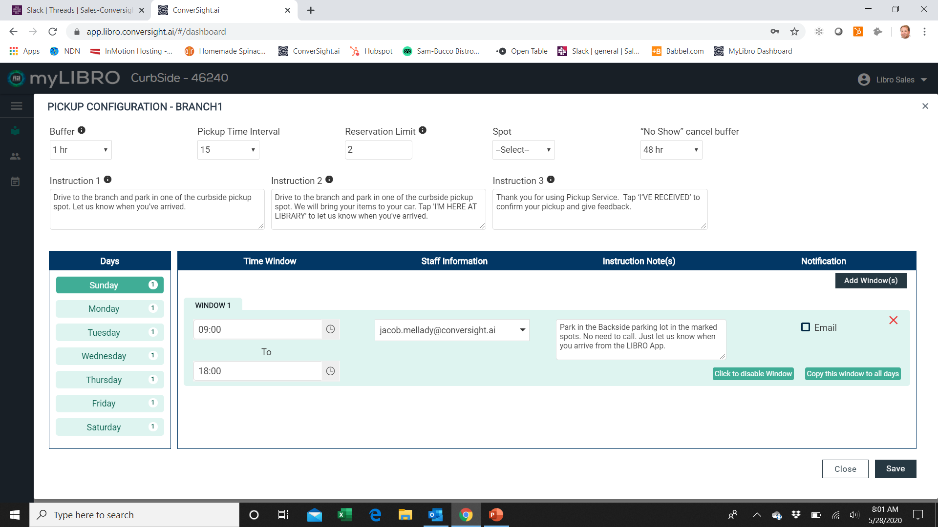
Intuitive Admin Portal Customizes Library’s Processes

Slide 19
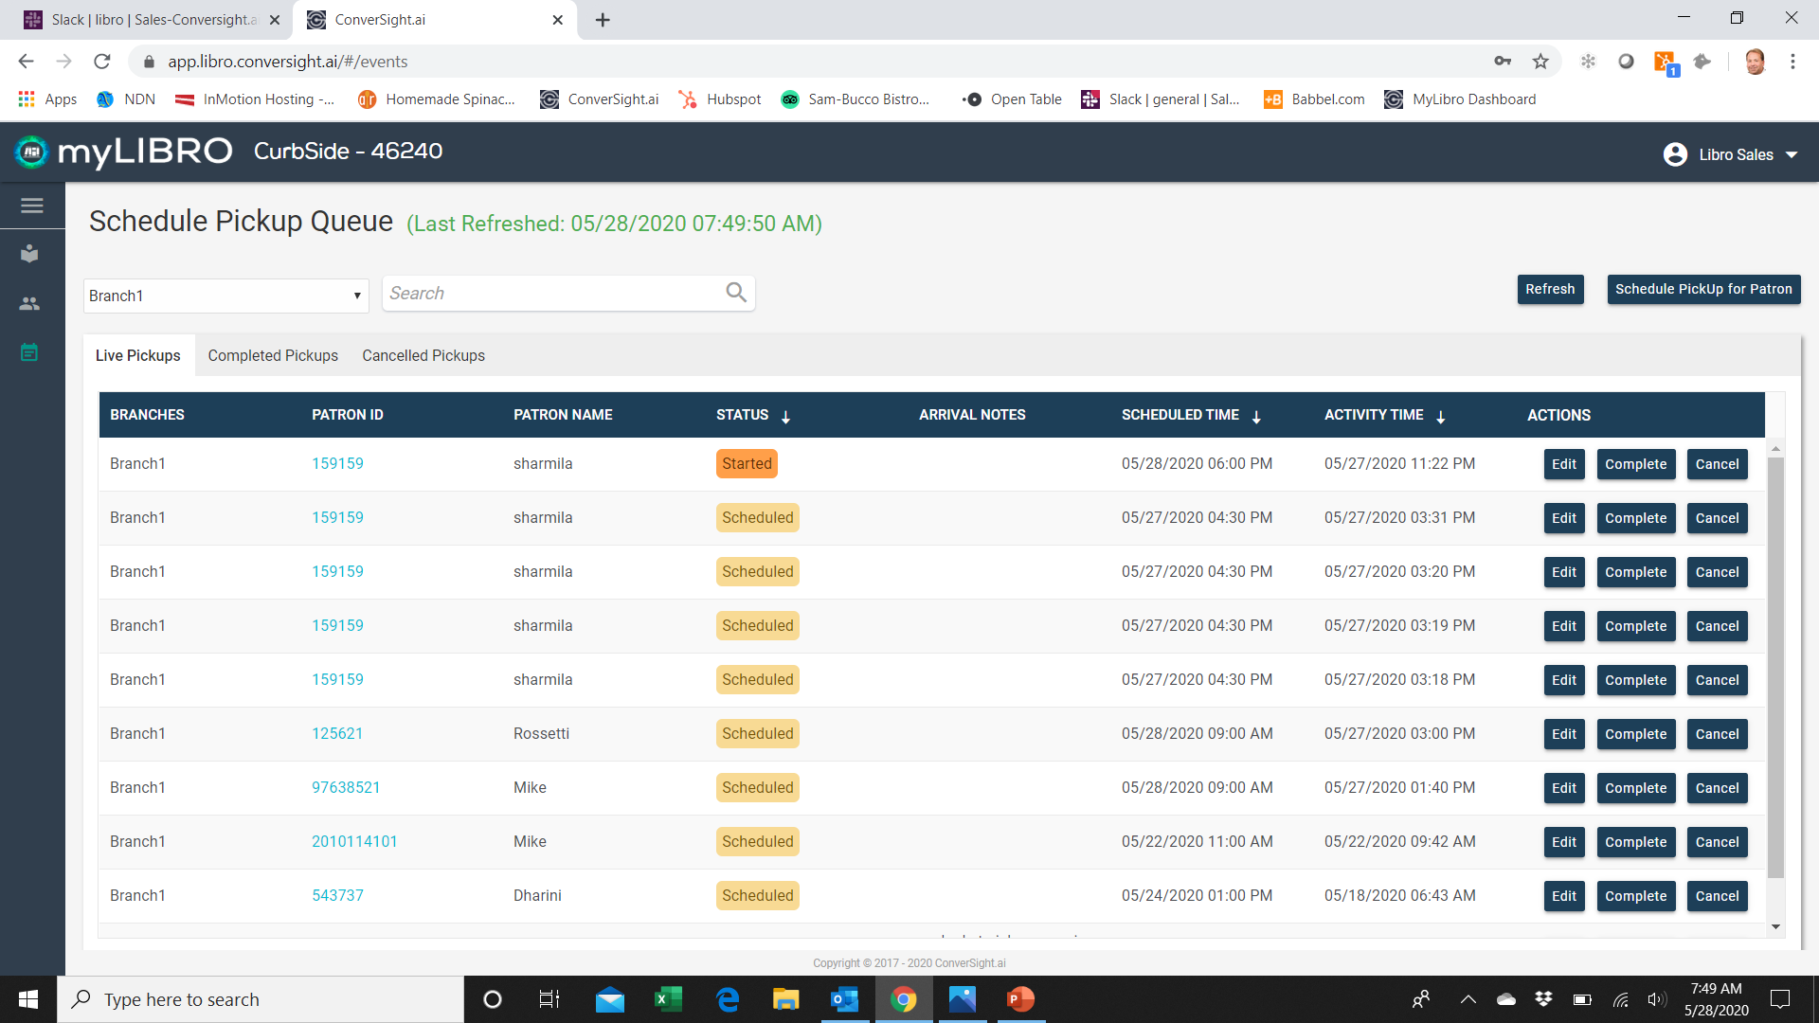
Real-Time Dashboard Makes Fulfillment Seamless

Slide 20
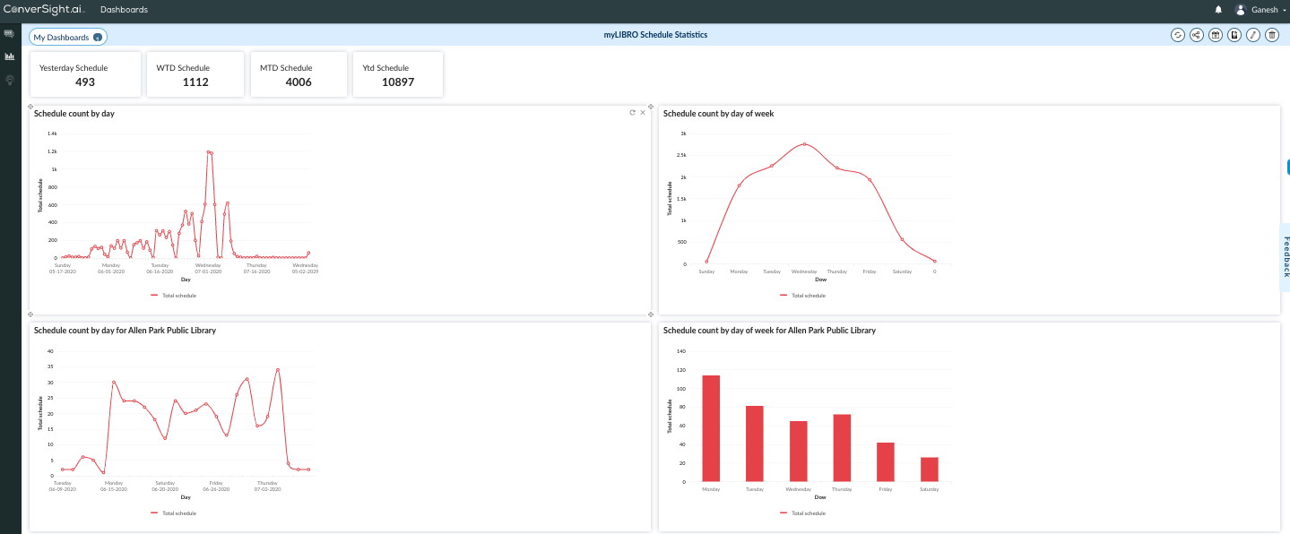
Dashboard Reports Usage & Patron Satisfaction

Slide 21
davisgr@iastate.edu

