Slide 1
Ex Libris Update for eBug
Jane Burke
Vice President, Strategic Initiatives

Slide 2

Post pandemic
Discovery
Alma
RapidILL and Rapido
Rialto
Leganto
Esploro
Content Operations
Customer Success
Diversity. Equity and Inclusion
Agenda

Slide 3











3,400+
2,000+
530+
240+
30+
750+
Notes:
Libraries that joined the community – include some numbers
Many of you are attending ELUNA for the first time this year

Slide 4
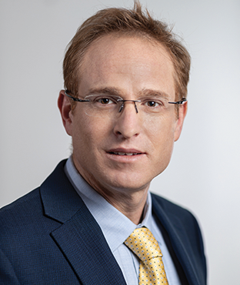

12 Months of Change
At Ex Libris
  New Management
  New Sales Model
Acquisition
In the World
Oded Scharfstein

Slide 5
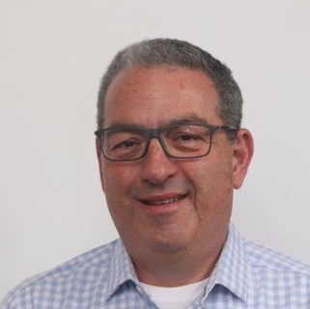











Leading the Business Units
Shlomi Kringel
Tamar Sharir Beiser
Guy Ben-Porat
Learning & Research
Library Management
Discovery &
Resource Sharing
Notes:
Shlomi

Slide 6



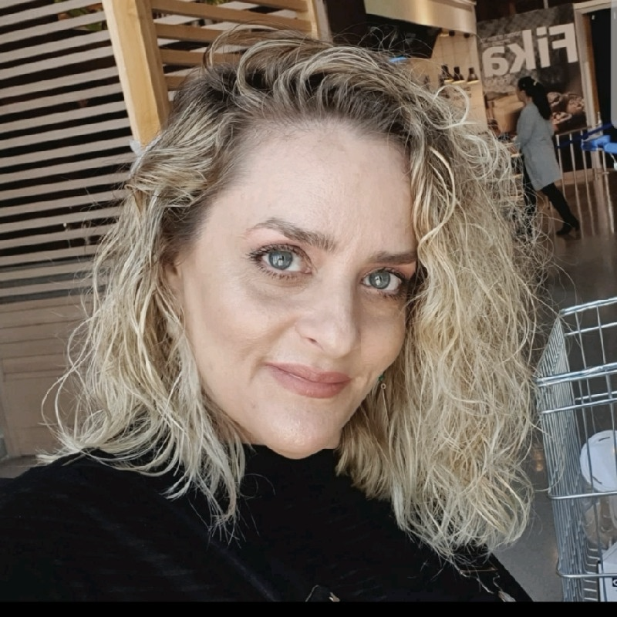

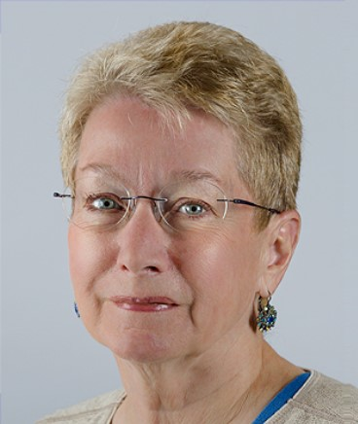
Customer Satisfaction & Experience
North America CX Management
Matt Baker
Customer Support, North America
Melissa Hilbert
Professional Services, North America
Shelley Hostetler
Customer Success
Global CX Management
Adi Fubini
Global Tech Support
Yaniv Cohen
Global Professional Services
Jane Burke
Strategic Initiatives

Slide 7






Ex Libris and ProQuest Integrated Salesforce
Unified Salesforce for ProQuest and Ex Libris
Go Live in Q3 2021
New Customer Portal
Close cooperation with the community and ELUNA
Improved holistic experience based on Salesforce best practices
  Latest Salesforce technologies

Slide 8
What We’re Hearing from You
Collections
  E-everything
  Mass digitization need for controlled digital lending
  Metadata is critical
  Collaborative collections
Collaboration in everything
2021
Reopening =
New Normal
Virtual learning is now the norm
Diversity, equity, inclusion in all things
Recognizing the power of the cloud
Respect for library increases, but so do budget pressures
Notes:
Acknowledge Christopher Cox, dean at Clemson
Access matters – shift in perception of collections – must be electronic
PQ Books example
It must be easier to manage these “wiggly” collections
Library can support virtual learning – new, fresh resources
“Harnessing the power of the cloud” -- recognizing this opportunity to do things in new ways
Resource sharing
Collaborative Collection development
2021 is year of big experiments -- nod to open source
Collaboration – in all things
You are participating in many communities
Library viewed as being responsive

Slide 9
What We’re Hearing from You → Our Focus Areas
Collections
  E-workflows – automation, selection, optimization, simplification
  Standardizing CDL within Ex Libris solutions
  CDI-based services, rich metadata
The power of the cloud
  Performance and resilience
  Connected and adaptable library services
Library Impact
Teaching, learning and
research partnership
  Learning resources
  Visibility of research publications & data
  Mobile experience
Diversity, equity, inclusion
  Product enhancements
  Community DEI initiatives
Collaboration
  Resource sharing
  Community
Notes:
Acknowledge Christopher Cox, dean at Clemson
Access matters – shift in perception of collections – must be electronic
PQ Books example
It must be easier to manage these “wiggly” collections
Library can support virtual learning – new, fresh resources
“Harnessing the power of the cloud” -- recognizing this opportunity to do things in new ways
Resource sharing
Collaborative Collection development
2021 is year of big experiments -- nod to open source
Collaboration – in all things
You are participating in many communities
Library viewed as being responsive

Slide 10



Unchanged: Ex Libris Core Mission: Supporting Your Success
Academic Libraries Market
ProQuest-Ex Libris
EdTech Strategy
Key Enablers
Collaboration with customers to boost innovation
Robust higher-ed cloud platform
World-class customer experience
Open ecosystem and content neutrality
Research & Student Solutions
Notes:
To execute on our strategy, Ex Libris rely on few core assets and competences.
The first being the Ex Libris higher-ed world class cloud platform and infrastructure. This platform provides unified service across solutions – shared data models, shared content, joint analytics, security, APIs, and more. By having a unified platform we can develop new solutions quicker and help customers adopt them with greater ease.
The second being the experienced teams that we deploy to manage the Customer Experience. Our products and services are rich, robust and constantly evolving. Our customers need us to support and guide them closely as they implement them to achieve the success and unleash their full potential.
And last, there are two critical values, content neutrality and openness, that are always at the core of the Ex Libris strategy. These values are critical in gaining customers trust as they deploy our products and services into their core library operations.

Slide 11
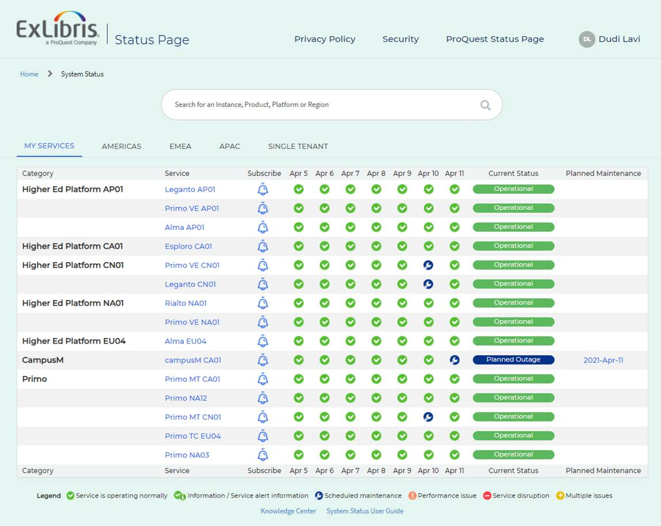
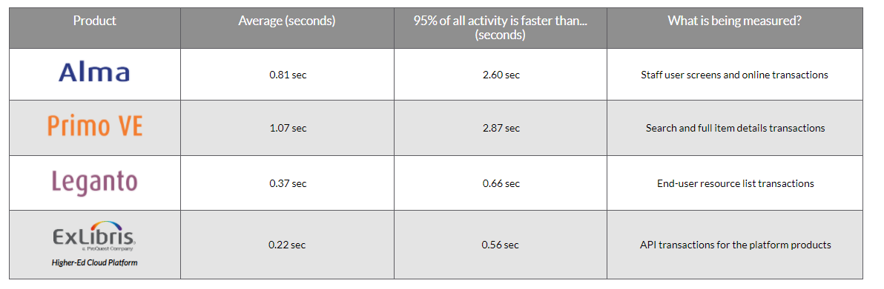

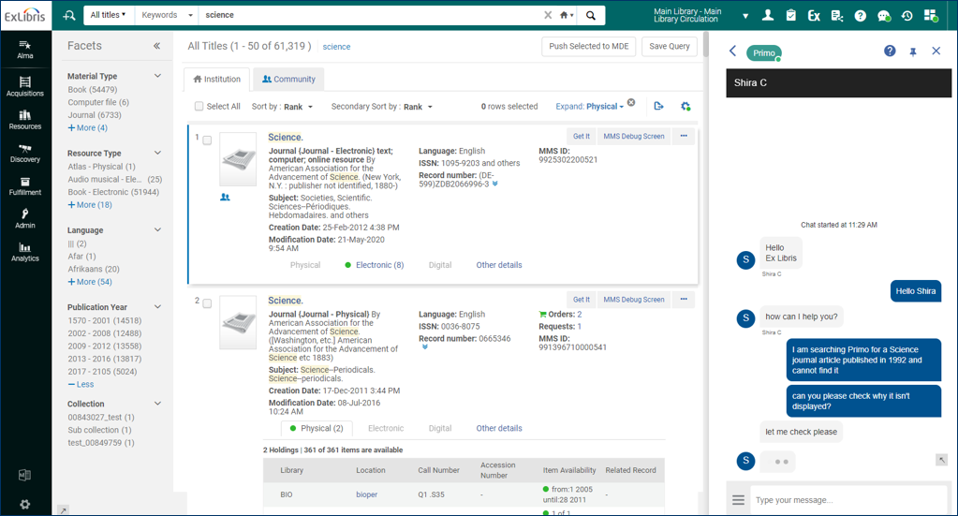
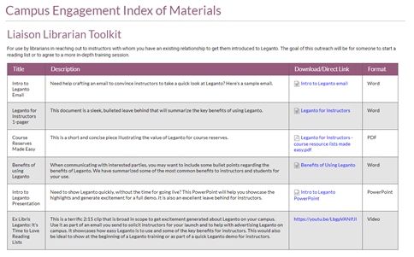
Customer Satisfaction & Experience – Snapshot of Key Initiatives
New Status Page
Online Performance Reports
Alma First-Year
Success Program
Campus Engagement & Rollout Programs
Online Chat Support Alma, Leganto, Primo VE

Slide 12
Discovery

Slide 13

Flavors of discovery
Primo VE
Summon
CDI for all
Continuous development
Joint content operations
Joint discovery services
Part of Ex Libris platforms
  Knowledge Center
  Idea Exchange
  Status Page
  Dev. Network
Primo

Slide 14



CDI – a scalable index, built for growth
4.5 billion records, 10% annual growth
3 Instances, powered by SolR
2558 live institutions, 354 in implementation
44Mio searches/ week average

Slide 15

CDI for discovery – Focus areas
  Accelerating rights processing to 24 – 48 hours
  Enhancing metadata quality
  Improving linking capabilities
  Enhancing search and ranking
  DEI data work in collaboration with the user group and NISO
  Continuous work on
    Rights processing
    Data quality
    Linking
    DEI
  Additions and enhancements to features based on data relations, e.g.
    “related items”
    “more like this”
  Enable all customers to move to CDI
  Switch everyone live
quicklinks
2020–2021
2021–2022
2022–2023

Slide 16

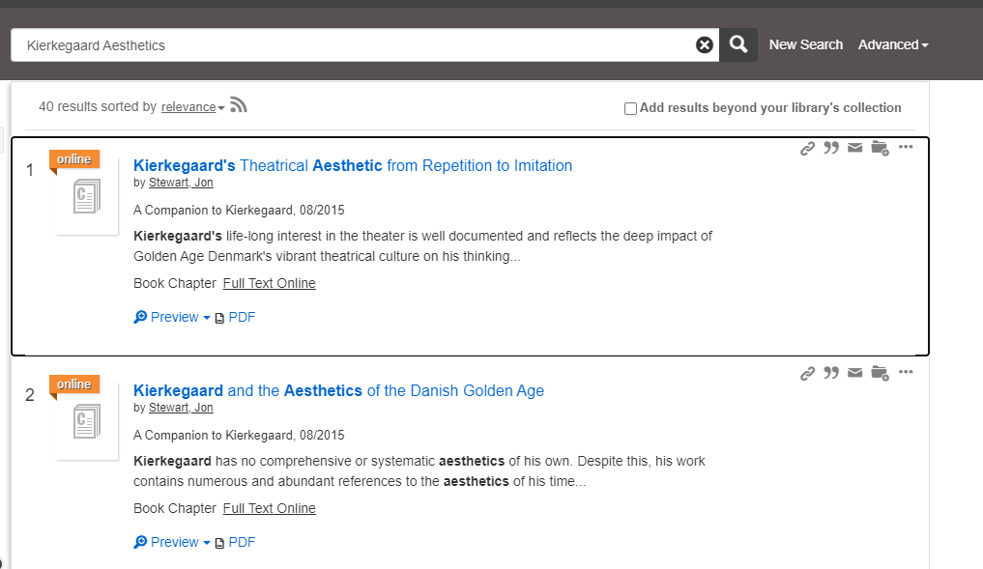
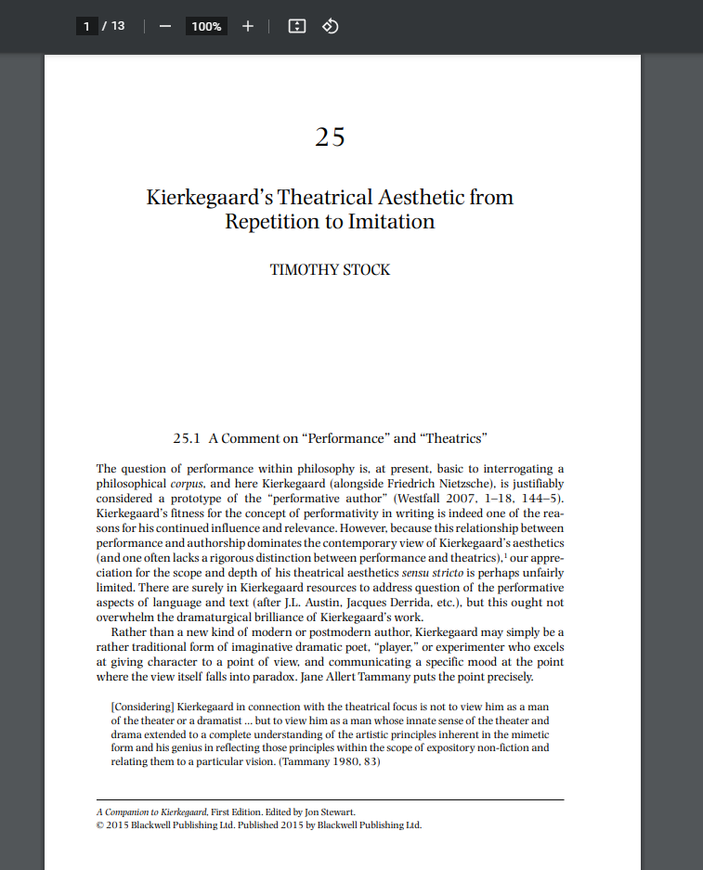
quicklinks – From citation to pdf/html full text in one click

Slide 17


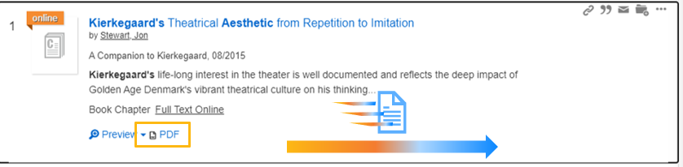
User Experience
Accessibility
  Working with
  WCAG 2.1
  Publish updated VPAT
  Accessibility standards applied to new features
Streamline core patron workflows
Ongoing Development
  quicklinks
  Data relations
  Search & ranking
  DEI support
Notes:
All our users, regardless of ability, need to be able to work with Ex Libris products. We are committed to provide a fully accessible experience with our products​
In the last year we have worked to improve the compatibility of Ex Libris Products such as Primo and Alma with the latest standard of WCAG 2.1 ​
We are working with , a leader in Digital Accessilbity. They test and verify our products​
Starting January 2021 Primo is compatible with WCAG 2.1 and Alma will be by the end of 2021.​
The improvements are delivered throughout the releases ​
For Accessbility statements see Ex Libris Knowledge​

Slide 18
Primo VE Adoption
1113
780
Mass Adoption
250
34
1
ELUNA 2017
ELUNA 2018
ELUNA 2019
ELUNA 2020
ELUNA 2021
Today

Slide 19


Focus on Primo VE Product Quality
# of All Priority Defects Trend
Quicker resolution
Continuous decrease of defect backlog while onboarding new customers
Higher quality
Continuous decrease in new defects

Slide 20
Alma

Slide 21

Alma Product Focus Areas
Quality
Quality
Simplicity and Usability
Deliver product excellence by implementing R&D best practices
Streamline core librarians’ workflows and augment staff efficiency by introducing UX
and product innovation
Extensibility
Serviceability
Connect to the academic ecosystem
via integrations & applications
Provide best in class customer support and operations for system librarians

Slide 22
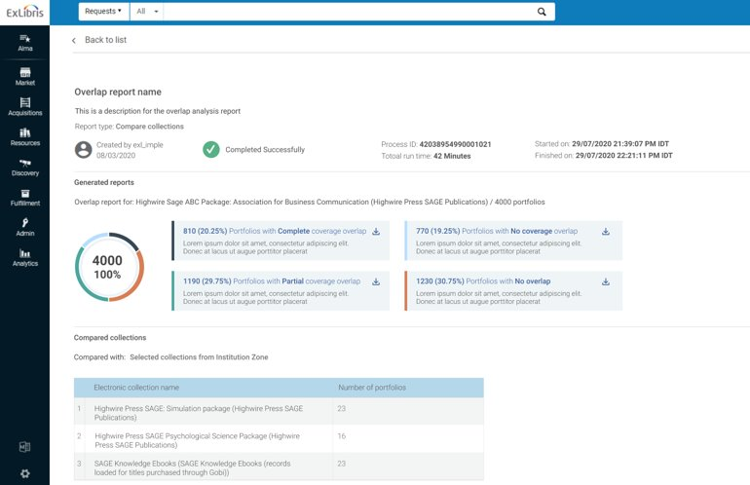
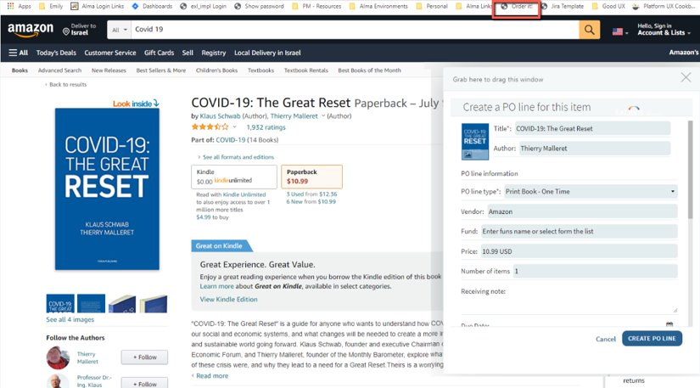
Simplicity
Create and work with a new SML focus group
Significant improvement in user experience
of key workflows
Introducing new UI concepts
Simplification (SML) Hackathon
Simplify Analytics
(e.g. Introduce and improve new OTB Reports)
Re-organize menus and improve navigation
Implementing wizards for common workflows

Slide 23

Extensibility
Turnkey integrations with key systems
Create engaged community around
Cloud Apps usage through joint
development efforts
(hackathons with UGs, competition, etc.)
2.5B+ API calls in 2020
CLOUD APPS
Launched H2 2020
30 Apps and growing
Over 250 Institutions using
Hackathon in ANZ
New Apps Created by
  Institutions
  Region (China, Japan (plan)

Slide 24





Quality
Aggressive quality improvement plan:
Focus on all bugs, not just high
Focus on prevention vs. resolution
Increase automation coverage
Build a long-term strategic plan
to improve content quality
Cultivate developers’ quality
mindset/culture
Notes:
Start with Quality <and go to slide 5 and change the order, top left first>

Slide 25

Serviceability
Release Cadence
Documentation uplift
Customer experience focus
Alma 1st year program
Chat support

Slide 26

Performance – 2020 Highlights
UI ▸ all staff screens
All API ▸ transactions
Average ▸ 35% reduction | 95% ▸ 30% reduction
Average ▸ 50% reduction
UI Performance ▸ Average
UI Performance ▸ 95%
UI Performance ▸ Average
API’s Performance ▸ 95%
0 – 1.5
1.5 - 3
4+
0 - 3
3 - 5
5+
0 – 0.5
0.5 – 1.5
1.5+
0 - 1
1 – 2.5
2.5+
2
2.5
3
3
4
1
1
1.5
2
1.5
3.5
2
5
1
4
0.5
1.5
1
6
0.5
2.5
0.5
4.5
0
5
0
7
0
2
0
3
End of 2020: 0.8 Sec
March 2020: 1.25 Sec
End of 2020: 2.8 Sec
March 2020: 4 Sec
End of 2020: 0.25 Sec
March 2020: 0.5 Sec
End of 2020: 0.9 Sec
March 2020: 1 Sec
Notes:
Asaf

Slide 27
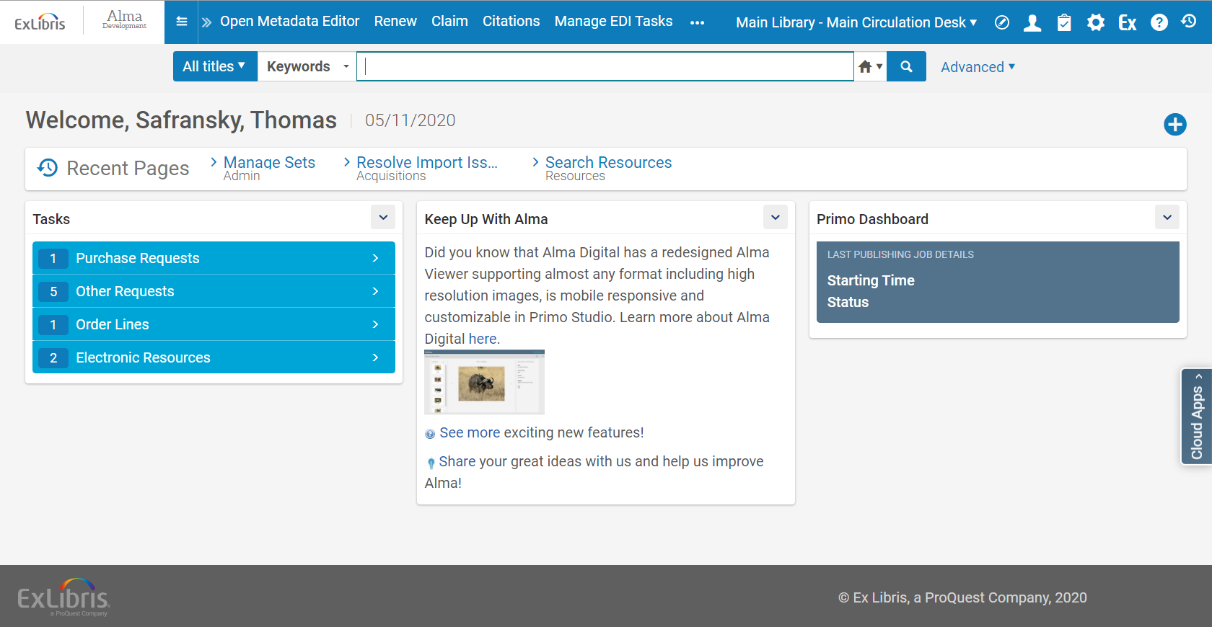
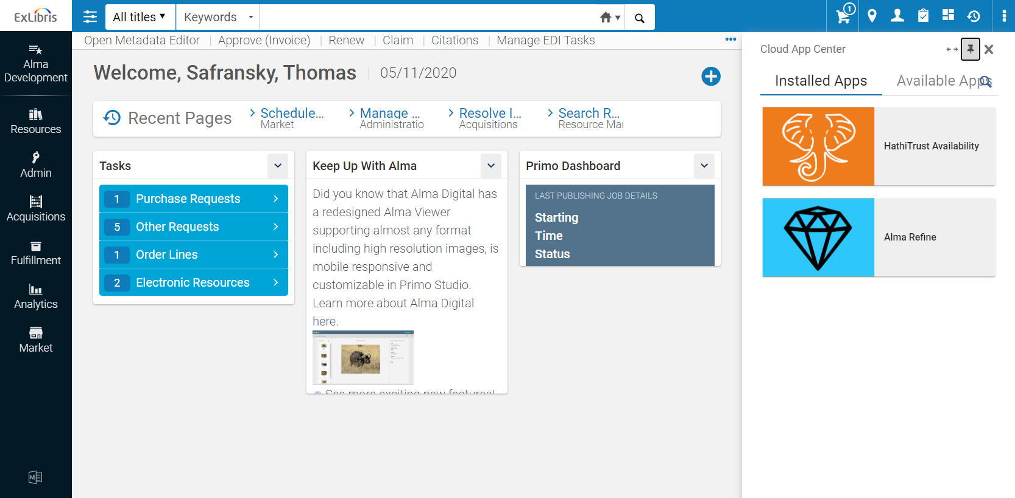
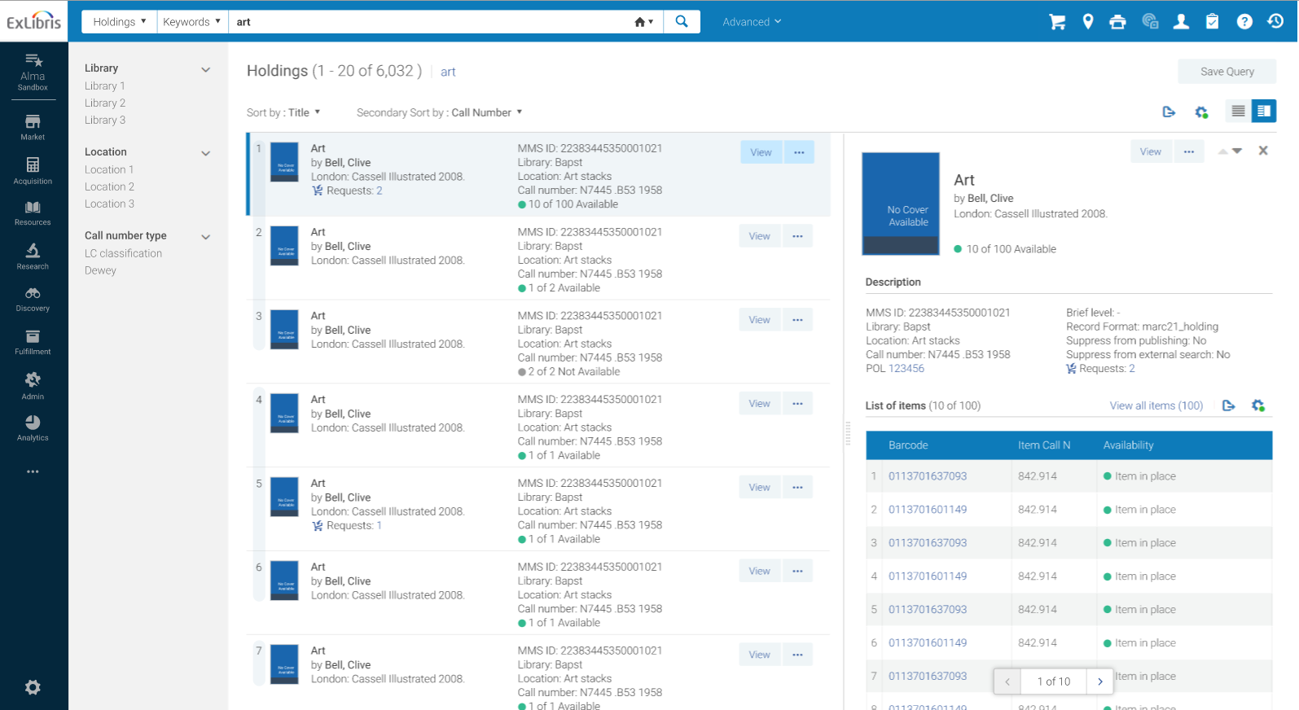
User Experience – An ongoing commitment
1
New UI
2
New Concepts
  New layout
  Side by side
  Slide out
  Cards
3
Apply
  Acquisitions
  Repository searches
  Configuration
  More…
Notes:
2016-2018 – 1
2019-2020 – 2
2021-> - 3

Slide 28
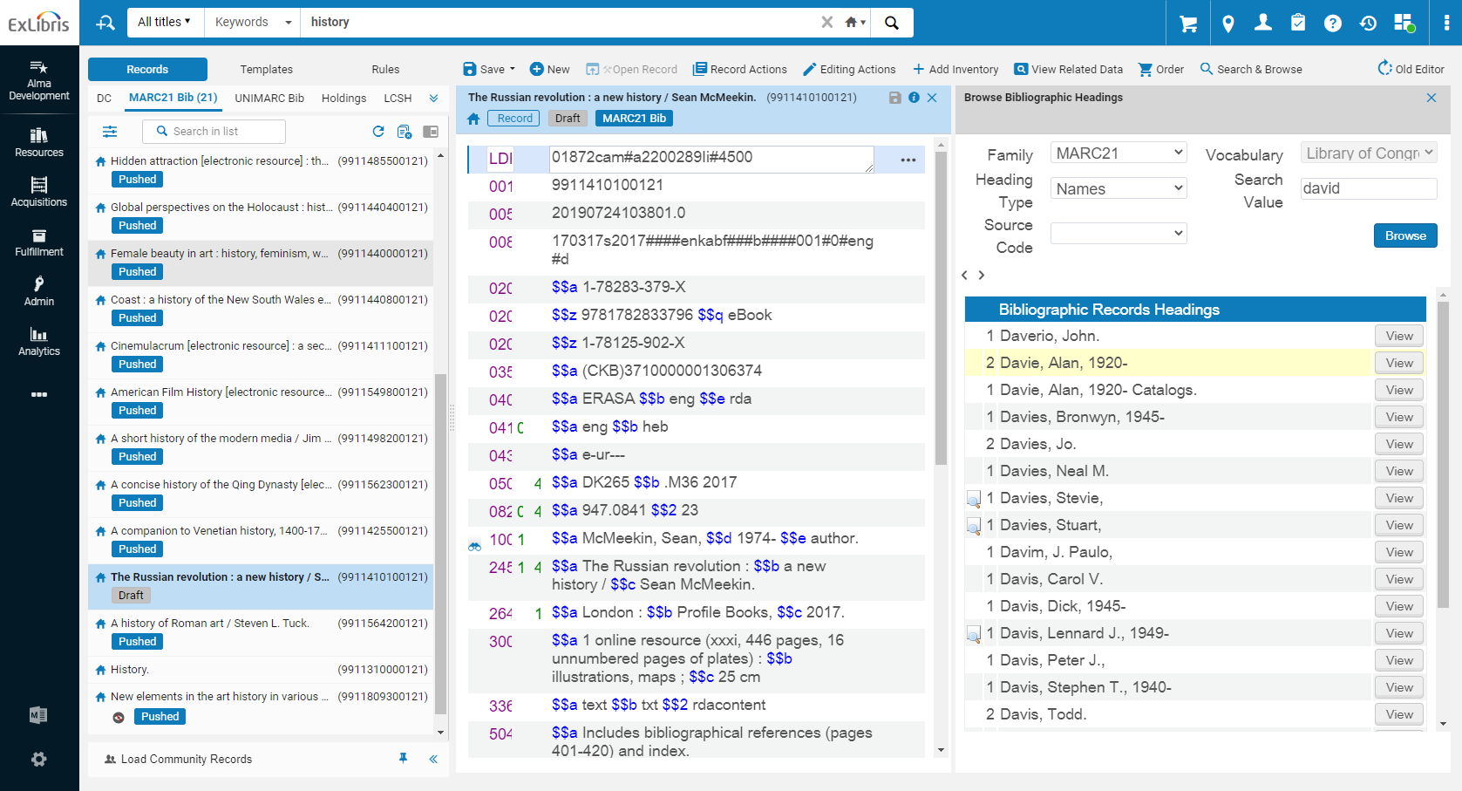
New Metadata Editor – just a reminder
Last functionality gaps now filled
Support for “classic” MDE ends in October

Slide 29

Focus on Alma Product Quality
50% Reduction in High Priority Defects
50% Reduction in Regressions
50% Reduction in Defect Mean Time to Resolution

Slide 30

RapidILL/Rapido Product Update

Slide 31
A global community focused on a high level of resource sharing
An increasingly rich and deep collective collection
Improved match rate
Better 24/7 coverage
The dynamic routing algorithm works even better with added community members and new time zones
RapidILL consists of nearly 500 community members worldwide and growing

Slide 32
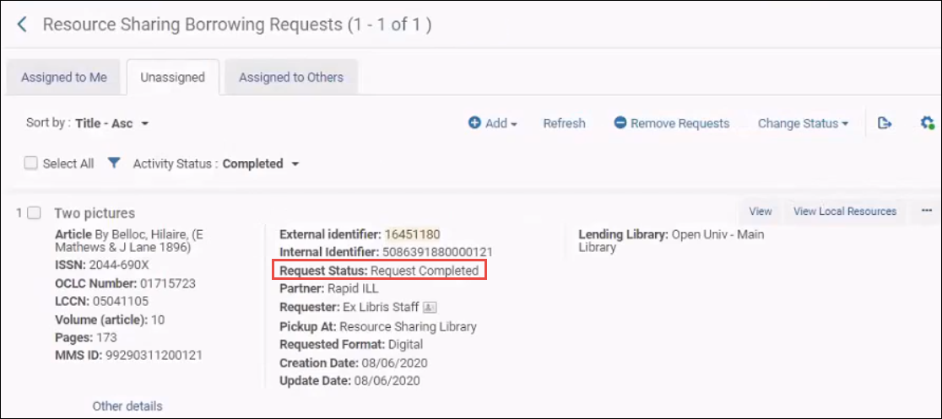

RapidILL Integration with Alma
Supports full borrowing and lending workflows
Integrated into the Alma Resource Sharing workflows
Automated end-to-end borrowing
Statistics through Alma Analytics

Slide 33

Internet Archive – RapidILL Pilot
The Internet Archive is an American digital library with the stated mission of "universal access to all knowledge”
Focus on providing access to their collections through library resource sharing
Collections include print journals, microform and monographs
RapidILL activity includes article and chapter requests
Pilot numbers – February through May 17:
1,810 article and chapter requests
1,712 requests filled 95% fill rate
Average TAT less than one hour
Over 100 libraries have participated in the pilot

Slide 34
Rapido as an enabler for agility is focused on:
Transforming how we provide services to our patrons
Providing a wide community for sharing
Focusing on automation and unmediated processes to meet demand
Finding solutions to future needs like ebooks , Controlled Digital Lending
Notes:
Cornerstone: users and their experience

Slide 35
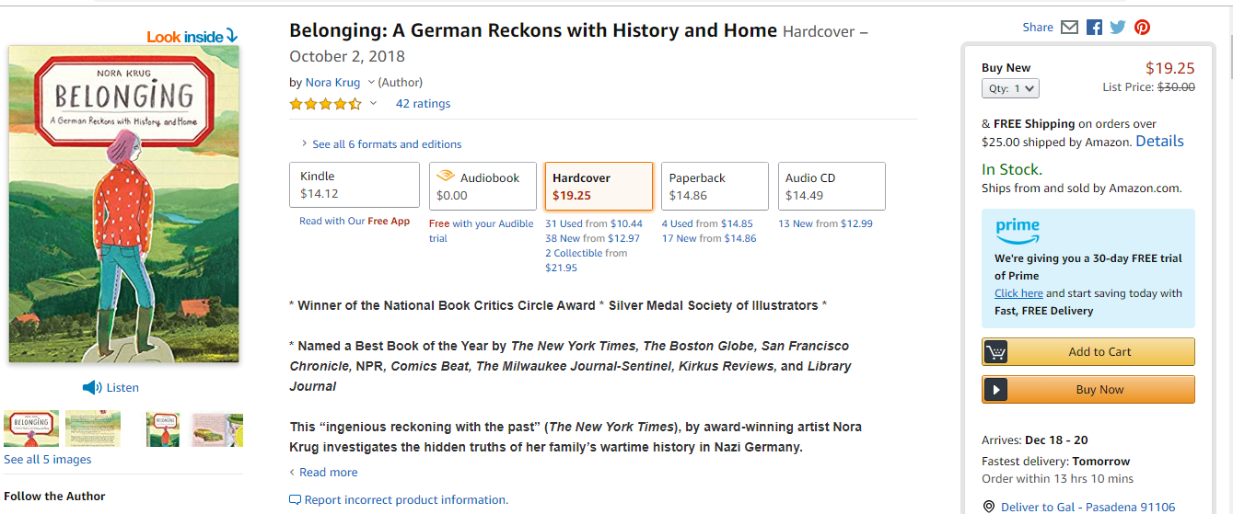
User experience and expectations
Notes:
Amazon experience
-meeting users at the point of need
-all different options of obtaining the desired material, kindle, audiobook, harcover, paperback
-delivery times

Slide 36
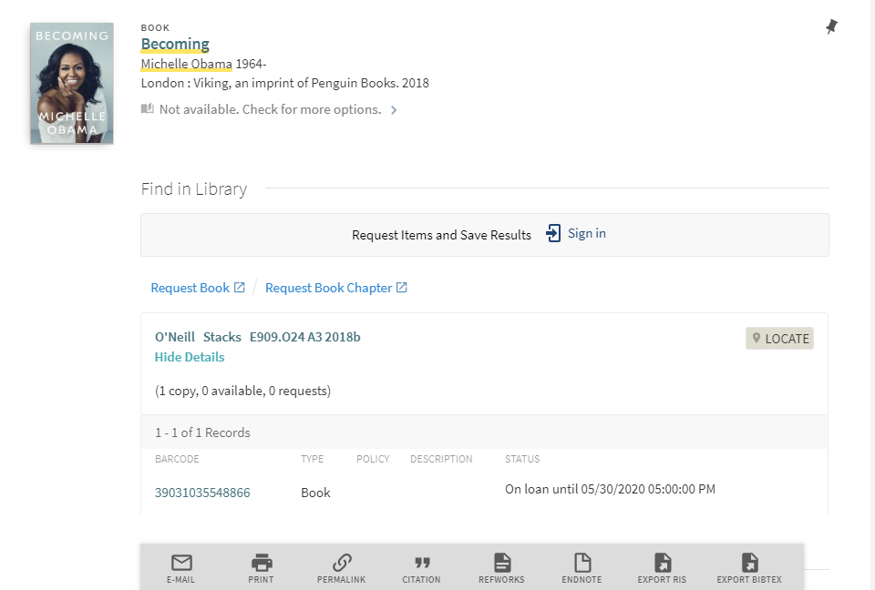
Move from a library focused experience
Notes:
In library discovery, typical experience. If a library doesn’t have what you are looking for, presented with these options
-Request it button, ILLiad, Worldshare, maybe multiple links
-when do I get it?
-might look for other ways to obtain

Slide 37
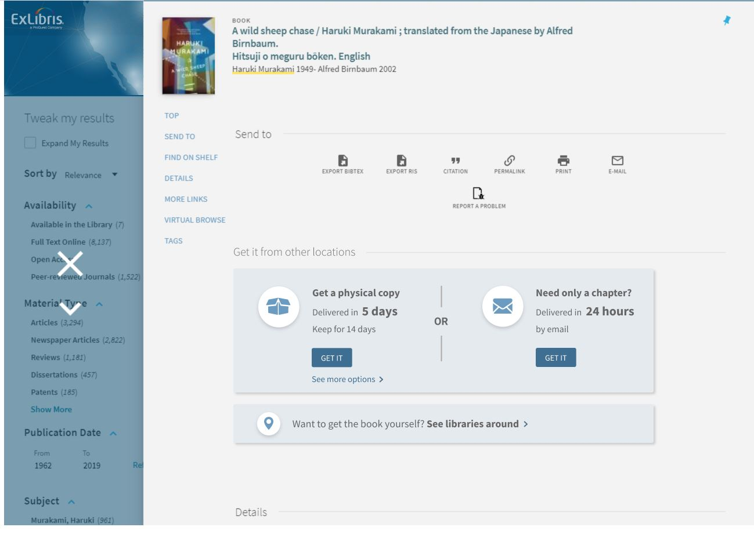
To a patron intuitive service
Notes:
With Rapido, offering services at the point of discovery in real time
-calculating the best option or alternative, including terms of use
-Get a physical copy, keep for two weeks, or maybe only need a chapter and you can receive within 24 hours
-language that is clear, relevant, transforming the user experience at the time they need

Slide 38
One platform for all communities of sharing
Rapido member
Courier group \ consortia
Next priority – e.g. nation wide
Other Resource Sharing solutions
Rapido
External partners
Notes:
Similar to how RapidILL works, providing flexibility for how you work with your partner libraries
-pod structure and priority

Slide 39
Rapido Main Initiatives
Production
Get all the EA and Dev partners live
CDL
Controlled Digital Lending
Eco-System - Integrations
ILLiad, ReShare, IDS, RapidR
eBooks
Resource sharing of eBooks/pilot with PQ
Rapido for Non-Alma
Conceptual/HLD + estimation
Resource sharing fees
Interlibrary Loan Fee Management

Slide 40


Resource sharing – part of a bigger picture
I need to read it
I need to cite from it
Which resources should I own?
Resource sharing as part of a collective collection approach
When you plan to buy an item: see which other libraries around you hold a copies
When you lend an items several times, should you acquire it?
Is there an open access alternative
Which resources should I loan?
I just need to find it

Slide 41
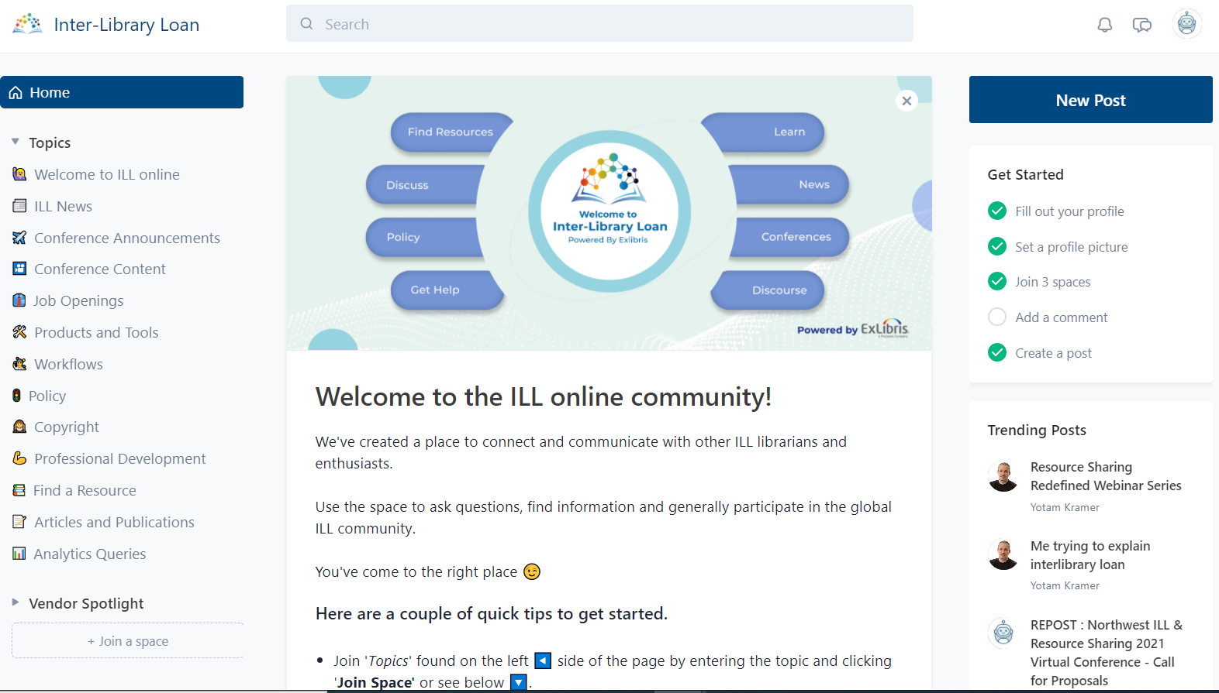
A new community platform - https://ill.circle.so

Slide 42


Slide 43

Meet ProQuest Rialto
ProQuest Rialto is designed for today’s librarians to be a single integrated experience enabling evidence based, data driven decisions.
.
Comprehensive Neutral Marketplace
Millions of electronic and print books from thousands of publishers
Seamless Workflow
Built on the Ex Libris Higher-Ed cloud platform
Recommendation Feeds and Selection Plans
power decisions based on outcomes
Easy to Use
User friendly design is simple to learn, navigate and use

Slide 44
Naturally efficient workflows
How? Users perform all work in one system.
Rialto is embedded in the Ex Libris Higher Ed platform, Alma
No need to wait, check back, or synchronize—information is embedded in real-time
Tasks are proactively pushed to users’ attention
Result: Time-saving efficiencies and better coordination among library staff

Slide 45
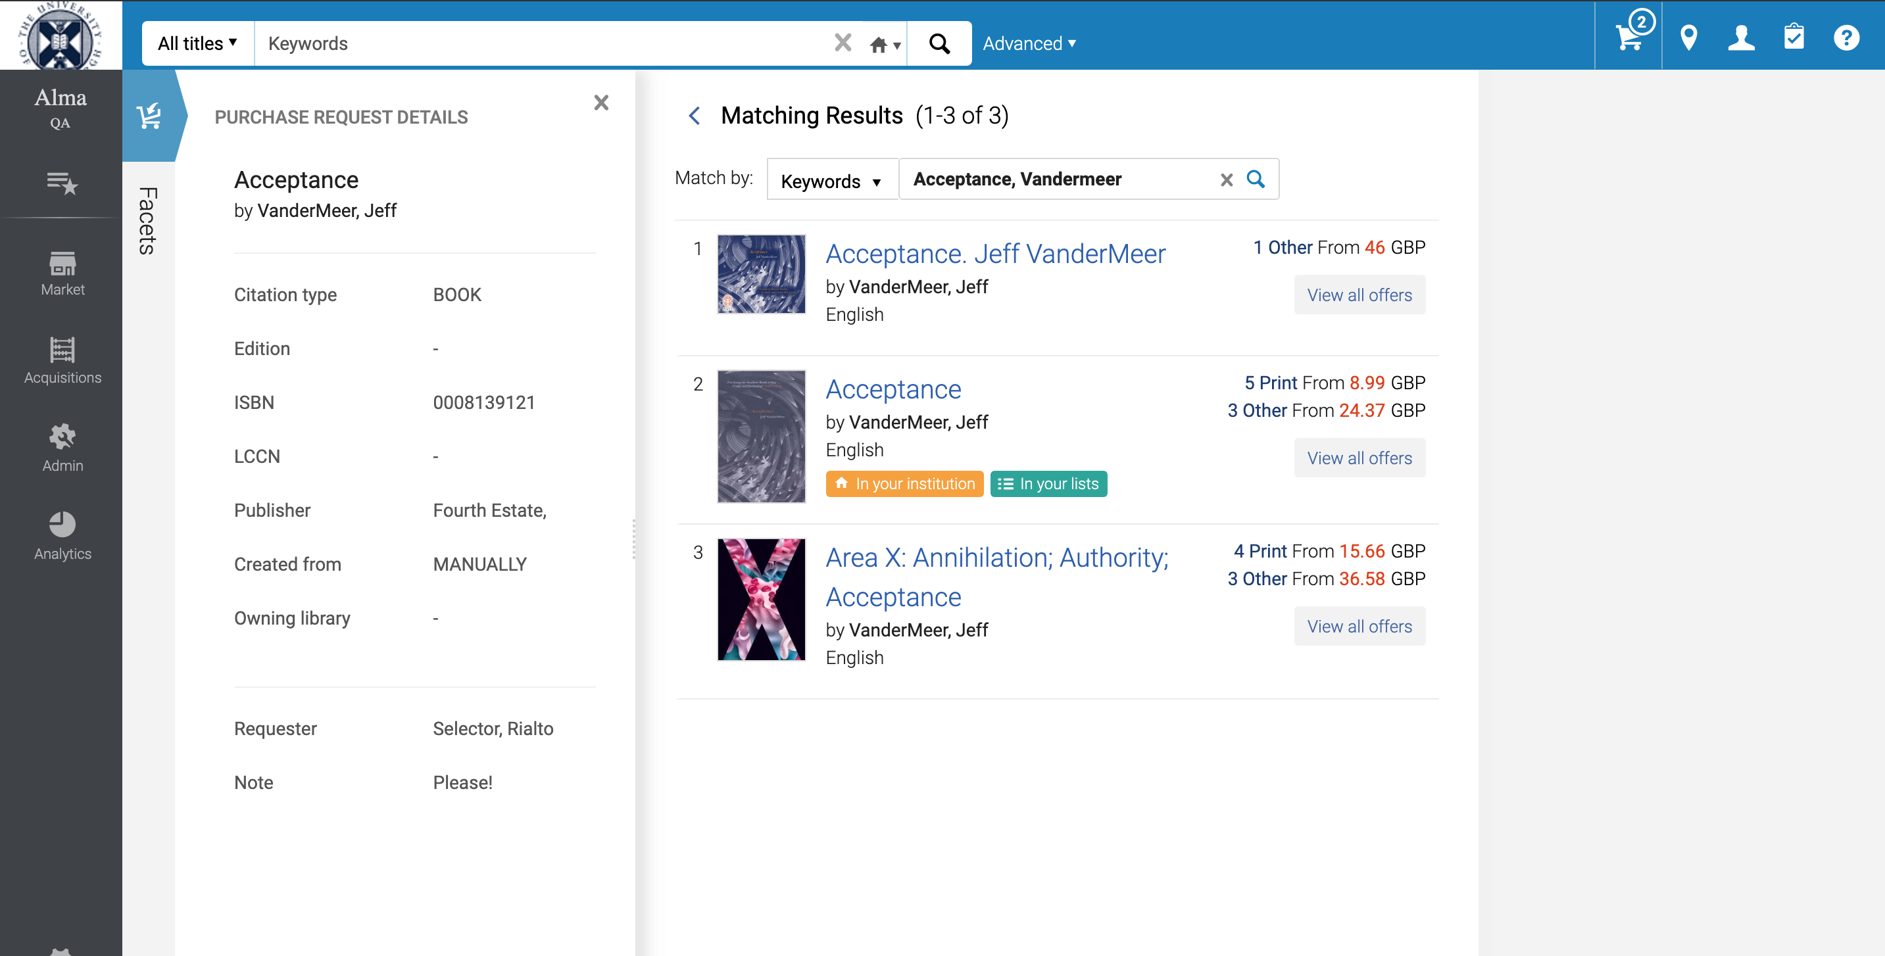
In Rialto: One click into the market
Title, author in keyword search
Holdings &
List indicators
Purchase request details

Slide 46
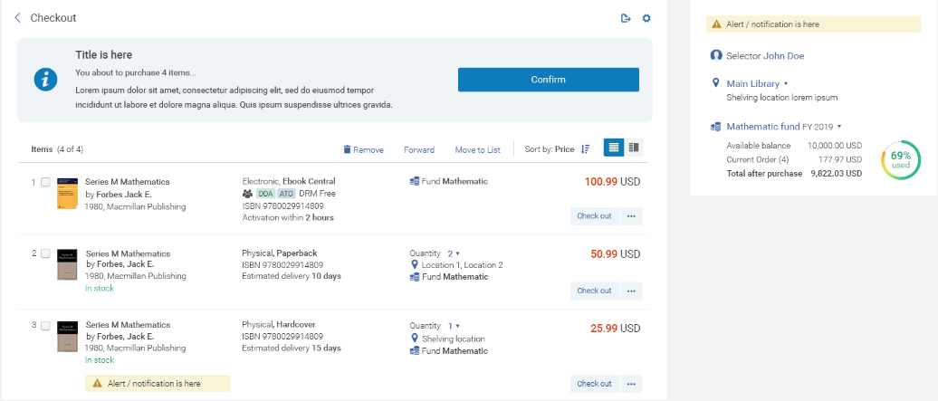
Ordering Approval & Checkout
Fund and location information
Real-time funding

Slide 47
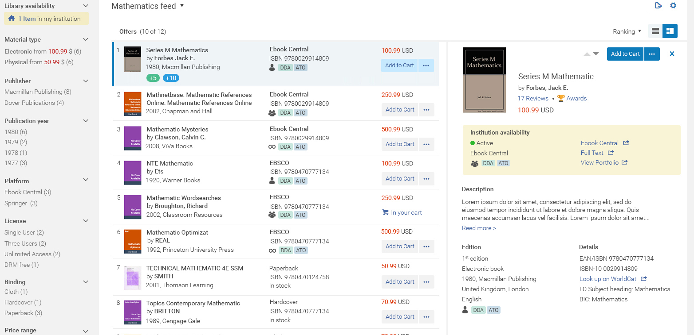
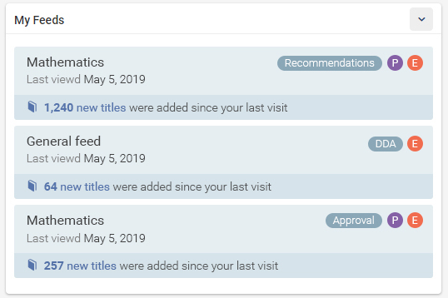
Recommendations: A transformative approach
Relevance ranking and filters instead of complex static profiles
Recommendation tuning and learning over time
Self-serve configurations

Slide 48
Built on the Ex Libris Higher – Ed Cloud Platform
Key Components
Shared holding index
ILS Fulfillment services
Library definitions and pods
‘Amazon like’ Patron experience
Ex Libris Higher-Ed Cloud Platform
Automated flows and new staff UX
Document delivery via RapidILL
Notes:
-Shared holdings index, who owns what, expand outside of what you own, shared holdings, not a full catalog
-Library definitions and pods, not enough to know what you have in your library, also need to know if available for resource sharing, which items are available for which group
-Amazon like experience for the end user
-Automated flows and new staff ux, spent a lot of work with dev partners to develop Rapido as a replacement for other tools such (ILLiad, Tipasa, Clio)
-Document delivery, articles and chapters, RapidILL, mature product, with a high level of service commitment, nearing 400 users worldwide

Slide 49
Leganto
Now 250 customers !

Slide 50
The Library and Its Services: Faculty Perception and Aspiration
75%
77%
Would like the library to be more involved in purchasing, licensing, and digitizing course materials
46%
Happy with the library support of teaching and learning activities
64%
Would like to increase their collaboration with the library regarding course materials
Would like the library to be more involved in clearing copyrights
70%
Would like the library to be more involved is supporting affordable learning

Slide 51
Challenges and Opportunities
Library as a partner: there is a need and there is willingness, from both sides
Library expertise is underused: faculty look for academic quality and reduced costs for students—in other words, they look for the materials that the library provides
Technology can save faculty much time and effort spent on helping students get to the assigned course materials
Notes:
Library is an unused expert: there is a need and there is the willingness

Slide 52

Course resource lists made easy
All types of materials
Online access, on any device
Integrated and automated workflows
Advanced analytics and reports
Integration with institutions’ LMS
Leveraging the Ex Libris Higher-Ed Cloud Platform
Notes:
Leganto makes it easy for academics and the library to set up course reading lists, and also to work together in order to build more effective lists.
Students can access all their course materials from a single list with direct links to library-held material or online resources, and details about physical resources available at the library.
The Leganto reading lists integrate directly with library workflows, with the ability to initiate these workflows automatically once an academic creates a list or adds an item to the list
The library has detailed analytics that can be used to understand how the library collection is being used in courses, as well as understand the usage of non-library materials for collection development purposes.
And the entire solutions integrates with systems that are already in place on campus in order to increase their potential, including the learning management system, reference management tools, and the Ex Libris higher-ed cloud platform.

Slide 53
Save money for students and schools
Maximize the use of library collections
Increase library efficiency & copyright compliance
Improve the teaching & learning experience
Enhance student success
Notes:
These are exactly the problems that we are solving with Leganto.
Leganto is a solution that saves money for students and schools and allows the institution to maximize the use of library collections for course materials.
In addition, there are dedicated workflows for managing these resources, making it much more efficient for instructors and the library to manage course materials and track copyright compliance. And of course, this is all with the end goal of improving the teaching and learning experience and enhancing student success.

Slide 54

Coming Next: Responsive Reading
Putting the text in the center:
  Step 1: Annotations
  Step 2: Assignments
  Step 3: Grades
Setting clear context for mutual understanding
Building interactions between students and faculty
Getting insights that help identify gaps, assess student progress, drive further actions

Slide 55
The Opportunity for Libraries:
Supporting the Research Enterprise

Slide 56
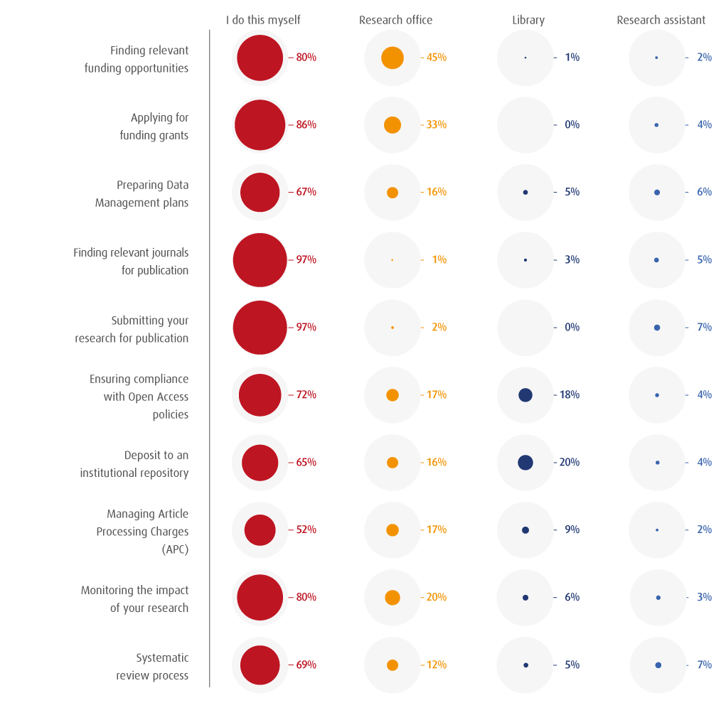
Researchers Spend ~45% of their Time on Admin Tasks
Researchers spend significant time on tasks that are at the core
of library expertise
Updating Profiles
Compliance
Activity Reporting

Slide 57

Esploro Research Information Management Solution
Expert Finder
University
Prestige & Ranking
Data for
Activity Reporting
National
Assessment
Industry
Partnerships
Open Access
Repository
Research Portal SEO-Friendly
Researcher Profiles
Funding Opportunities
Research Analytics
APIs &
Data Exports
Research Information Hub
(Publications, Datasets, Activities, Awarded Grants, Projects, etc.)
Smart Harvesting AI
(Ex Libris Central Index, National Repositories, Disciplinary Repositories)
Direct & Mediated Deposits
(Libraries, Researchers, Assistants)

Slide 58
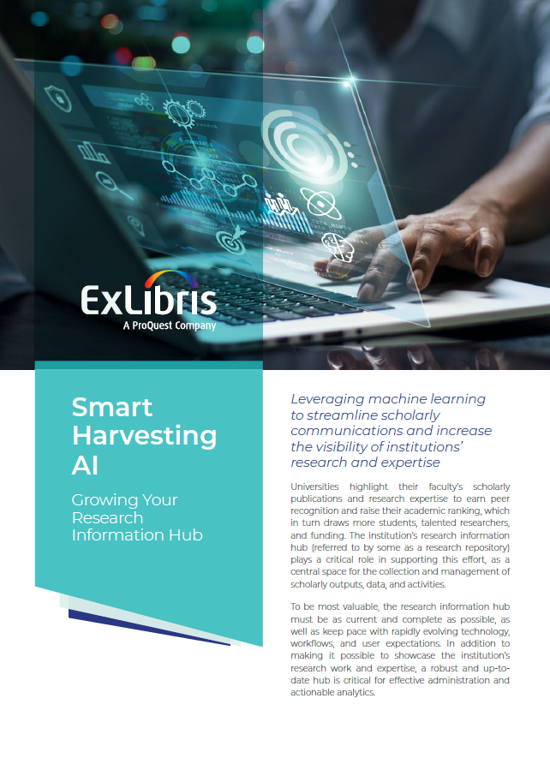
New paper:
Smart Harvesting AI
Growing your Research Information Hub
https://page.exlibrisgroup.com/esploro-smart-harvesting-ai

Slide 59
“Libraries demonstrate value to their institutions when they address particularly thorny problems for faculty and students, even if that means changing longstanding policies and practices.”
--Jason Byrd, Associate Dean for Research and User Engagement, Adelphi University Libraries

Slide 60
Content Operations

Slide 61


The Content Triangle
Institutions
End Users
Full Text
Activation
Acquisition
Content
Providers
Ex Libris
CDI
Ingestion
360 KB
Alma CZ
SFX KB
Provider Platform

Slide 62
Back to Basics
CDI
CDI
360 KB
Alma CZ
Over 58,000 collections
Over 70 million holdings
50% collection growth last year
4.5 billion records
10% annual growth
SFX KB
  Title level metadata
  Electronic Resource Management tool
  Link Resolver
  Includes collections (aka provider offerings) and holdings
  Providers supply KBART, MARC*
  Article level metadata
  Includes rich records: authors, subjects, abstract, full text, etc.
  Optimized for keyword search (Discovery)
  Local catalogs for Summon clients
  Providers supply XML, MARC*
* Format and metadata not always standardized
* May require legal agreement

Slide 63




Data Quality
Improving and optimizing the merged record
Normalization improvements
Journal titles, author names, subject headings
Resource type review
More efficient data correction processes Internal and external
ALL SUCH PROJECTS TAKE TIME

Slide 64


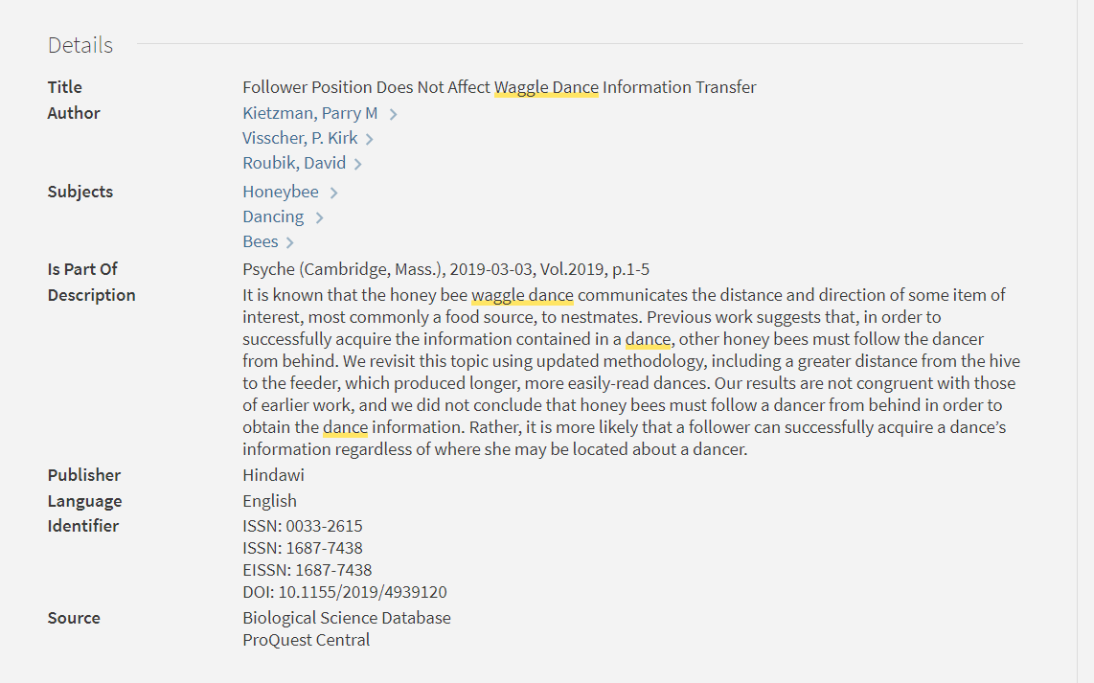

Rights Processing and Tools
Rights processing within 24 – 48 hours
For Primo: Activation source analysis – understanding where a record is coming from

Slide 65
Customer Success

Slide 66


New Status Page
Up to three (3) months status history
Detailed Service disruption
Personalized view according to time zone
Easy, free text Search
Mobile compatibility
LIVE since April 26th

Slide 67
Chat Support Customer Experience and Rollout
Game changer in Support experience
Immediate response
Live support by our experienced analysts
96% customer satisfaction
RefWorks and Pivot
Research Professional
RefWorks in Korea
Summon, 360, Intota (NA)
Rialto
Summon, 360, Intota (EU, RoW)
Primo VE (EU)
Primo VE (NA)
Alma, Leganto (EU)
Alma, Leganto (NA)
CDI
Nov 2019
Feb 2020
Mar 2020
May 2020
Jul 2020
Oct 2020
Nov 2020
Dec 2020
Feb 2021
Mar 2021
Q2 2021

Slide 68
Chat Usage Statistics in NA
1339
60%
18%
250
45%
Institutions enabled
Enabled the Chat with Support role to at least 1 user
Of incoming cases were initiated from chat
Chat sessions
Resolved in chat
96%
Customer satisfaction

Slide 69

Alma Success From Day One
Customer Success, right from the start and at no charge
  Monthly calls with dedicated Success contact
  Pro-active environmental Health Checks
  Consultancy Services
    Menu of 17 options
    Learn on the job with expert, real time guidance
  Knowledge Acceleration live training program
    6 live sessions over 6 weeks
    All library staff included

Slide 70

Realizing More Value from Alma Year over Year
Annual Business Reviews pilot program begins in H2
  For libraries live more than 1 year
Tailored guidance
  Creating a custom success roadmap for your library
Based on our Adoption Scorecard, focusing on value drivers
  Increasing efficiency of operations
  Utilizing integrations with third-party systems
Libraries like yours
  Compares your utilization with other libraries of same size and region

Slide 71
Diversity, Inclusion, Equity and Combating Bias at Ex Libris

Slide 72
Our approach and focus areas
Products and Technology
Community Collaboration
Employee Diversity and Education

Slide 73

Anti-bias: Our path
z
Take action!
Educate
Diverse views:
The community
External consultants
Awareness
Explore
Reporting
Vision, values and goals

Slide 74

Products and technology, especially discovery
Bias
Systematic Bias
Bias in Discovery

Slide 75
Do we have bias in our systems?
Not intentionally! Never!
But …bias can be unconscious and unintentional
It can surface in any algorithm (e.g. in Primo/Summon)
It can be the result of outdated data (e.g. subject headings)
It is not only a result of our code but is influenced by content and metadata from many sources
As opposed to Google, in library systems results vary from institution to institution due to local collections and practices
There are many other factors involved – like the static ranking
Ex Libris has a responsibility to guard against unintentional bias

Slide 76
Technology approach
Conduct periodic reviews of our relevance ranking algorithm, search features, and usability
Collect, evaluate and respond to any reported incidents
Consult with libraries regarding their specific library activations, configurations, locally indexed data and boosting/de-boosting of fields in local catalog records
Block, suppress, and down-boost specific word combinations and associations that may create unintentional bias
Engage with external consultants focused on algorithms, accessibility, and other diversity, inclusion and equity (DEI) matters
Implement various discovery service feature enhancements

Slide 77
Employee Diversification and Education
Important aspect of avoiding unintentional bias
  Diverse workforce, especially developers
Ex Libris hires across a spectrum of talent
  Development is global
    Jerusalem
    Chicago
    Ann Arbor
    Remote workers – many places
  Increasing focus to diverse talent
Employee Diversity and Education

Slide 78
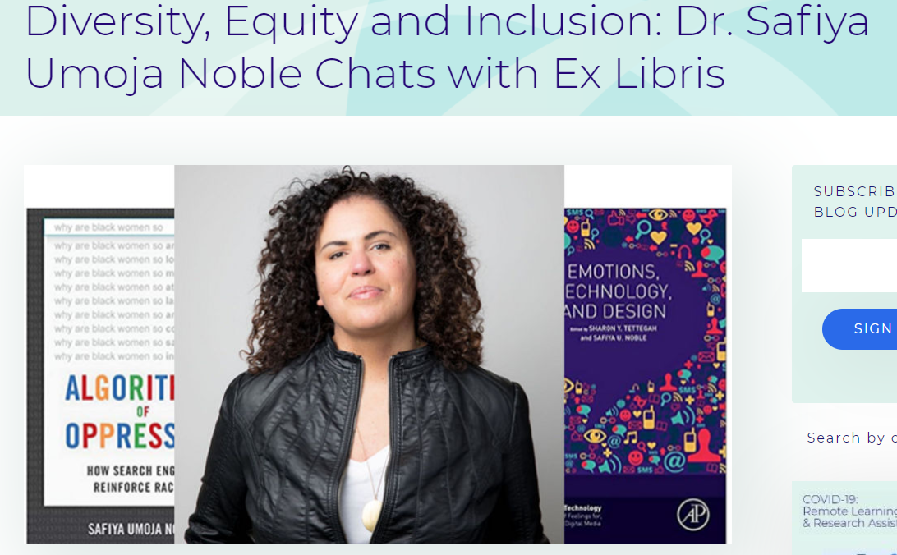
Committed to Staff Awareness Training
Hired Safiya Noble to deliver an internal education program
  Author of Algorithms of Oppression
  Delivered an internal program in fall 2020, sponsored by CEO
  Also engaged her to keynote at IGeLU

Slide 79
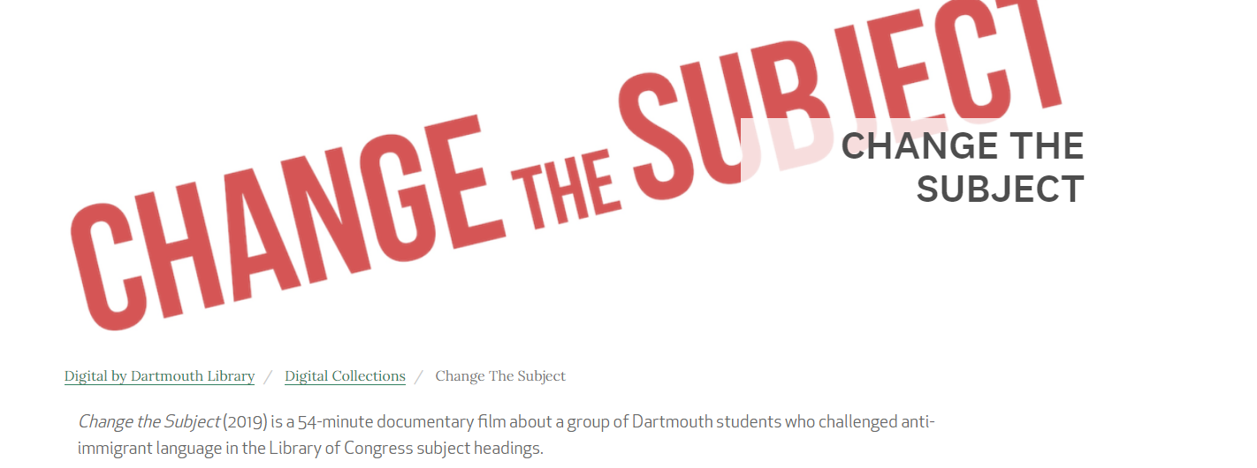
Internal Discussion of
Internal workshop around “Changing the Subject” documentary

Slide 80








Select diversity & inclusion initiatives at Ex Libris and ProQuest
Women’s Mentoring Program
Employee Community Networks and Groups
    PQ Pride Alliance
    Women at ProQuest
    Mental Health and Wellness Team
    Racial Diversity Thought Group
Leadership Education and Training
Diversity In Policies
Diversity Recruitment
Diversity and Inclusion Steering Committee and Executive Leadership Oversight
Philanthropic Support
Culture Celebration
and Events

Slide 81


Community Collaboration

Slide 82
ELUNA/IGeLU Goals
Create an advisory group on the representation of culturally diverse perspectives within a search index such as CDI.
Understand how bias may be introduced at various stages of the content supply chain (source material, metadata, etc.) and within the search application.
Collaborate with Ex Libris to identify/mitigate bias within the centralized article index and later, local search applications.
Educate the broader user community and end users on these efforts.
Examine approaches by customers to introduce alternative subject headings into their authority files, their catalog and search index (particularly First Nation terms)

Slide 83
Our commitment
At Ex Libris we are committed to diversity, inclusion and equity as pillars that makes us a stronger company. We embrace the power of our people and services to stand against bias and inequity.
Address this issue comprehensively and to support social justice
Form a team solely dedicated to identify and act against bias
Create the necessary awareness and advance programs, targeted to prevent and mitigate bias

Slide 84

Your Voices Improve The Products – Thank You!
Responding & recovering from Covid-19
Listservs
NERS/Idea Exchange
Developer’s Network
Working with the library community
  Product Working Groups
  DEI – recommendations for discovery & content

Slide 85
Jane.burke@exlibrisgroup.com

