Slide 1
Investigating Web Accessibility: Primo
Cindi Blyberg (she / they)
Digital Strategies & Technology
University of Kentucky Libraries
cindi.blyberg@uky.edu
Notes:
Cindi Blyberg is the Head, Web Technologies & Development for the University of Kentucky Libraries. She previously held positions in product management for Springshare and OCLC, and was on the library faculty at The Libraries of The Claremont Colleges and Eastern Kentucky University.

Slide 2
Agenda
What is web accessibility?
Tools
Preliminary findings: Primo
Next steps

Slide 3
Web accessibility
WCAG Principles: POUR
Perceivable
Operable
Understandable
Robust
Content
Structure
Images and media
Text: color, font, size, contrast
Forms, links, buttons, menus
Assistive technology compatibility
Source: webaim.org and w3c.org
Notes:
Accessible websites attempt to eliminate or lower barriers to their use by people with disabilities of all kinds.
The World Wide Web Consortium (WC3) devises web standards that are applied globally. The the WCAG guidelines came out of this group’s Web Accessibility initiative.
The Web Content Accessibility Guidelines (WCAG: /WUH-kag/) help website creators and maintainers ensure that sites function for users with low or no vision, colorblindness, mobility concerns, hearing impairments, learning disabilities and/or neurodiversity, and other disabilities. Creating and maintaining websites that conform to accessibility guidelines can make using any website a better experience for all users.
The principles of the WCAG guidelines dictate that, generally, websites must be:
Perceivable - Available to the user through sight, hearing, or touch.
Operable - Compatible with keyboard, mouse or other pointing devices, voice control and reading, and other assistive technologies.
Understandable - Easy for the user to comprehend.
Robust - Works across devices and operating systems (including mobile), browsers, assistive technologies.
To make a website accessible consider your content’s:
Structure: so that content has sensible navigation
Images and media: additional in-context information is required to make these accessible to users with low or no vision, with hearing disabilities, or with auditory processing difficulties.
Text: is the font size large enough for the device it’s displayed on? Is the font face accessible, for example, to people who have dyslexia or other reading difficulties, do the color and contrast make the text comprehensible?
Are the components of your pages like forms, links, buttons, and menus accessible? Are they navigable (in proper order) and usable by keyboard and screen readers?
Is your content compatible with other forms of assistive technology, like voice commands, braille readers, screen magnifiers, assistive software?

Slide 4
WCAG 2.2
Principles
Guidelines
Success criteria
Levels of conformance
Source: webaim.org and w3c.org
Notes:
The guidelines are broken down by the four POUR principles, and each contains multiple success criteria to help web staff and developers determine whether a component of the software meets the desired conformance level.
For example, Guideline 1 is Perceivable, and the success criterion 1.2.2 states that captions are necessary for all pre-recorded audio available on the site for Level A conformance.
There are three conformance levels, A, AA, AAA. A is the lowest or basic level, with AAA being highest. It is expected that all criteria for level A be met, and the goal is for AA to be met. The AAA-specific criteria, while useful, are generally considered optional.

Slide 5
Regulatory concerns
Section 508 of the Rehabilitation Act of 1973
Americans with Disabilities Act
EU web accessibility directive
Post Brexit: Public Sector Bodies (Websites and Mobile Applications) (No. 2) Accessibility Regulations 2018 (whew)
Notes:
WCAG is probably the most common thing that will be encountered by library staff and developers, but it’s important to know that there are regulations and laws in effect
Section 508 of the Rehabilitation Act of 1973 – has links to a lot of great information and guidance on how to build accessible websites, including a link to the Code4Lib finish note
ADA – since 1996, consistently required to apply to websites. See link for caselaw.
EU web accessibility directive and, since Brexit, the UK’s web accessibility regulations also apply. Library software companies with a global customer base must also adhere to these.
Also others internationally.
Not being conformant can lead to fines, litigation, complaints to the HHS (Dept of Health and Human Svcs) Office of Civil Rights. This has implications for higher education, K12 schools, public libraries. There have been dozens of complaints made against these institutions. It’s now common for universities to have guidelines and policies for their own websites but also applicable to any web software that is subscribed to or purchased.

Slide 6
Subscription software
Vendor information
Statements (Ex Libris’s)
VPATs document defects for:
Web
Electronic Docs
Software
Closed
Authoring tool (guidelines)
Notes:
The approach to accessibility for libraries differs depending on if the software is created by the library or subscribed to, like Alma and Primo. An important consideration here is the distinction between the software and its content. Software can be compliant “out of the box,” but libraries can easily add content that does not meet standards. We’ll see an example of this in the following slides.
There are resources available to assist libraries when considering the accessibility of subscription software. Companies often openly publish statements on their commitment to accessibility or the accessibility of their software, including the level of conformance they aim for.
More detailed are the VPATs: Voluntary Product Accessibility Template from the Information Technology Industry Council. In these documents, the software creators document in detail where the software supports, partially supports, does not support the WCAG success criteria, whether that criterion is not applicable, or if the criteria was just not evaluated. The latter is only allowed for conformance to the AAA level.
The templates are structured to enable software creators to understand how they meet the WCAG success criteria and therefore Section 508 or the EU guidelines. Providers must consider several aspects of their software:
Web (generally the software itself that is available via the web)
Electronic Docs (generally support documentation)
Software (any installable components, like downloadable clients)
Closed
Authoring tool (whatever software used on the staff side to add or manage content. A good example here is the LibApps platform that library staff use to create and edit LibGuides). These have separate guidelines.
Ex Libris does a VPAT process and work with a third party provider to do iterative testing and remediation.

Slide 7
Tools
Non-developers
Browser extensions
Screen readers
For developers & designers
← All of those things!
Browser a11y tools
axe dev tools
Chrome a11y features
Firefox a11y inspector
Not shown here
Automated testing
AI-assisted testing
Notes:
Since this presentation focuses on the accessibility of Primo, which is a third-party product not built by a library, I am going to focus on freely-available tools that can be used in human-driven testing (opposed to automated testing) that may be particularly useful to those who are new to assessing web accessibility and remediating issues. We’ll look at the basic accessibility of Primo’s search screen, focusing on customizations available to libraries.

Slide 8
Applying principles
Content creators
Alt text, decorative images
Use skip links for effective nav
Transcribe videos
Don’t use color as a sole way to show information or navigation
Don’t forget keyboard navigation
Links that open in a new window
Consider voice readability
Developers & Designers
Create accessible forms
Consider navigation structure and order
ARIA
Code accessibly
Use accessible software libraries and components
Design accessibly: consider color-blind users, font face and size, contrast
Notes:
Earlier I mentioned that applying accessibility principles and guidelines means examining different aspects of the content. These are a few examples.
Folks who develop or design web software should adopt an accessibility mindset when coding. That is, it should be top-of-mind and not an afterthought.
ARIA – Accessible Rich Internet Applications: adding ARIA tags brings semantic information to the web content and behaviors so that assistive technology can provide in-context accessibility information, such as labeling fields, adding text to be read by a screen reader, etc.

Slide 9
For library systems
Systems / Discovery Librarians
Consider accessibility when customizing third-party software
Where possible, aim for consistent UX with other institutional web applications
Test with users; retest after enhancements are released or you change options
Familiarize yourself with the VPAT to know what’s coming down the pike—and what isn’t
Be vocal about accessibility issues in partnership with your vendor
Notes:
Overall, some tips for systems and discovery librarians and any library staff responsible for subscription software:

Slide 10
Primo: Tota11y
(browser bookmarklet)
Notes:
Tota11y (pronounced “totally”) is a handy bookmarklet that provides a really quick overview of the accessibility issues and features of any webpage. Visit the Tota11y website, drag the bookmarklet to your bookmarks bar, and click it to add the overlay to any webpage.

Slide 11
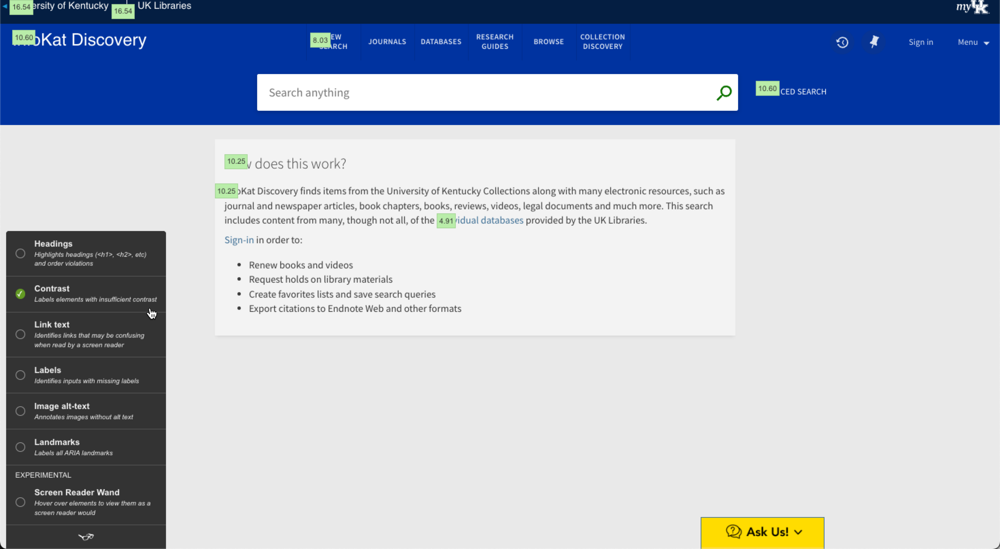
Clicking the Contrast radio button displays the contrast ratios for different parts of the page. There are no errors on this page. The WCAG minimum ratio is 4.5:1.
Notes:
Click the Tota11y bookmarklet in your bookmarks bar to activate the Tota11y button.
Click the Tota11y icon, bottom left (a pair of glasses)
Click the Contrast radio button to view contrast ratios for items on the page. We can see that all the elements on the UK Libraries Primo search screen have contrast ratios that exceed that required by WCAG.

Slide 12
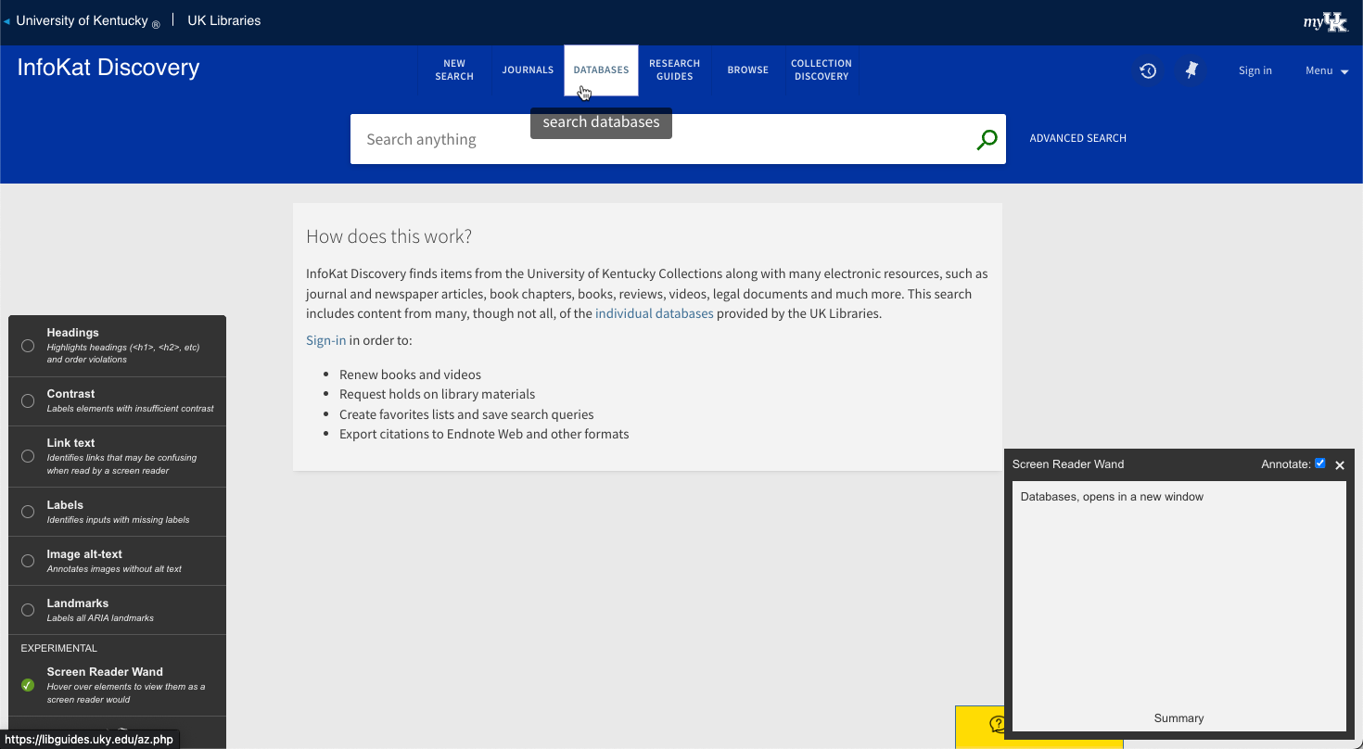
Invoking Tota11y’s Screen Reader wand will demonstrate what would be read aloud at the cursor position.
Remember:
Tota11y is NOT a screen reader;
Voice-read output of any screen reader + browser + OS combinations can vary;
Therefore YMMV.
Notes:
This screenshot demonstrates the fact that a screen reader will read “Databases, opens in a new window” rather than just what is on screen, “Databases.” The “opens in a new window” text is encoded in an ARIA label, which are read aloud by screen readers.
Remember that Tota11y is NOT a screen reader. Screen reader output can vary depending on the combination of the reader, device, browser, and operating system in use.
Reload the page to remove the Tota11y overlay

Slide 13
Primo: WAVE
(browser extension)
Notes:
WAVE, the Web Accessibility eValuation Extension, is provided by webaim.org,

Slide 14
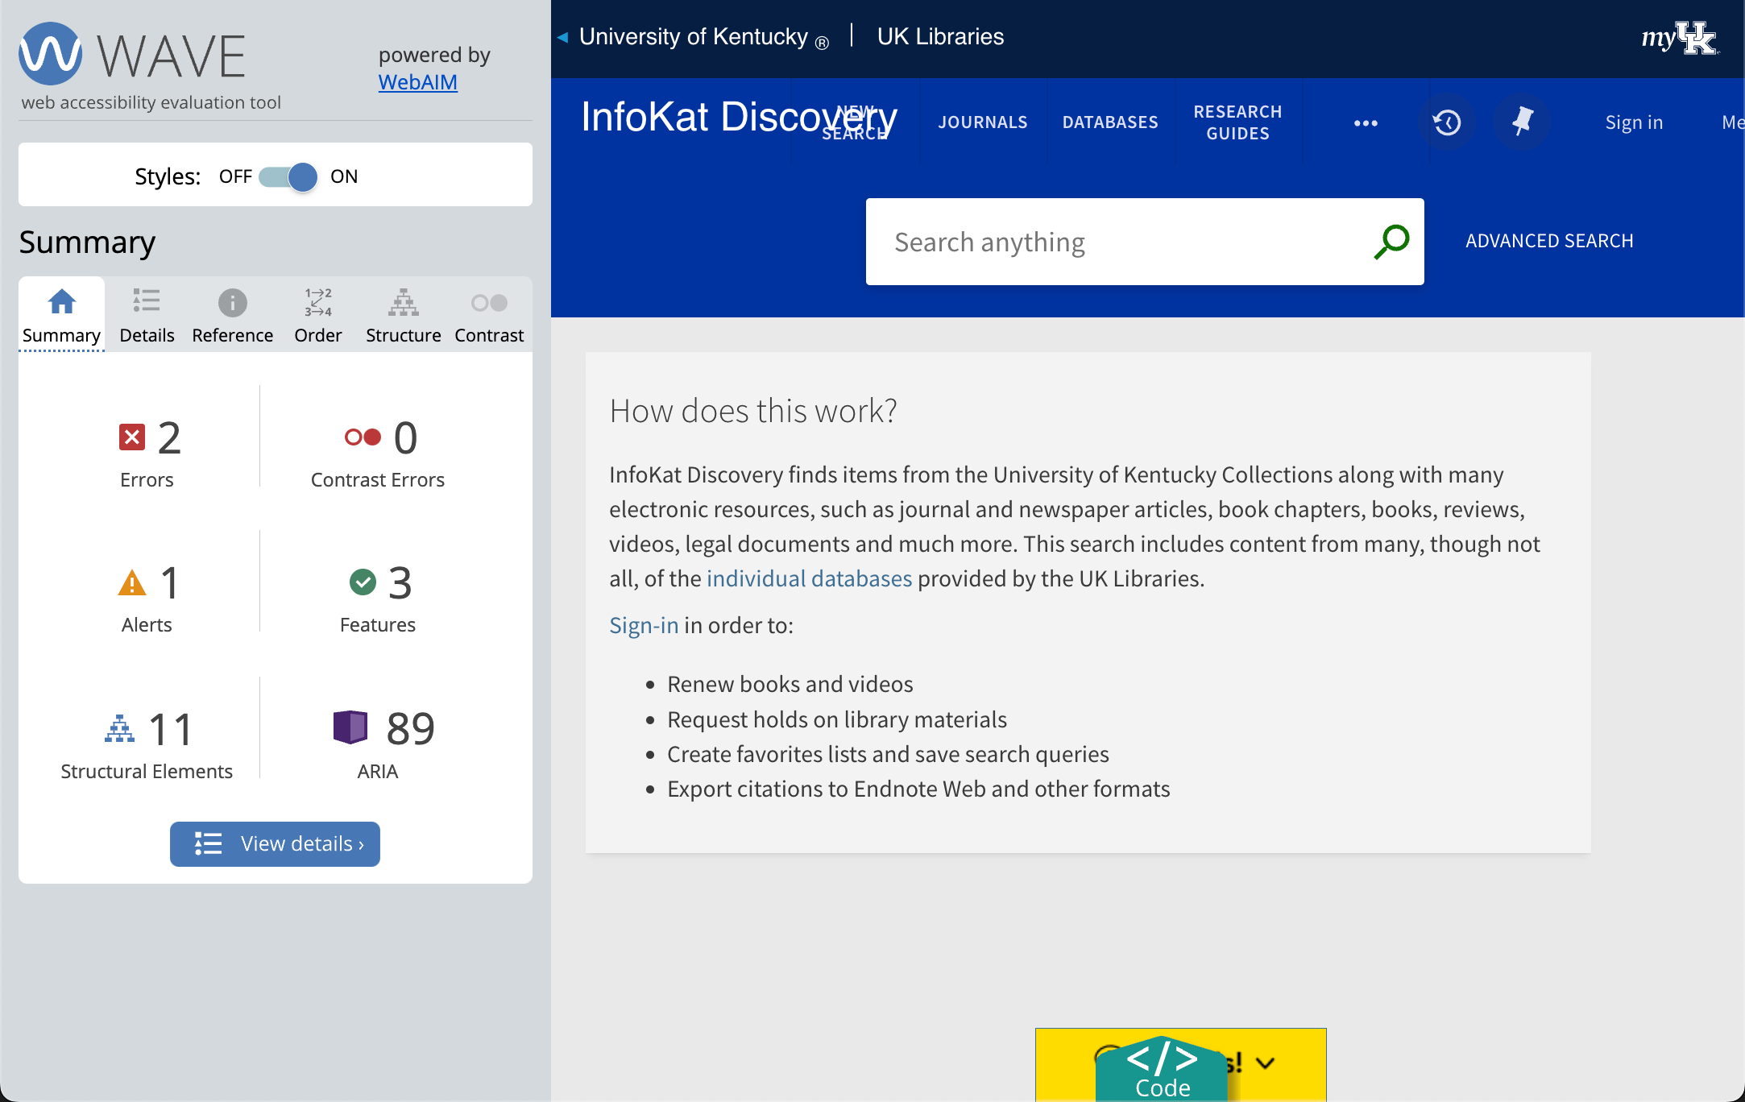
Notes:
Errors are things to fix
Alerts are things that aren’t necessarily errors, but could be. Requires human examination and possible remediation.
Contrast errors – all good here!
Features – accessibility enhancing features being used on the page
Structural elements—shows you where <h1>, <h2>, header etc are
ARIA – shows an icon for every place in the page an ARIA related piece of code exists. ARIA is (definition)

Slide 15
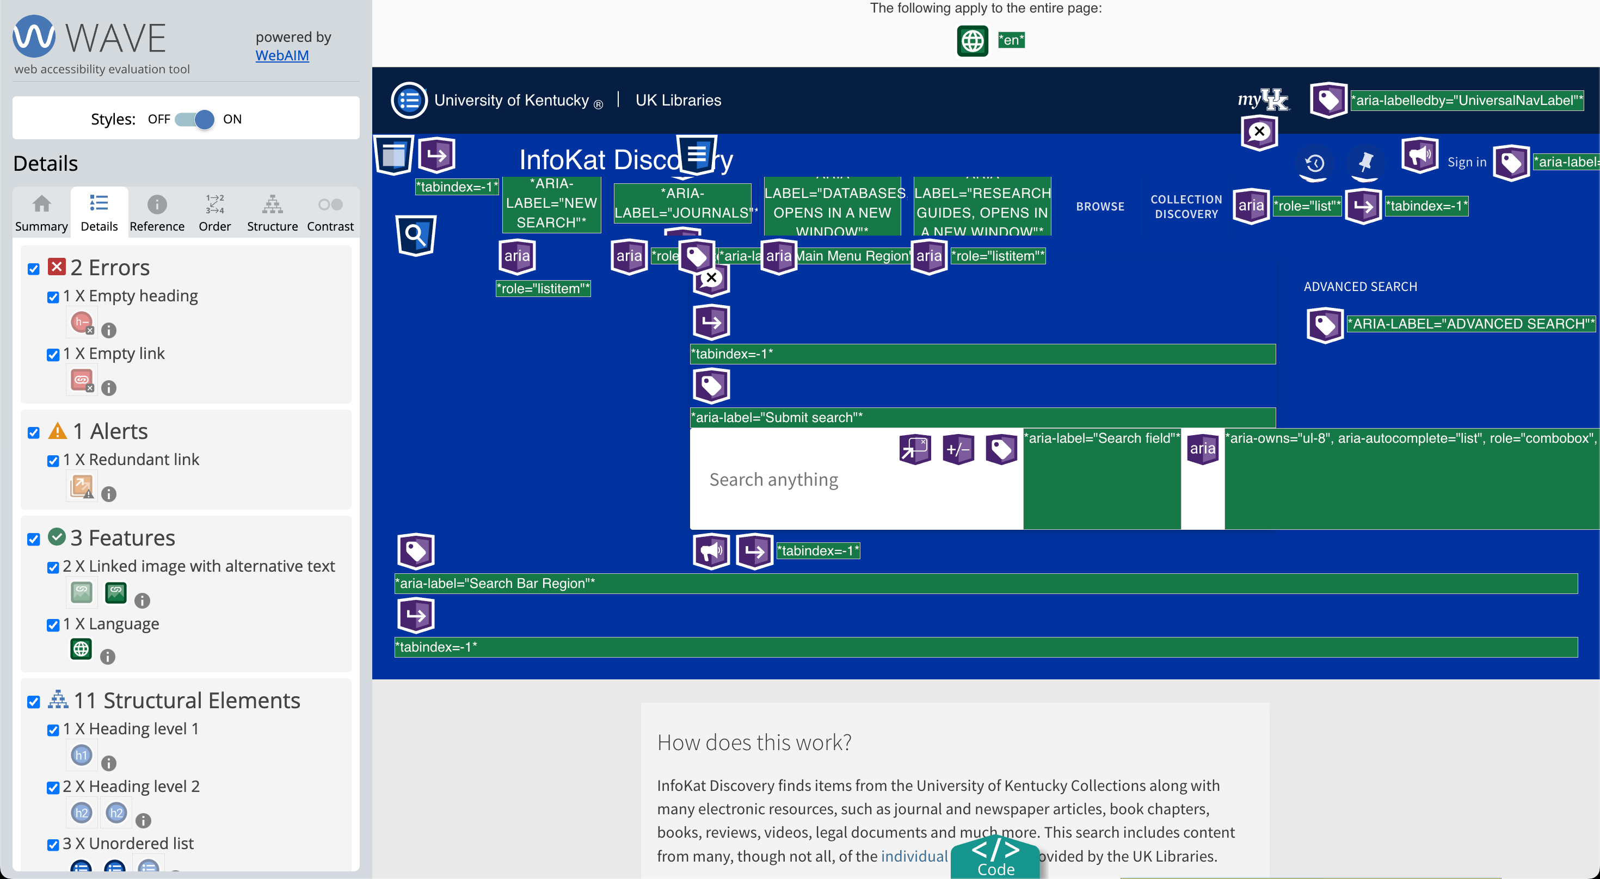
Notes:
When you first activate WAVE on a page, it can be overwhelming. Let’s look at one section at a time (uncheck them to make icons go away)

Slide 16
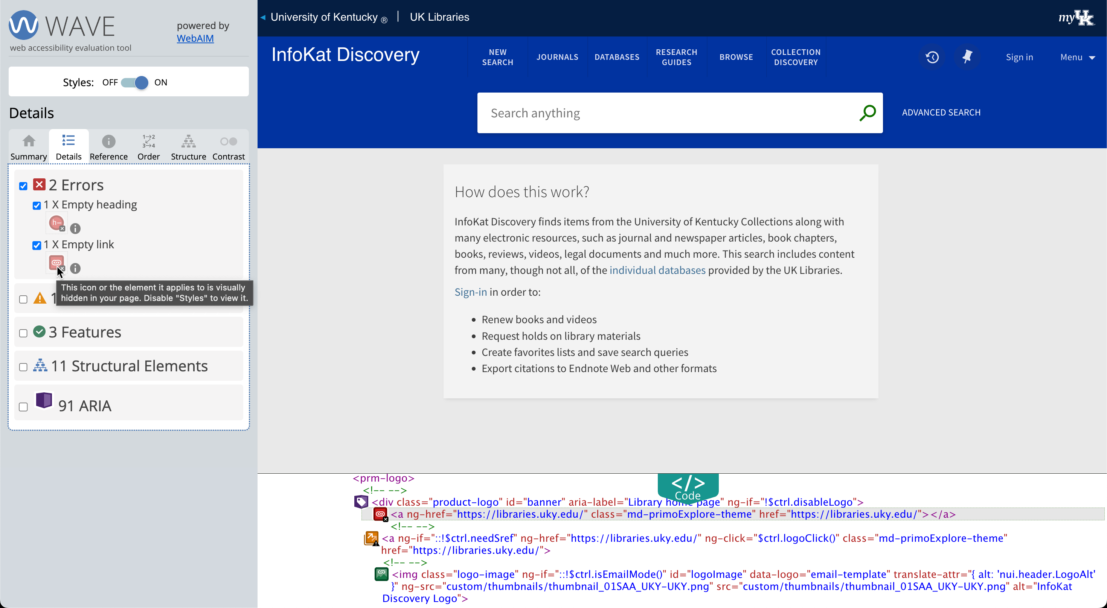
Two errors, but they are hidden (grayed out)
Notes:
To view the code: Turn off Styles (at the top), Click the teal “Code” icon, then click one of the errors. Turn styles back on to see this view.
After digging through this code, I found that this is caused by an institution logo that is in a hidden <div>. Make that <div> display:block, and it shows.
Path: /html/body/primo-explore/div/prm-explore-main/div/prm-topbar/div/prm-logo/div
The other hidden error is due to an empty <h2> header in our custom header code, so something that we should be able to fix

Slide 17
Turn styles off to load HTML only and view code hidden by JS or CSS
Notes:
To view the code: Turn off Styles (at the top), Click the teal “Code” icon, then click one of the errors. Turn styles back on to see this view.
After digging through this code, I found that this is caused by an institution logo that is in a hidden <div>. Make that <div> display:block, and it shows.
Path: /html/body/primo-explore/div/prm-explore-main/div/prm-topbar/div/prm-logo/div
The other hidden error is due to an empty <h2> header in our custom header code, so something that we should be able to fix

Slide 18
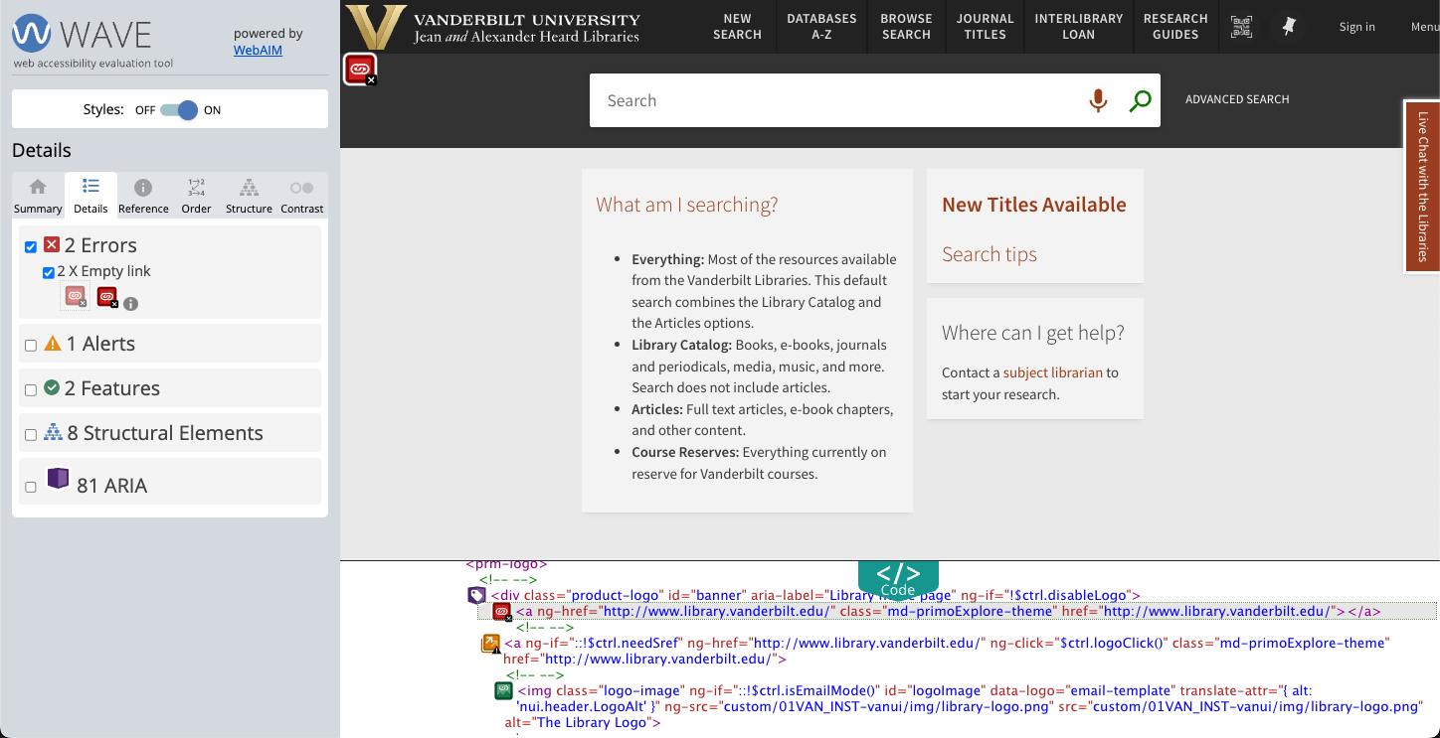
Primo at Vanderbilt has the same error in the same place, suggesting this is a Primo issue.
Notes:
Vanderbilt’s primo has same error in the same place, suggesting it’s an Ex Libris issue. BUT is there anything that the library can do to mitigate this? Does removing the image remove the logo code? Is it possible to add link text? NB the Alert on this one – the library logo (though hidden) has two links to the library homepage that are right next to each other.

Slide 19
No link text between <a> and </a>
Notes:
Vanderbilt’s primo has same error in the same place, suggesting it’s an Ex Libris issue. BUT is there anything that the library can do to mitigate this? Does removing the image remove the logo code? Is it possible to add link text? NB the Alert on this one – the library logo (though hidden) has two links to the library homepage that are right next to each other.

Slide 20
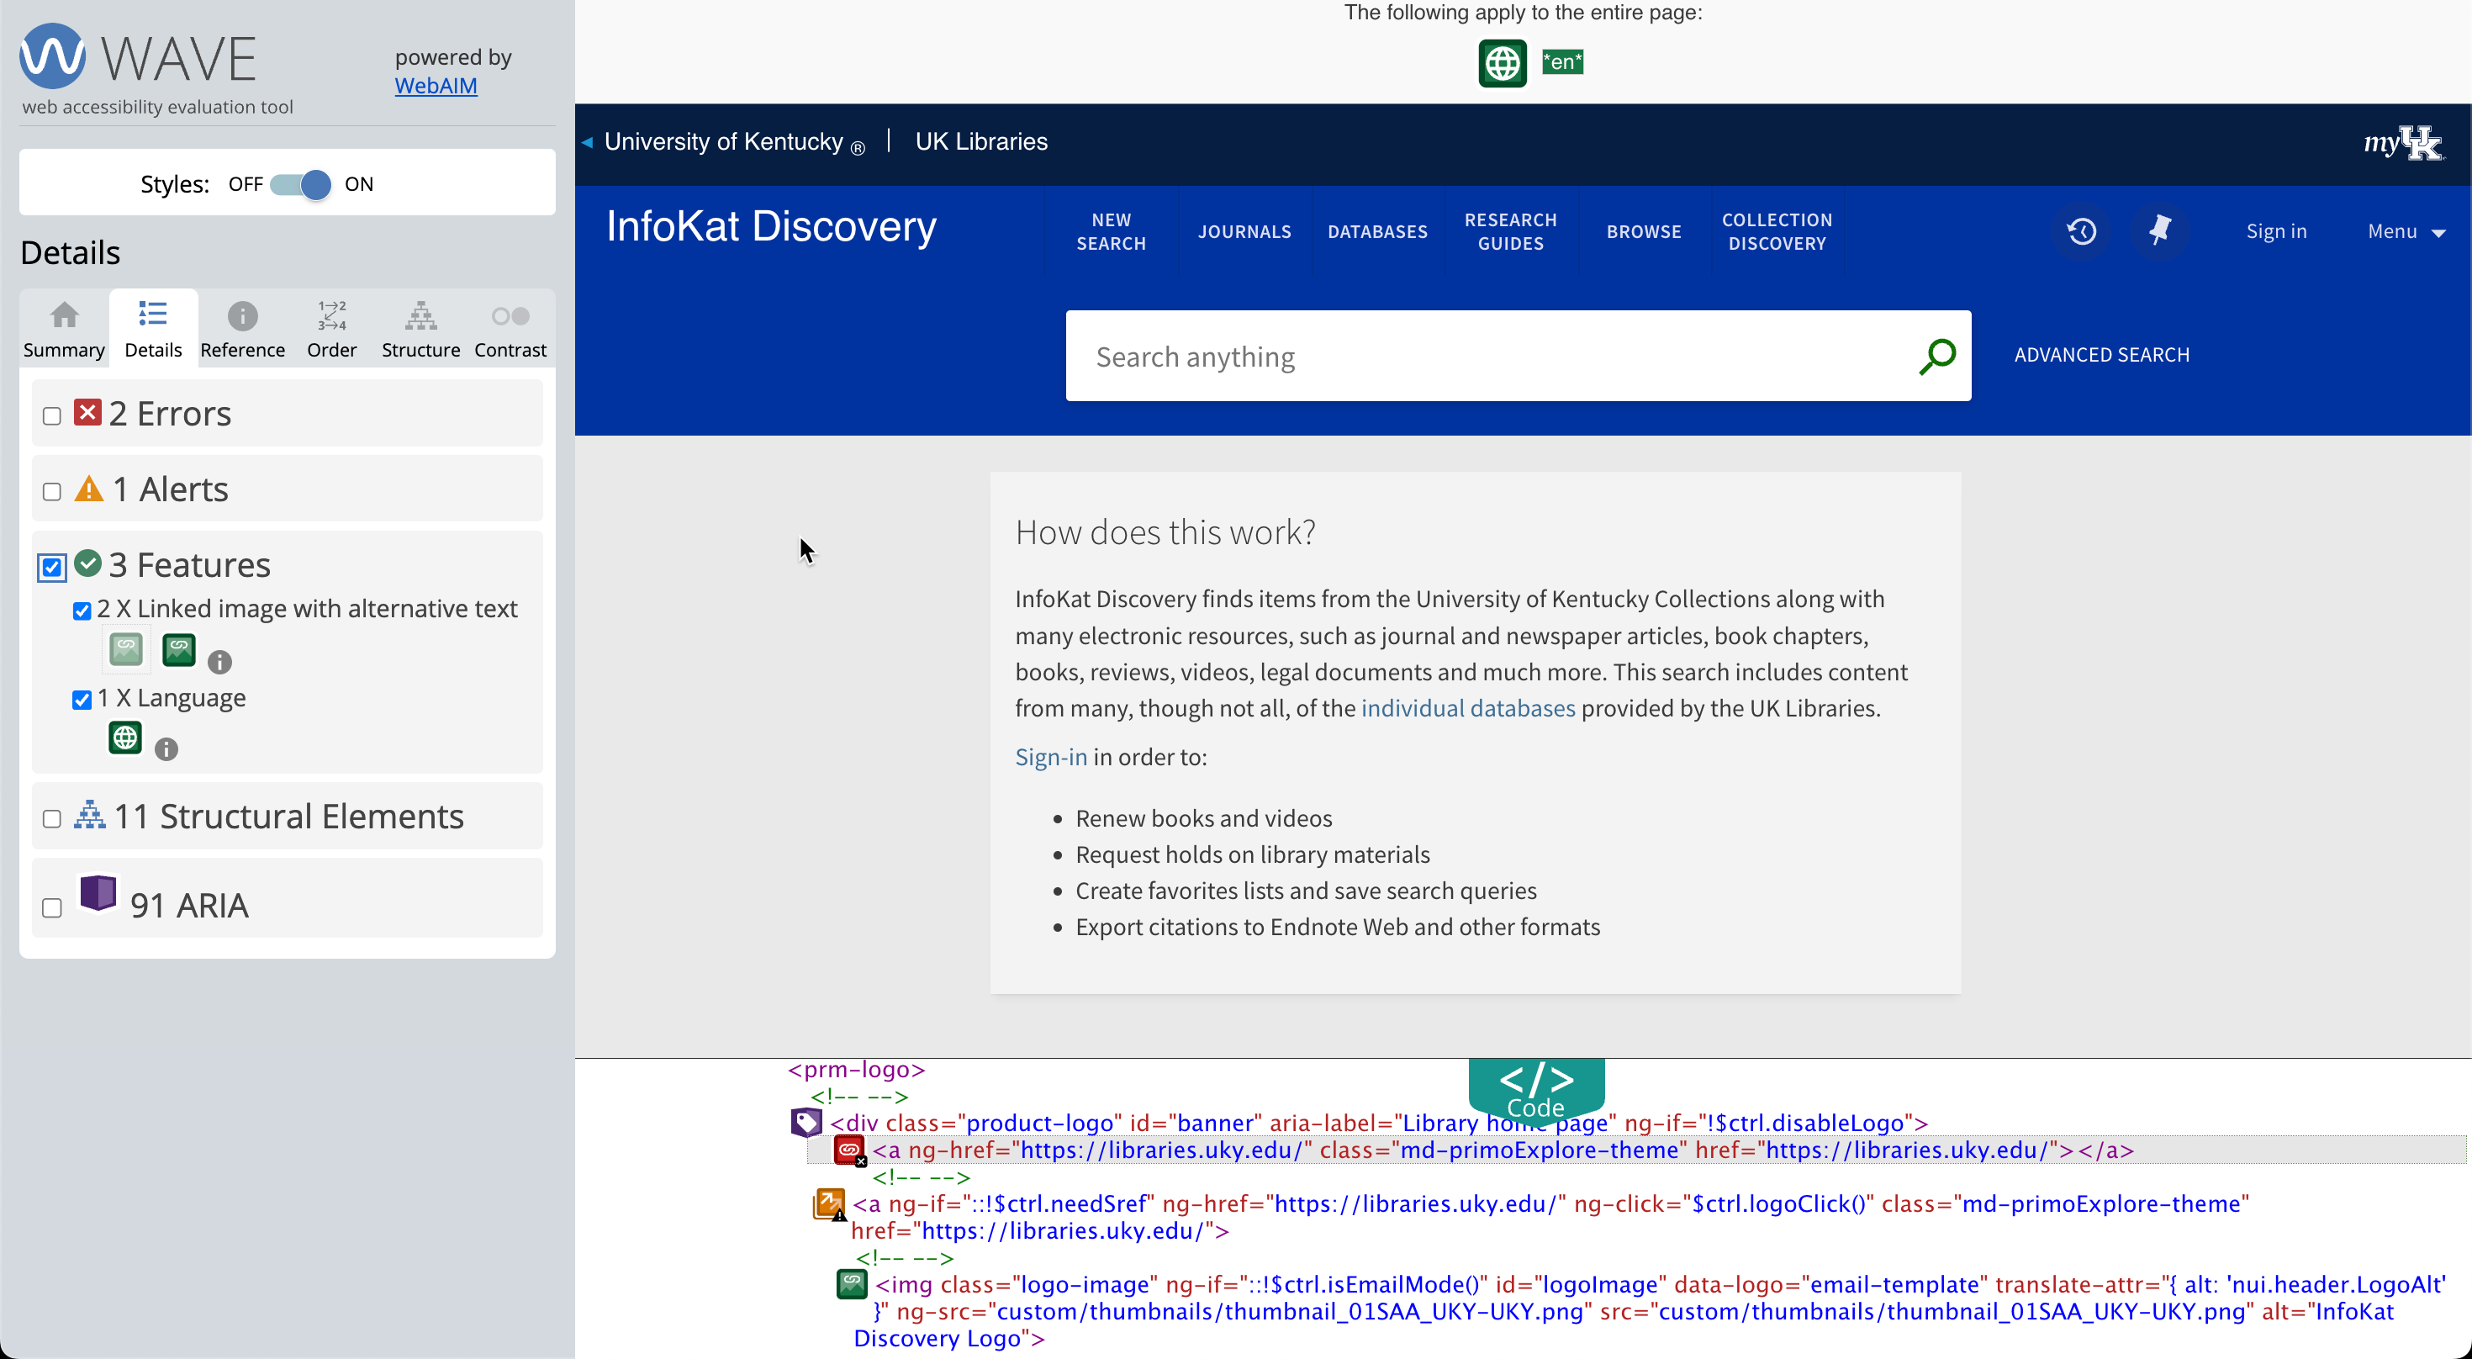
Language declared for the page
Notes:
Features are pieces of code detected that contribute to the accessibility of the page. In this case, the language attribute has been identified

Slide 21
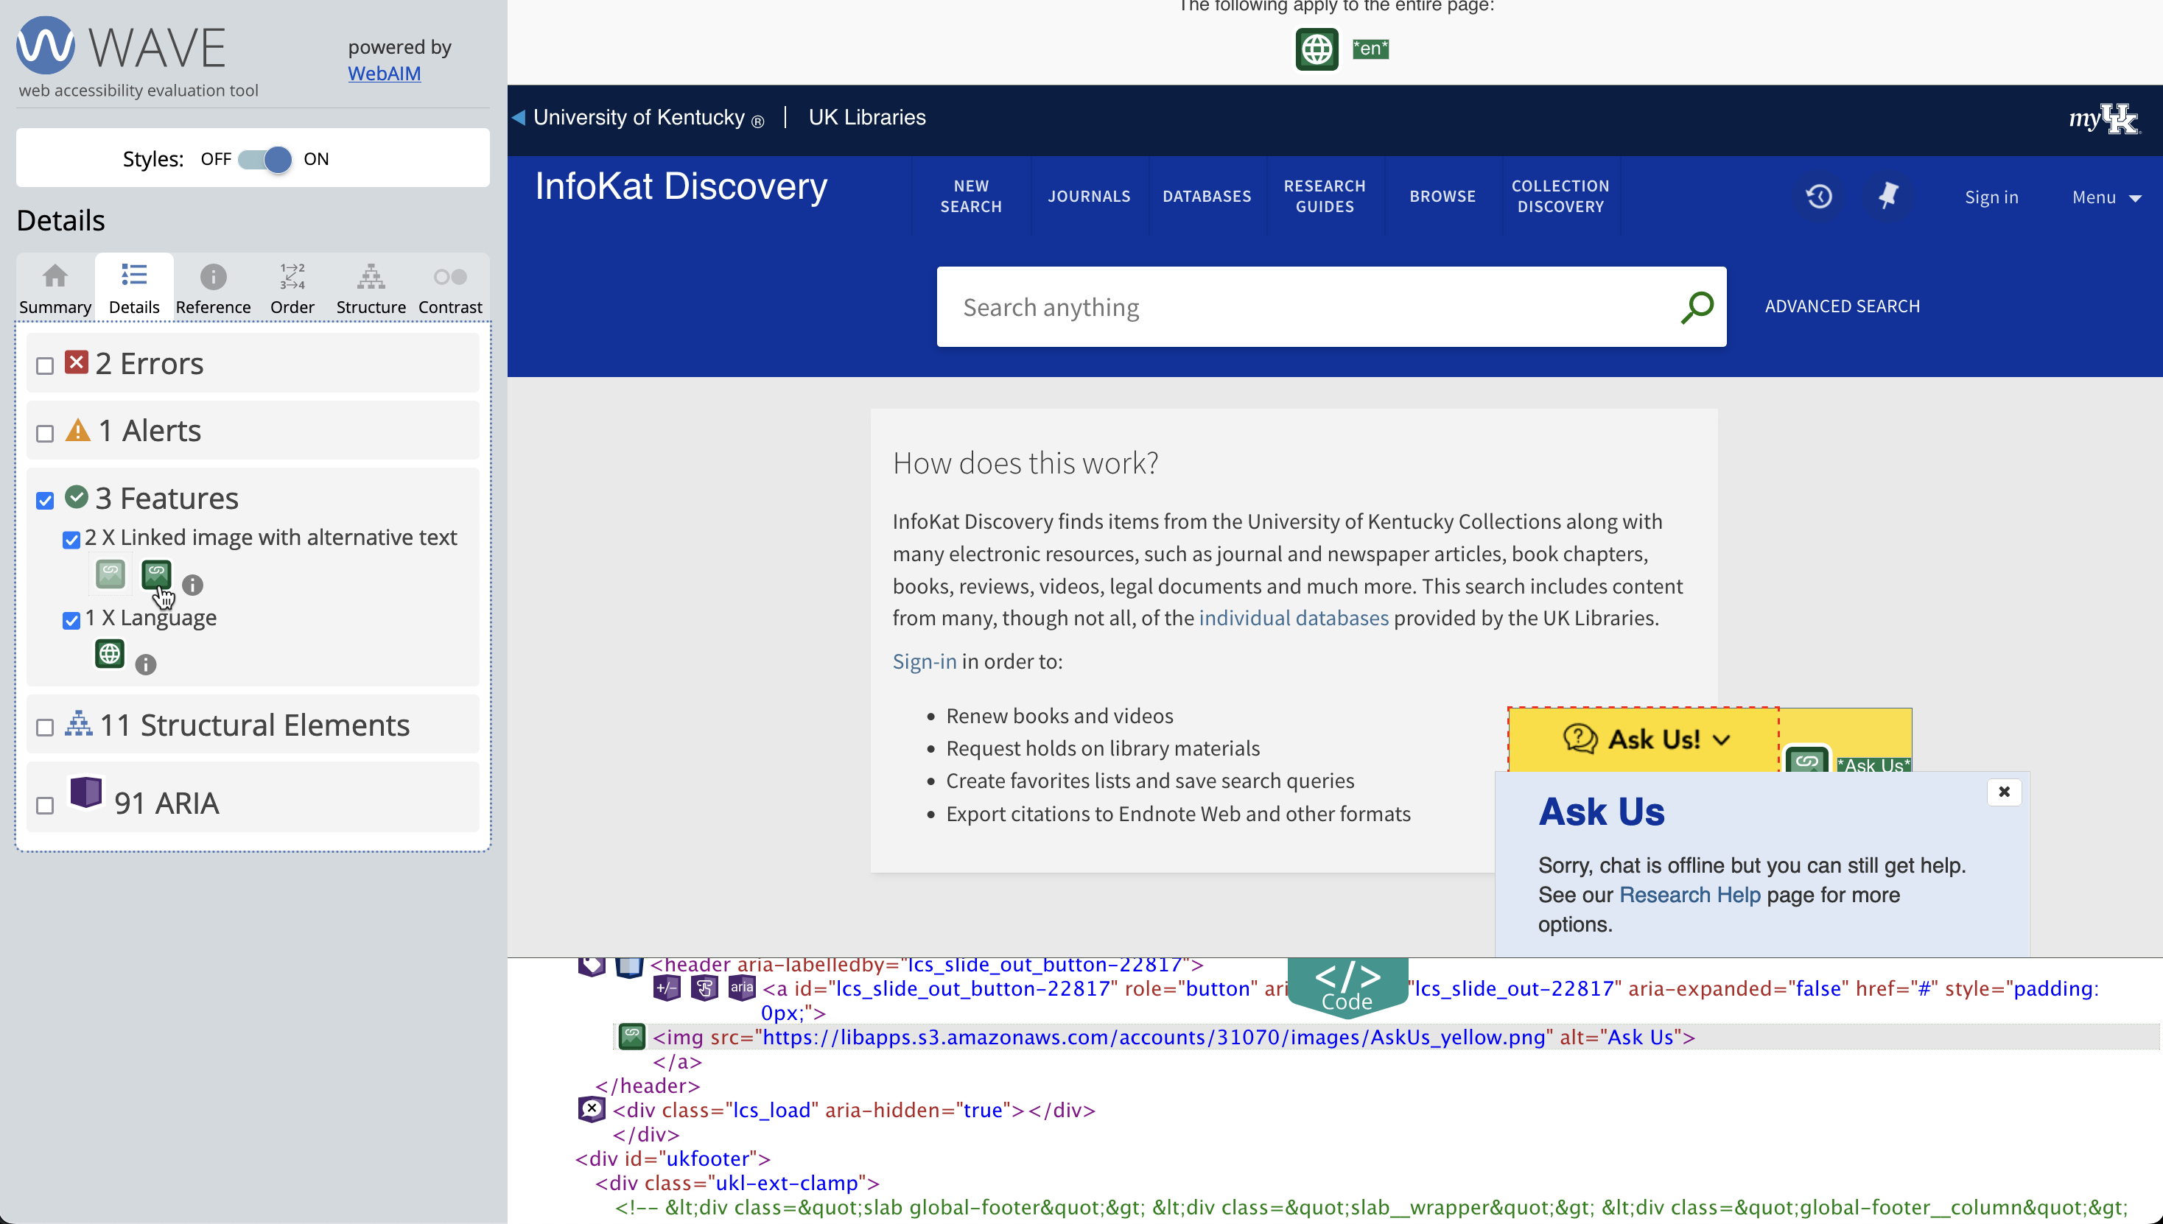
Two images have Alt text (one is hidden)
Notes:
…and 2 images have been identified that have ALT text defined. One of them is the “Ask Us” image for the LibAnswers widget, and the second (hidden) one turns out to be related to the logo code highlighted above.

Slide 22
Primo: SiteImprove
(browser extension)

Slide 23
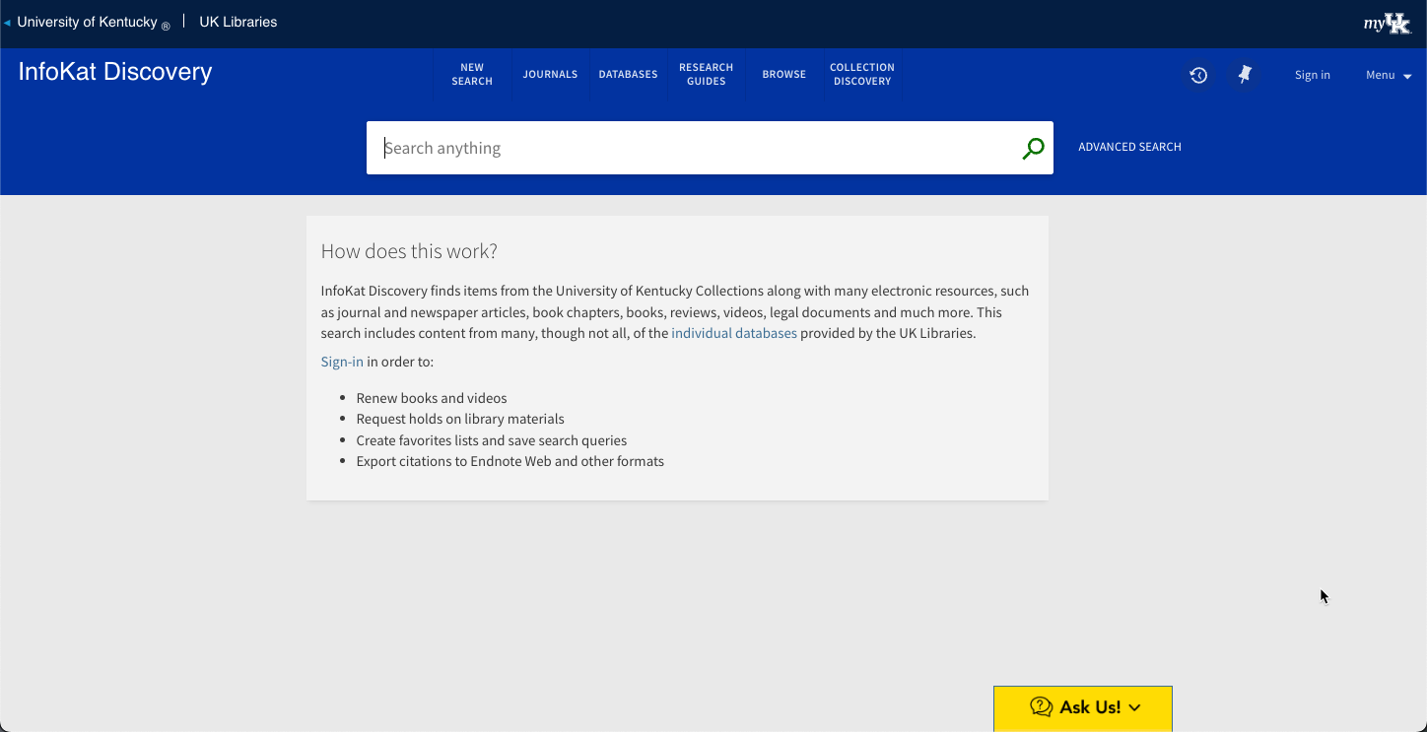
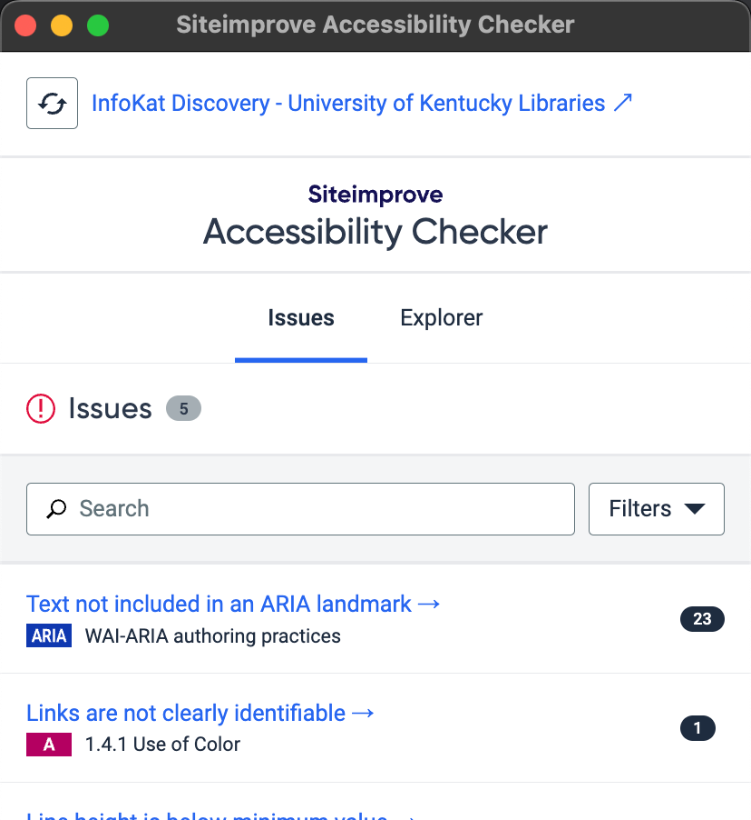
Tied directly to WCAG and ARIA guidelines
Displays level of compliance (A, AA, AAA)
Notes:
Invoking the Site Improve extension pops up another window with results.
As you can see it’s tied directly to the WCAG and ARIA guidelines, linking back to the appropriate guideline or practice to assist in remediation.

Slide 24
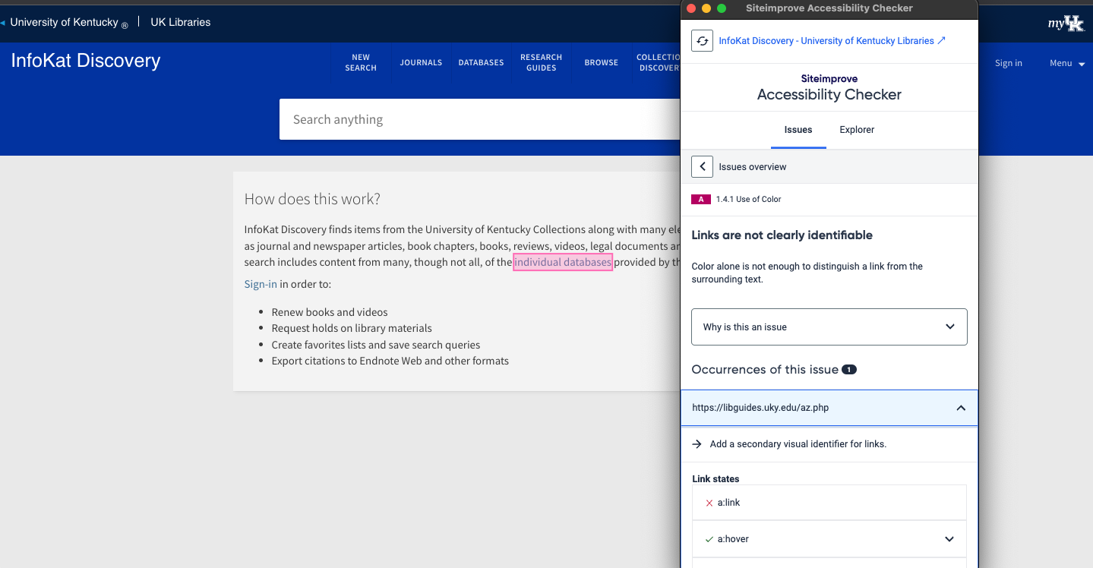
Primo: SiteImprove
Tied directly to WCAG 2.1 guidelines
Displays level of compliance (A, AA, AAA)
Other links aren’t implicated here; can we fix this?
Notes:
There is on hover underline behavior for this link.
Other links on the page have a white background and large tool-tip-type thing on hover. Why are they not flagged?

Slide 25
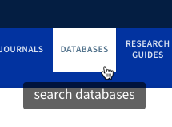
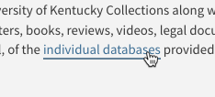
The (on hover) behavior is different for these links, yet the Databases link is not flagged in SiteImprove. How can we change the custom link to make it compliant?
Notes:
The on hover behavior is different for banner links and links in the text.

Slide 26
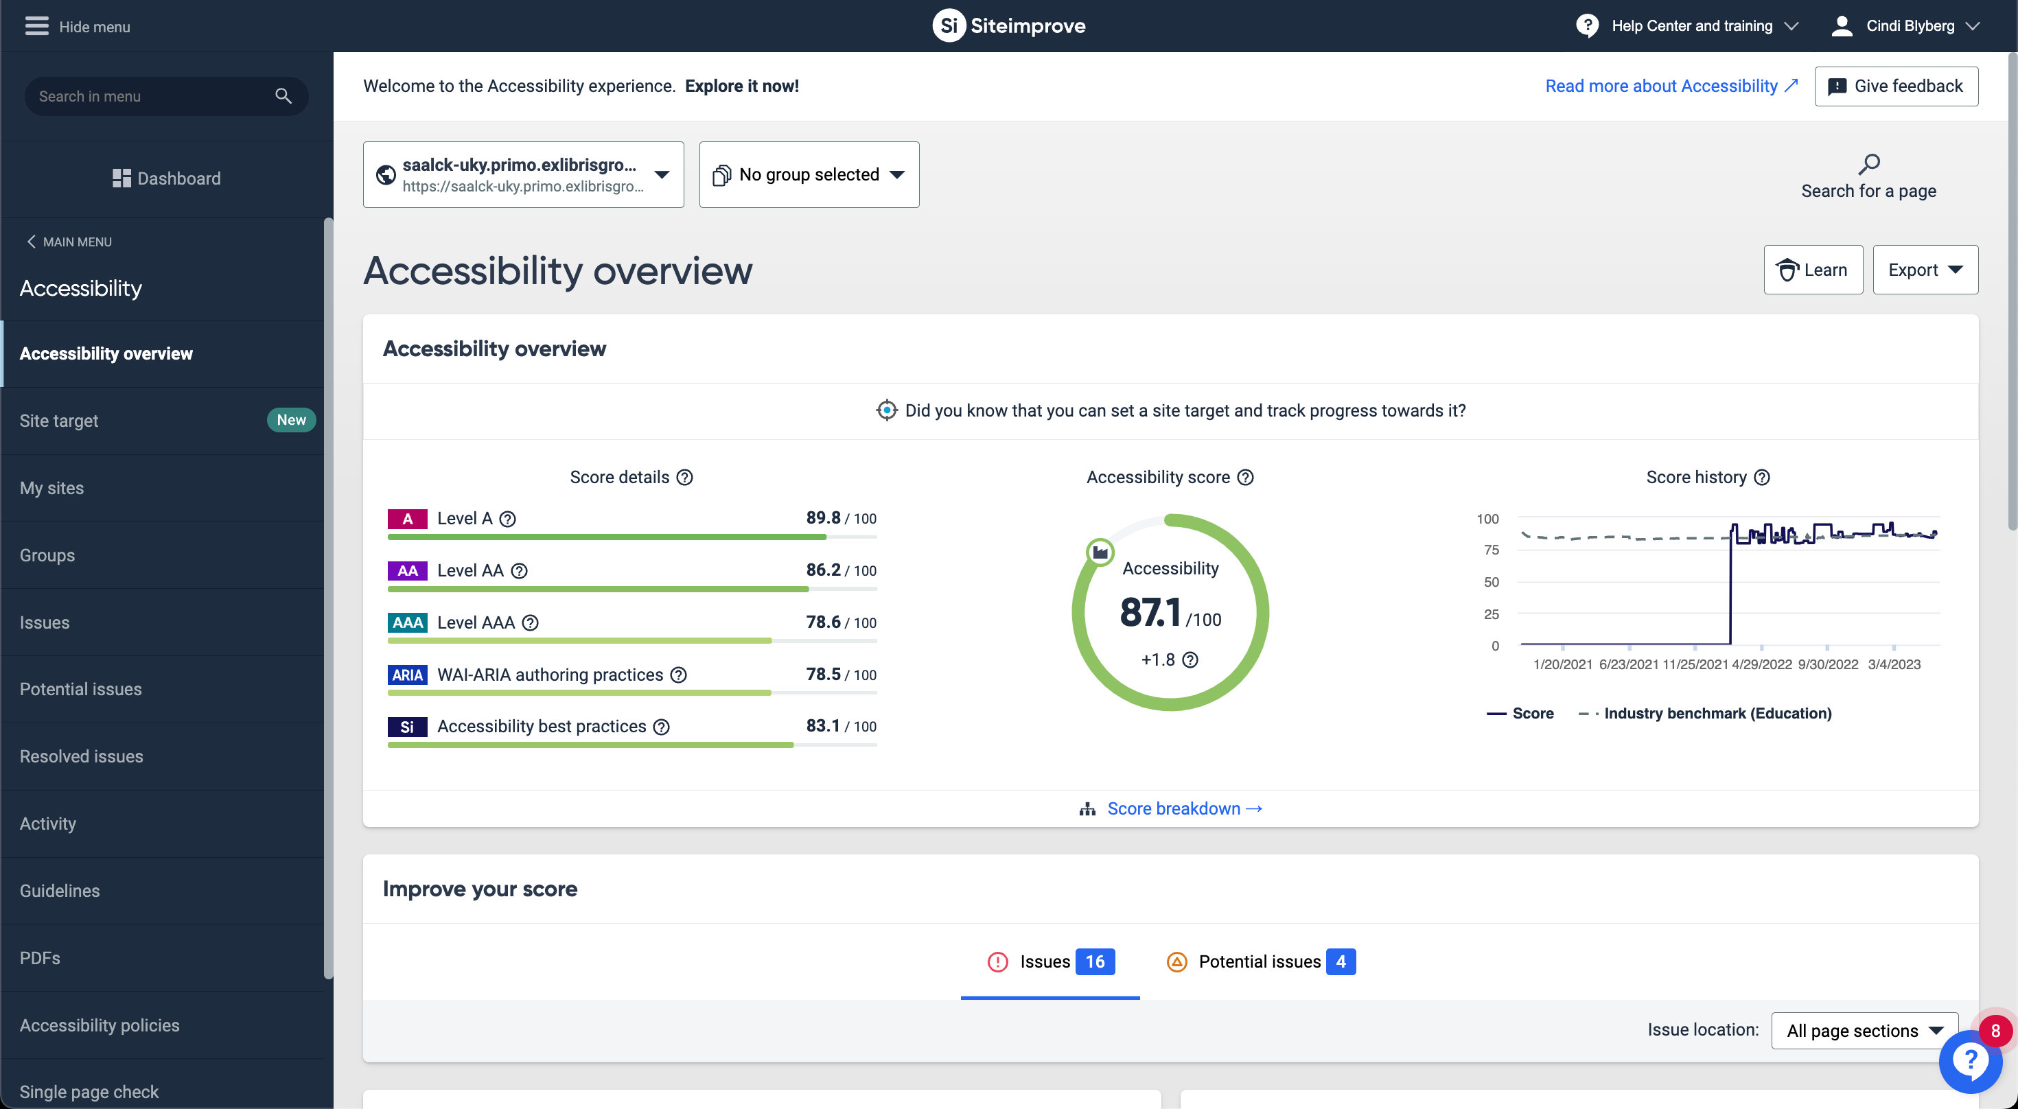
Notes:
Purchasing a SiteImprove subscription brings many more features; currently at UK Libraries we are using the broken link checker to crawl our LibGuides and will be using the accessibility report to assess and remediate issues across UK web properties.

Slide 27
Primo: Navigation
(screen readers, keyboard or other input devices)

Slide 28
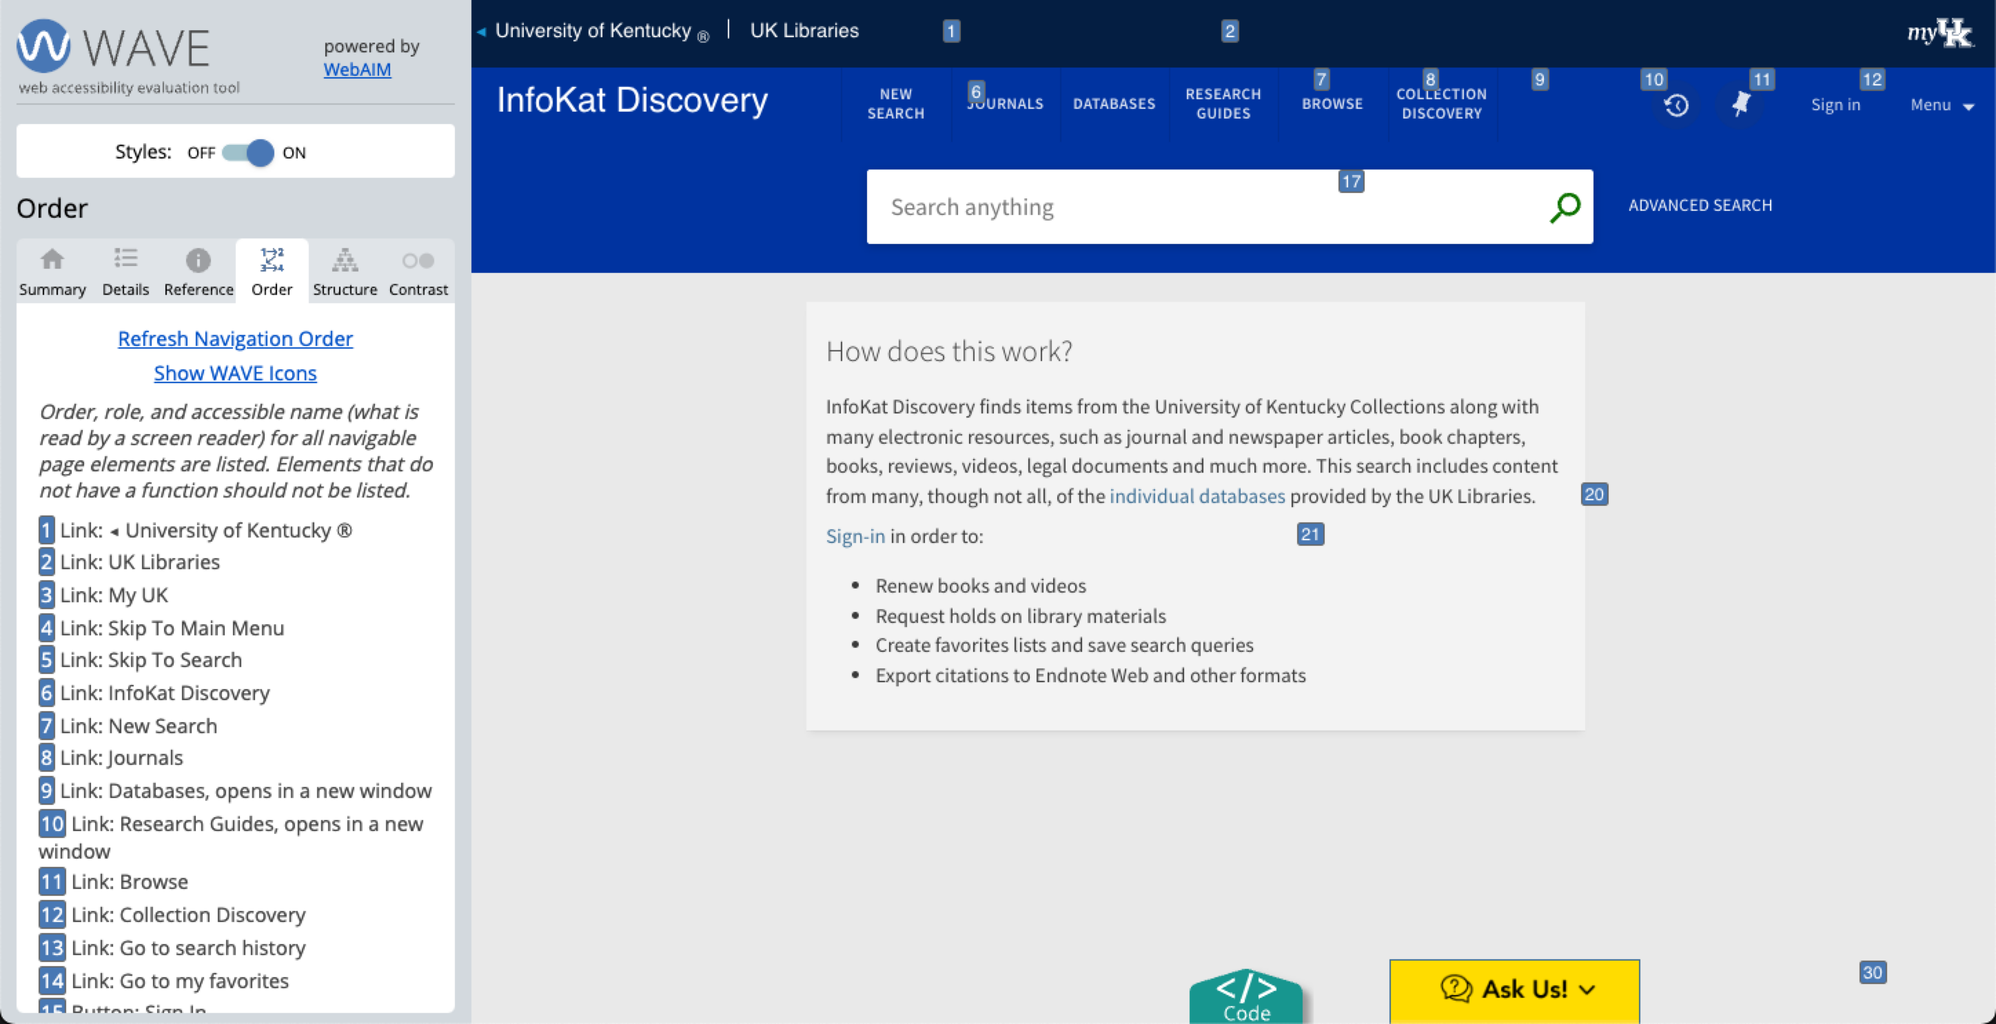
Primo: WAVE
Navigation order
Notes:
This is WAVE
Note the numbers on the screen
Note the presence of skip links and how they are on the screen even if the text is not

Slide 29
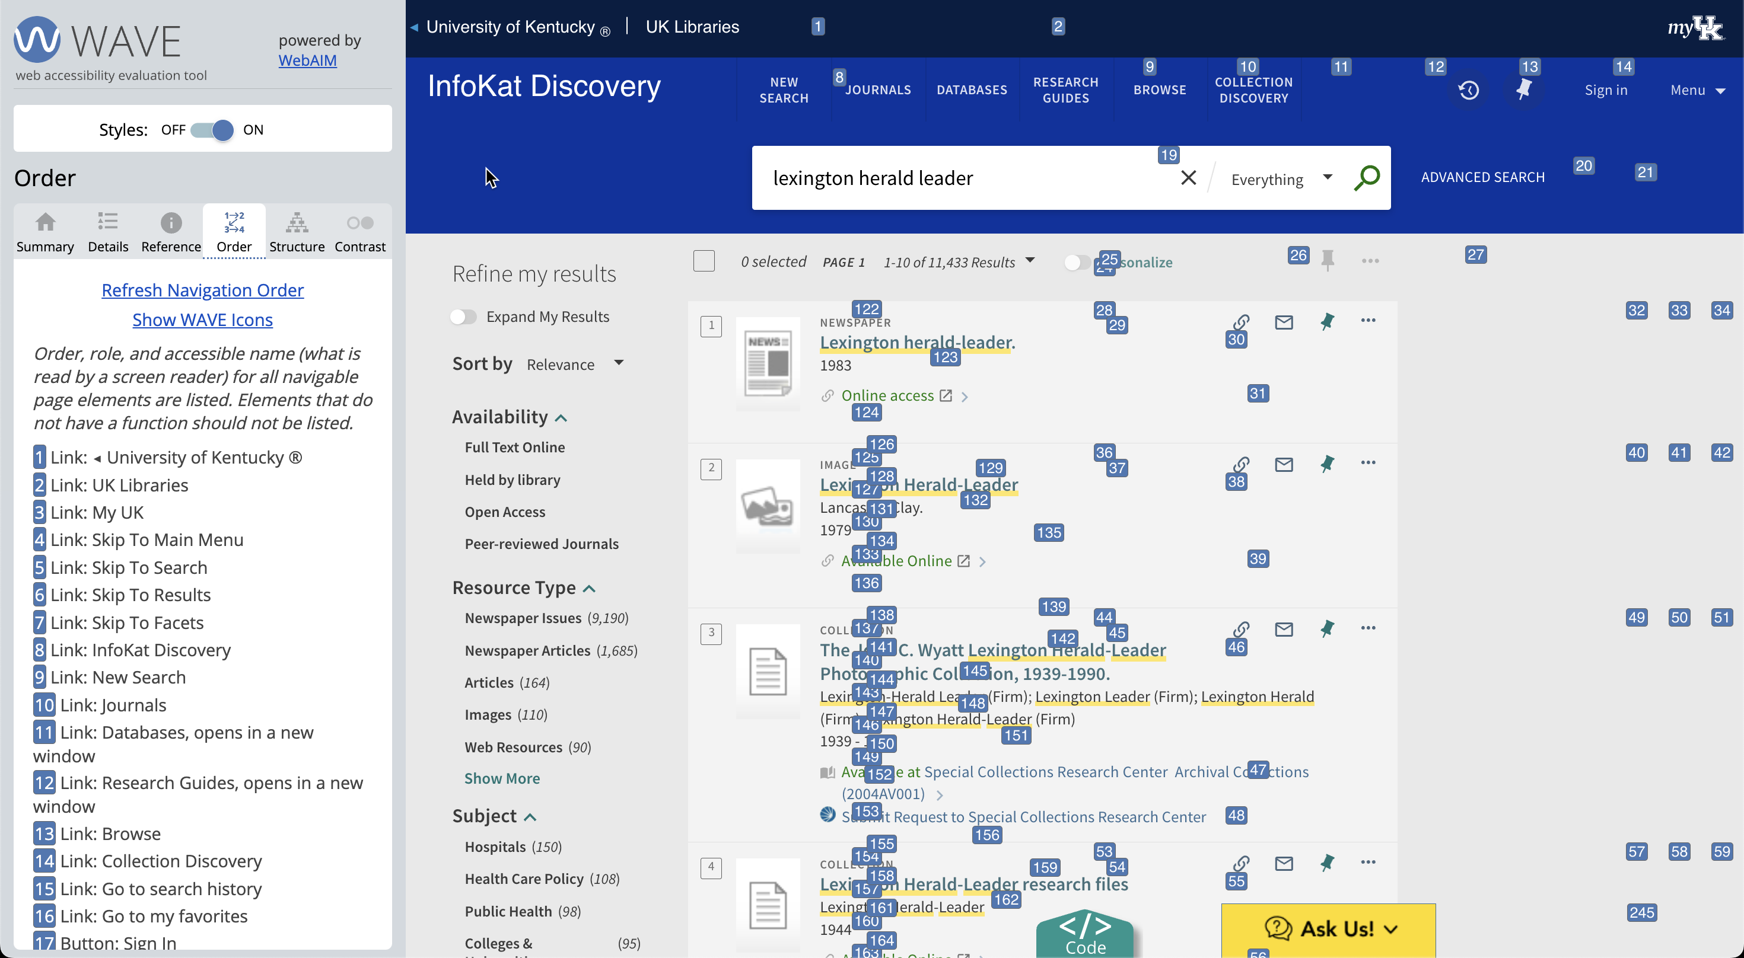
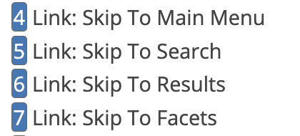
Notes:
Just by necessity, the search results page has way more navigation points. There are more skip links here as well that enable navigation directly to results and facets. Note for Ex Libris: when the facets are configured to appear on the left, the keyboard navigation should change accordingly. The keyboard and screen reader navigation come after navigating all the way through the search results rather than after the search bar, as expected.

Slide 30
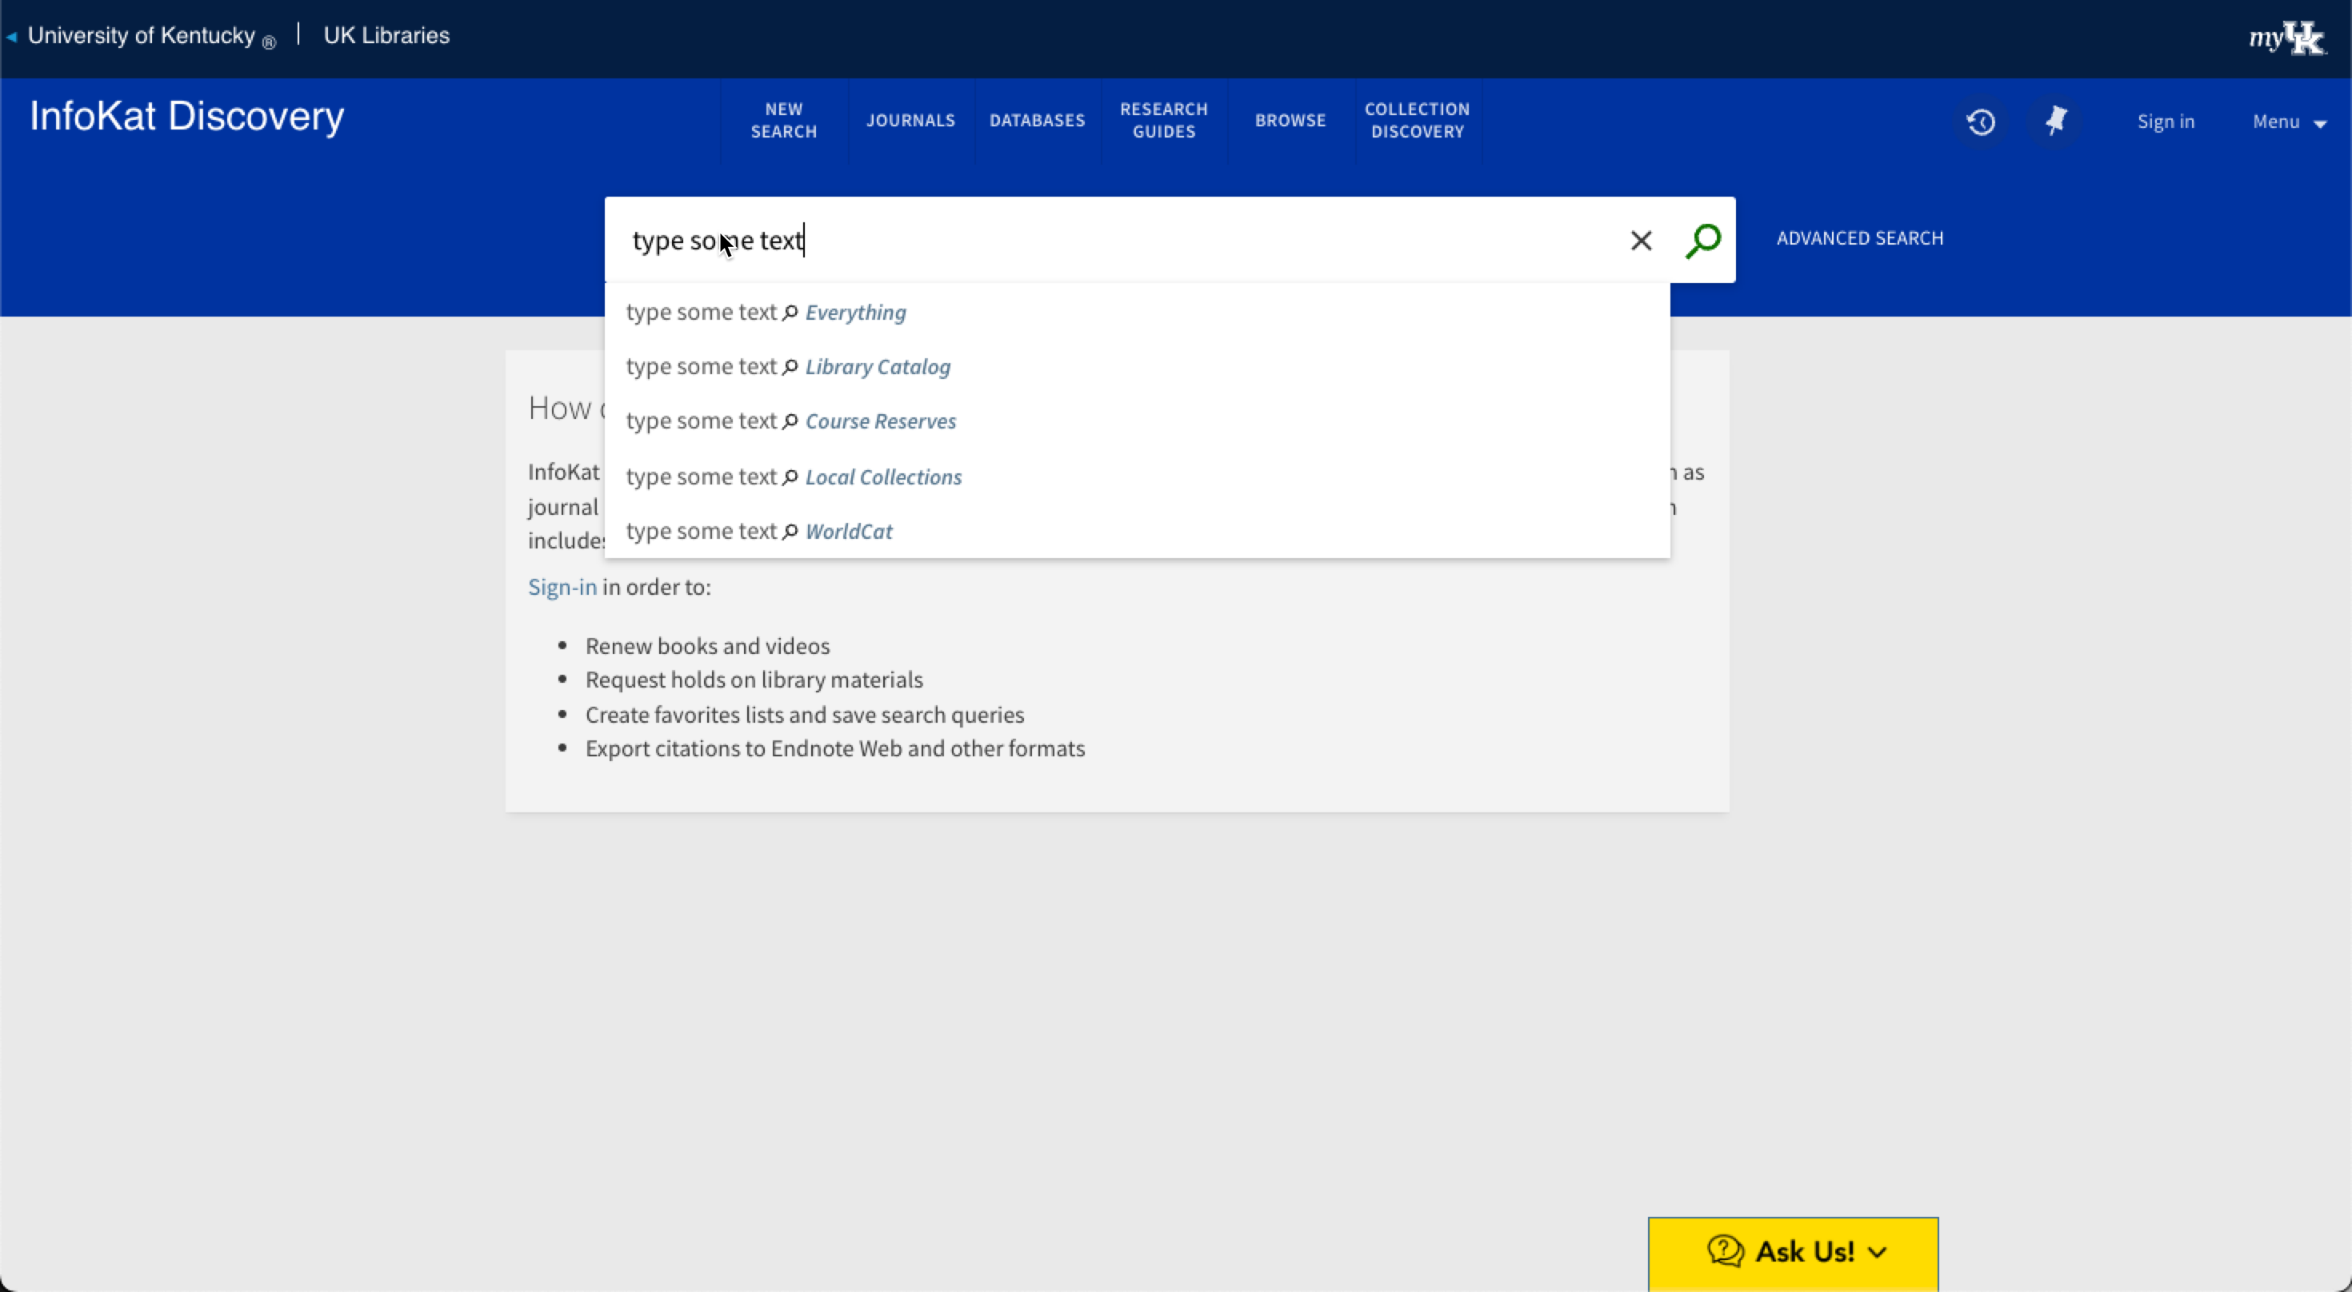
2. User types text
1. Cursor is in search box on page load 👍🏻
4. User can tab to reach “clear search,” ”search,” or “advanced search.” User presses Enter to execute desired function.
3. User can use arrows to navigate scopes
User can press enter at any time to execute search in desired scope. 👍🏻 Not choosing a scope executes an “Everything” search.
Notes:
Primo search page keyboard navigation:
The sequence of keyboard navigation using the Tab, Arrow, and Enter keys

Slide 31
Notes:
Screen reader testing is complex and varies depending on operating system, screen reader software (or emulator), and browser used. I have used it in the past to make sure that the screen reader hits the most important functions of a page (in this case, skip nav and search), but I am far from an expert, and screen reader testing is best done by users of the software.

Slide 32
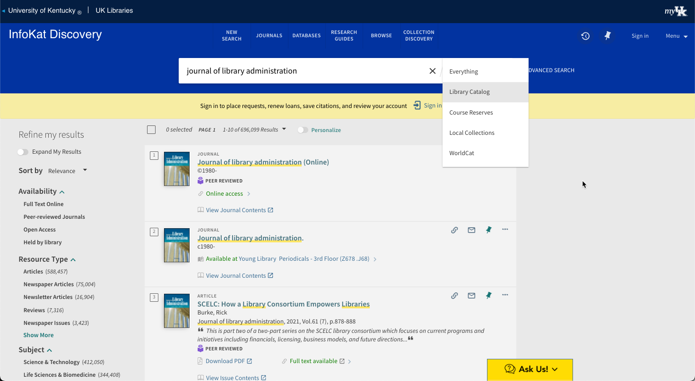
2. User can tab to reach “clear search,” change search scope, ”search,” or “advanced search.”
1. Cursor is in search box on page load. User’s text is retained. 👍🏻
3. User can press arrows to navigate scopes
5. User can continue to press tab to navigate into search results and press enter to execute a function or follow a link.
4. User presses enter to execute desired function
6. Facets are eventually reached after tabbing through all search results.
Notes:
The sequence of keyboard navigation using the Tab, Arrow, and Enter keys on the search results page. The page takes longer to navigate simply due to the exponentially higher number of elements on the page. Each result has ~10 elements to navigate through. But this ensures that all elements are focusable and navigable. Pressing enter while the title is highlighted brings up the individual record view.
Facet placement is configurable; the nav order doesn’t reflect this choice.
Consider new discovery experience—think about how navigation makes more sense or will be affected by the new layout.

Slide 33
Primo: ColorBlindly
(browser extension)

Slide 34
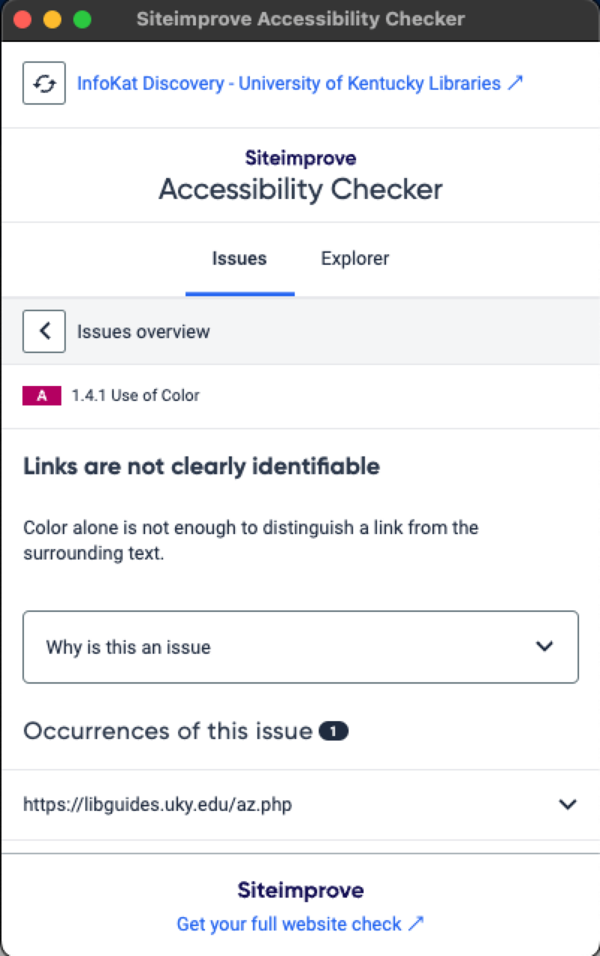
Link flagged under the “Use of Color” guideline
Notes:
As a reminder, SiteImprove flagged the links in our custom text as not being clearly identifiable.
Let’s look at the colorblind test overlay and this link. There may be a tweak we need to make.

Slide 35
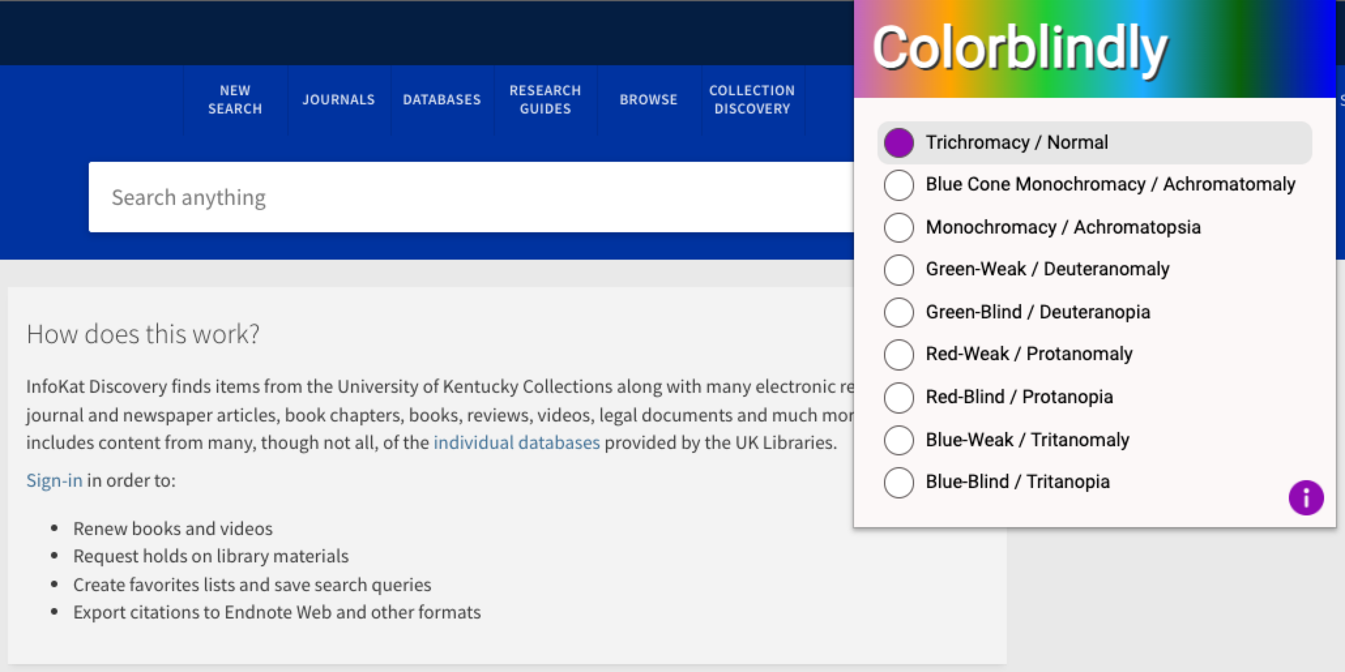
Notes:
The colorblindly extension for Chrome. Note the color spectrum at the top of the extension pane.

Slide 36
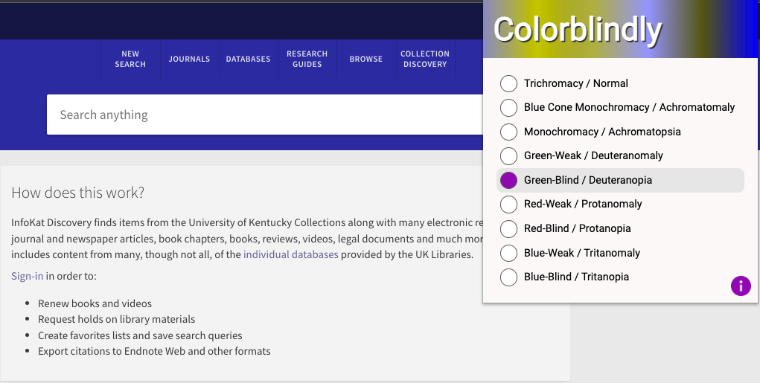
Notes:
Red/green color blindness is the most common. Note the colorblindly header that changes to show the full spectrum of what a user with “Deuteranopia” has.

Slide 37
Next Steps: UK Libraries
Share information with Systems and Discovery librarians
Look for and / or send enhancement request(s) to Ex Libris?
Work with Web Development librarian to address issues with universal header
Keep testing!
Notes:
* Keep testing – we will continue human-testing by library staff but are also in the beginning stages of planning some user testing for the fall across all UK web properties.

Slide 38
Links / References
WebAIM.org: Web Accessibility Principles Quick Reference & Checklist
WAI-ARIA guide & specifications
WCAG quick reference
Doing an a11y audit / review
WCAG Techniques and common failures
“A Practical Guide on Developing Accessible Websites,” Code4Lib Journal, Issue 37, July 2018
LevelAccess (for profit) WCAG checklist
Listicle on AI-Assisted Accessibility testing

Slide 39
Thank you!
Cindi Blyberg
Digital Strategies & Technology
cindi.blyberg@uky.edu

