Slide 1
An OpenAthens Migration Story: Lessons Learned
Christopher Gross: GW Libraries
Ruth Bueter,
Brian McDonald,
& JoLinda Thompson:
Himmelfarb Health Sciences Library

Slide 2
Outline
Logistical Preparation:
Team formation
Decisions to make
Communication
III Technical Preparation:
Alma Configuration
Planning for link clean-up
IV. Troubleshooting After
Go-Live

Slide 3
Logistical Preparation

Slide 4
Team Formation
Start Early!
Ideal Team Size:
4 - 6 people
Choose the Right People:
Identity Management!
Alma Configuration
E-Resources
Web Development

Slide 5
Team Challenges
Summer vacations
Multiple ticketing systems
OpenAthens/EBSCO Connect
ExLibris
Vendors
Follow up?
Increase number of OpenAthens admins

Slide 6
Challenges: Gathering vendors for setup
Use multiple sources to capture all vendors
Database A-Z list
EZproxy config.txt file & *.cfg files, or admin website
Alma collections, & portfolios in Single Journals collection
Include vendor contact info
Content selectors & ordering staff can help
After vendor cart is processed:
Can add more vendors before go-live

Slide 7
Challenges: Go-Live Vendors
Go Live Vendors:
Single authentication form
Contact go-live day
Dual Authentication Plan:
EZProxy backup after go-live
Caused Go Live Vendors issues
Quick Pivot:
Replaced EZProxy with redirector script

Slide 8
Challenges: Split Set-Up/User Groups
GW Context:
2 campus libraries
Separate subscriptions & vendor accounts
Campus-wide licenses
OpenAthens Set-Up:
Created linked accounts
Main Library (main)
Health Sciences Library (subaccount)

Slide 9
Challenges: Split Set-Up/User Groups
User Access:
Access to affiliated subaccount resources only
Resource activation:
Both accounts must activate resources
Created duplicate work
Federated Access:
Vendors struggle with federated access
Workaround:
Force OpenAthens to proxy
Vendor IP authentication

Slide 10
Challenges: Split Set-Up Resolution
Merge Accounts!
Timeline - Winter Break
Expected Benefits:
Resolve ongoing access issues

Slide 11
Communication

Slide 12
Communication
URL Construction:
Understand how to construct URL
Communicate with Library staff
Team Communication
Group chat was key!
Faculty & Blackboard Administrators
Earlier communication
Earlier link clean-up
Redirector masks broken links
Encourage faculty to link to catalog records
Not to direct resources

Slide 13
Technical Preparation

Slide 14
Alma Configuration: Setting up Proxy in Integration Profiles
Set up proxy configurations:
Config -> General -> Integration Profile List
Type: Resolver Proxy
For Redirector (federated):
Proxy server type = “OpenAthens Redirector”
Set to Default at Go Live

Slide 15
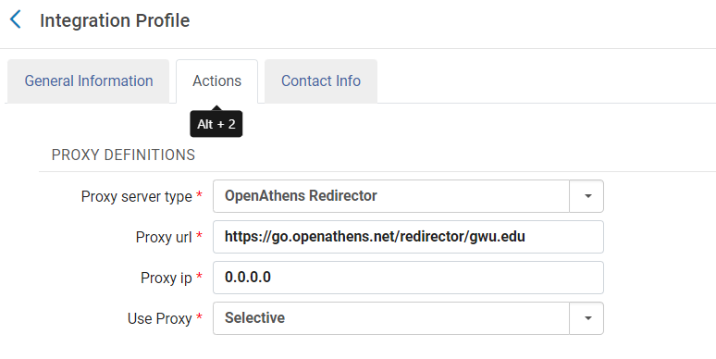
Alma Configuration: Setting up Proxy in Integration Profiles
Redirector prefix: https://go.openathens.net/redirector/gwu.edu?url=https

Slide 16
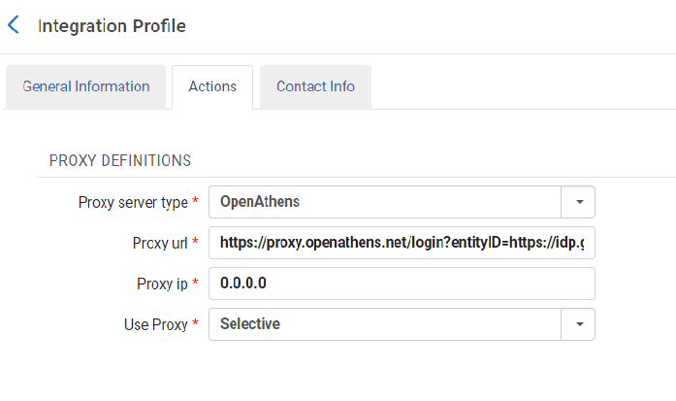
Alma Configuration: Setting up Proxy in Integration Profiles
OpenAthens Proxy: If Needed
Proxy server type=“OpenAthens”
Prefix generated: https://proxy.openathens.net/login?entityID=https://idp.gwu.edu/entity&qurl=https

Slide 17
Alma Configuration: Pre-Go-Live Testing
Run Analytics to identify current settings on e-collections
Service Proxy Enabled, Service Proxy Selected
Switch to OpenAthens resolver proxy at e-collection service level
Some vendors can’t be tested (Go Live Vendors: EBSCO, ProQuest)
Some may need additional linking parser parameter settings (ex. Ovid, Gale)
Test book, journal, & article level links
Revert to original settings after testing
At Go Live, e-collections with Default proxy will use the redirector when you switch the Default resolver proxy

Slide 18
Alma Configuration: Pre-Go-Live Testing
Additional linking parser parameter settings for some vendors:
EBSCO: Shibboleth=yes, customer ID in Customer_ID field (e.g. s8987071), SSO=yes, OPID=qwuora
Ovid: IP Auth= yes, Shibboleth=new, UShibboleth=your provider (e.g. https://idp.gwu.edu/entity)
Gale: your customer code in the LOC_ID field (e.g. wash74137)

Slide 19
Alma Configuration: Pre-Go-Live Testing
&debug=true is Your Friend!
Provides target URL
Before running target parser: https://wrlc-gwahlth.primo.exlibrisgroup.com/view/action/uresolver.do?operation=resolveService&package_service_id=10142158850004110&institutionId=4110&customerId=4100&VE=true&debug=true
After running target parser: https://go.openathens.net/redirector/gwu.edu?url=https%3A%2F%2Fwww.cochranelibrary.com%2F

Slide 20
Link Clean-Up: Planning
What links need to be updated?
Alma/Primo
LibGuides, other library sites
LMS (Blackboard, Canvas, …)
Citation managers, plugins, etc.
Who will make the updates?
Library staff
Individual faculty?
Instructional designers?
IT/LMS administrators?

Slide 21
Link Clean-Up: Issues
URL encoding required on base URL = less novice-friendly
https://proxygw.wrlc.org/login?url=https://jamanetwork.com/journals/jama
https://go.openathens.net/redirector/gwu.edu?url=https%3A%2F%2Fjamanetwork.com%2Fjournals%2Fjama
Switching to federated access may change base URL
https://search.ebscohost.com/login.aspx?authtype=ip,uid&custid=s8987071&groupid=main&profile=ehostgw&defaultdb=a9h
https://search.ebscohost.com/login.aspx?authtype=sso&custid=s8987071&groupid=main&profile=ehostgw&defaultdb=a9h

Slide 22
Link Clean-Up: Issues (cont.)
WIDE variation in legacy links
http(s)://proxygw.wrlc.org/login?url={original URL}
http(s)://login.proxygw.wrlc.org/login?qurl={encoded URL}
http(s)://original-server-dns.proxygw.wrlc.org/stuff-and-things
http://original.server.dns.proxygw.wrlc.org/stuff-and-things
And much more!

Slide 23
Link Clean-Up: Tools
Official OpenAthens link generator
Warns when resources aren’t configured in OpenAthens
Can’t handle EZproxy-formatted links
DIY “Quick Tool” widget for LibGuides
Designed to rewrite EZproxy-formatted links
Infinitely adaptable using JavaScript + regex
Adapted from a script developed by Dylan Hurd @ U of Arkansas

Slide 24
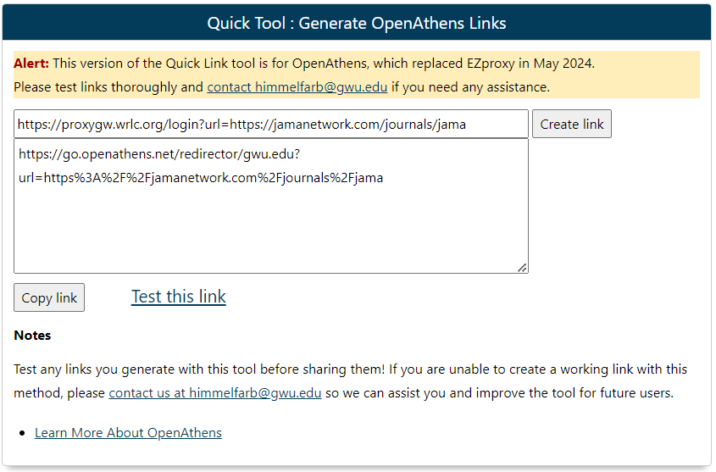
Link Clean-Up: Quick Link Tool

Slide 25
Link Clean-Up: EZproxy Redirector
Aliased *.proxygw.wrlc.org to a GW-managed AWS server
HTML + JavaScript / regex to detect & rewrite the URL
Written to handle:
variations in legacy EZproxy link format
changes to base URLs
resources that don’t need OpenAthens (as identified)

Slide 26
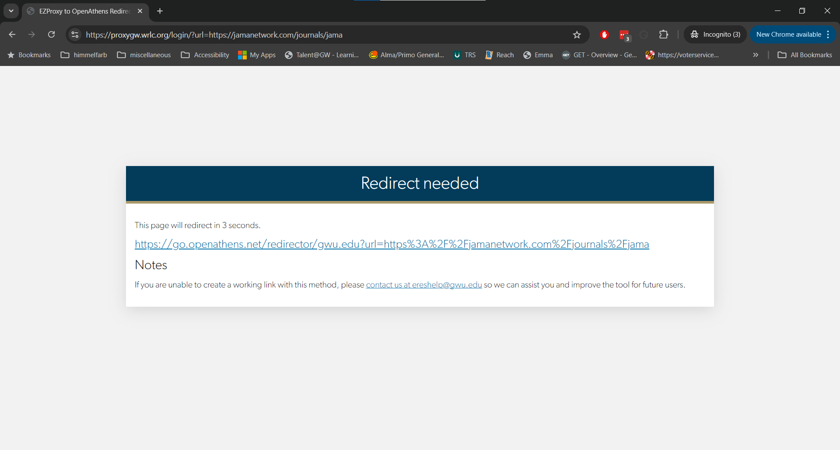

Slide 27
Link Clean-Up: Blackboard Clean-Up
2400+ links to EZproxy in initial export (2023-2024 courses)
Perl script to generate CSV mapping table
Extensive QA testing to account for exceptions
Some links unfixable - what to do?

Slide 28
Troubleshooting After Go-Live

Slide 29
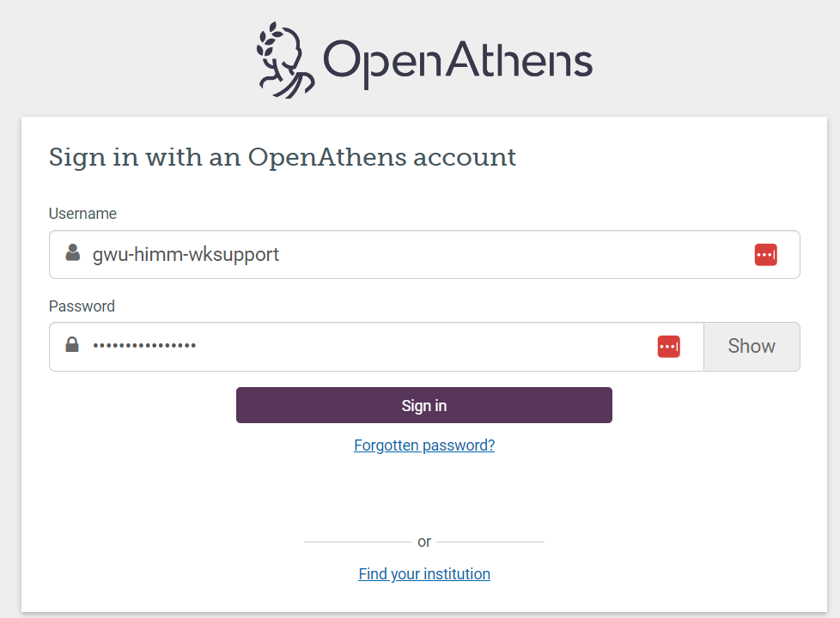
Troubleshooting
Internal reporting & issue tracking
Promoting our “report a problem” form
Creating vendor test accounts
Use my.openathens.net to get around institutional single sign-on
Expanding access to ticketing systems

Slide 30
Questions?
Contact Information:
Christopher Gross: chrisg@gwu.edu Ruth Bueter: rbueter@gwu.edu
Brian McDonald: bmcdonald@gwu.edu JoLinda Thompson: jlt@gwu.edu

