Slide 1
SOUTHWEST
USER GROUP (eSWUG)

Slide 2
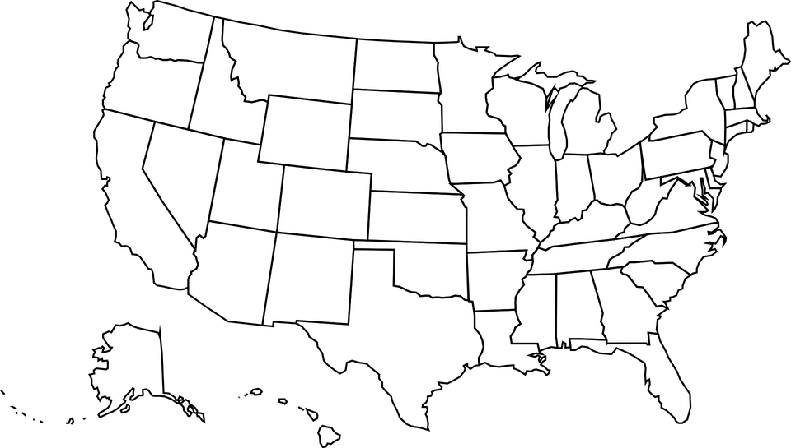
WHO IS eSWUG?
Notes:
Welcome to Wyoming in 2024!

Slide 3
eSWUG MEETINGS
15 Attendees
22 Attendees
32 Attendees
ELUNA 2023
August 2023
February 2024
Brainstormed ideas for future eSWUG meetings
2 presentations about collaboration & Primo VE
2 presentations about Alma Analytics & COUNTER/SUSHI

Slide 4
LESSONS LEARNED
Don’t use Zoom Webinars at the meeting
Double check closed captioning in working
Danielle needs a better mic (sorry!)
ASPIRATIONS
More eSWUGgies volunteers
Recording future meetings (not all can join all meetings)
Set a meeting for just Q&A
ExL Product Trainings

Slide 5
WHAT’S
NEXT?
Continue with online meetings? Always open to ideas!

Slide 6
QUESTIONS?
Email Danielle — danielleostendorf@mines.edu
Email eSWUG — elswug@exlibrisusers.org
Thanks for joining!
Notes:
Theme is called “Fashion Pitch Deck” from Slidesgo

